Slide 1
They’re Crazy!!!
Understanding & Combating the Stigma of Mental Illness
John E. Landers, Ph.D.
Assistant Hospital Administrator
State Hospital South
Department of Health and Welfare
office 208-785-8430 cell 208-690-9515
landersj@dhw.idaho.gov

Slide 2
Areas of Discussion
Stigmatization
The stigma mental illness
Why we stereotype and stigmatize
Suffering is normal, not happiness
We is they
Being mindful of our attitudes
Acting based on our values

Slide 3
Introduction Exercise
What if I asked that we go around the room and answer the following questions:
  Tell us what you like about yourself?
  Tell us about the last time you cried?
  Tell us about an experience with a loved one or close family member that has struggled with mental illness?
What thoughts and feelings would you be experiencing right now?
Why?

Slide 4
Origins of the word “Stigma”
Ancient Greece
Means “mark”
Marks were placed on slaves to identify their position in the social structure and indicate they were of lesser value

Slide 5
Stigmatization - Definition
Objectification and dehumanization of other human beings
Demonstrates a lack of empathy toward others

Slide 6
What we do when we Stigmatize
Labeling people with a condition
Stereotyping people with that condition
Creating a division – “us” and “them”
Discriminating against people based on their label

Slide 7
The Stigma of Mental Illness
Fear of stigma, and the resulting discrimination, discourages individuals and their families from getting the help they need.
People have more stigmatizing attitudes toward individuals with psychological disorders than toward those who suffer from physical diseases, particularly if they receive professional psychological services (e.g., Ben-Porath, 2002).
An estimated 23% of the U.S. population experience a mental disorder in any given year, but almost half of these individuals do not seek treatment (U.S. Department of Health and Human Services, 2002; U.S. Surgeon General, 2001).

Slide 8
Common Stigmas re: Mental Illness
People with mental illnesses are:
Dangerous
Unpredictable
Hard to talk to
Different
Unable to take care of themselves
Unlikely to recover
Source: Crisp, A. H., Gelder, M. G., Rix, S., Meltzer, H. I., & Rowlands, O. J. (2000). Stigmatisation of people with mental illnesses. British Journal of Psychiatry, 177, 4–7.

Slide 9
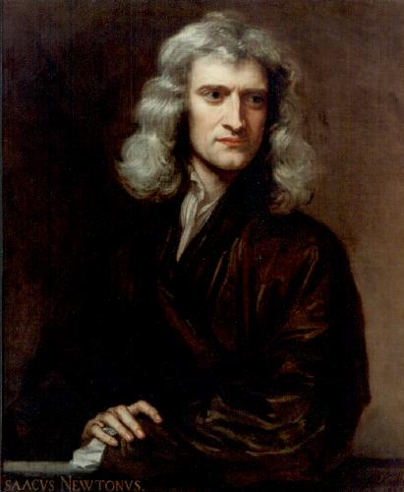
Famously Mentally Ill - Isaac Newton
He suffered from several “nervous breakdowns” in his life and was known for great fits of rage towards anyone who disagreed with him which some have labeled Bipolar Disorder.

Slide 10
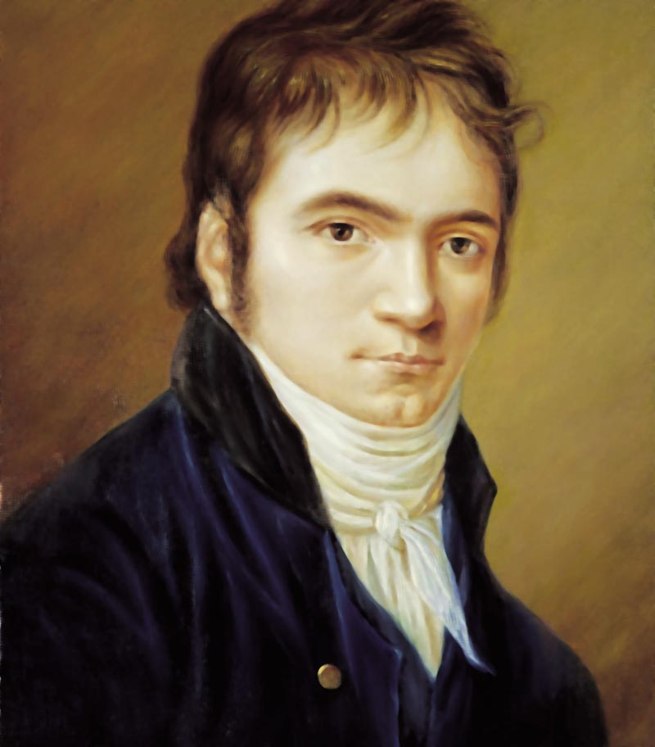
Famously Mentally Ill - Ludwig van Beethoven
Had bipolar disorder. His “manic” episodes seemed to fuel his creativity. He wrote his most famous works during times of torment, loneliness, and suffering psychotic delusions. He medicated himself with the only drugs available in that day to bring some relief –opium and alcohol- and died from the effects of liver disease.

Slide 11
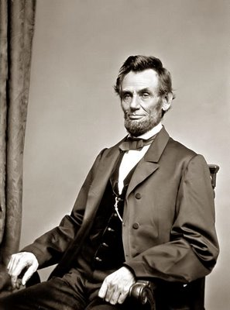
Famously Mentally Ill - Abraham Lincoln
Suffered from severe and debilitating and on occasion suicidal depressions. “A tendency to melancholy” Lincoln once wrote in a letter to a friend, “...let it be observed, is a misfortune, not a fault.”

Slide 12
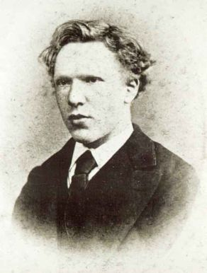
Famously Mentally Ill - Vincent Van Gogh
From recorded information it seems clear that he suffered from bipolar disorder with profound “highs” and “lows.” He committed suicide at age 37.

Slide 13
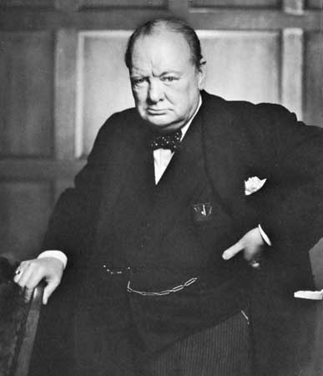
Famously Mentally Ill - Winston Churchill
He told in his own writings of suffering from “black dog,” Churchill’s term for severe and serious depression. Less often talked about are his writings of how he often self-medicated with alcohol to deal with these times.

Slide 14
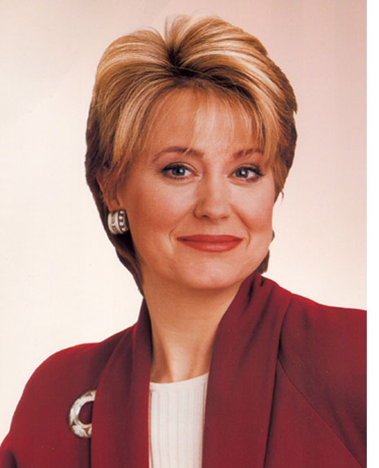
Famously Mentally Ill - Jane Pauley
NBC news broadcaster, since the age of 25, she talks candidly about her bipolar illness in her book, “Skywriting: A Life Out of the Blue.”

Slide 15
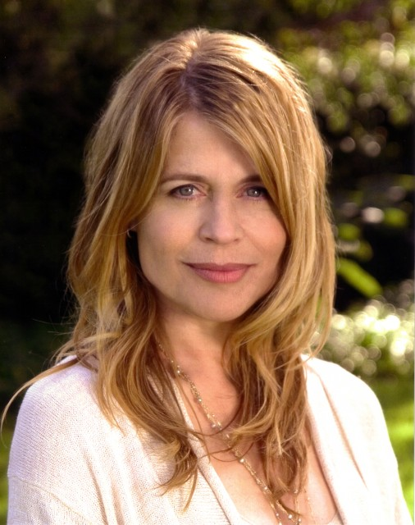
Famously Mentally Ill - Linda Hamilton
Actress, well known for her part with Arnold Schwarzenegger in "The Terminator" has gone public with her diagnosis of bi-polar disorder diagnosed at a young age.

Slide 16
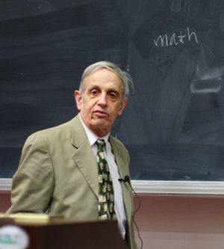
Famously Mentally Ill – John Nash
Nobel Prize Winner in mathematics, he has faced a lifelong battle with schizophrenia. His struggle was well documented in the book and movie, "A Beautiful Mind."

Slide 17
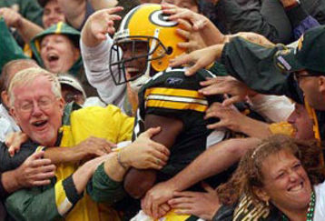
Famously Mentally Ill - Lionel Aldridge
A football player for the Green Bay Packers during the 1960's, he developed paranoid schizophrenia and was homeless for 2½ years. He is in active treatment and states that he is completely symptom free. He is a public speaker and advocate for the mentally ill.

Slide 18

Famously Mentally Ill - Ruth Graham
Daughter of Billy Graham, she writes about her many years of suffering with depression, drugs, eating disorders and thoughts of suicide in her 2004 book, “In Every Pew Sits A Broken Heart.”

Slide 19
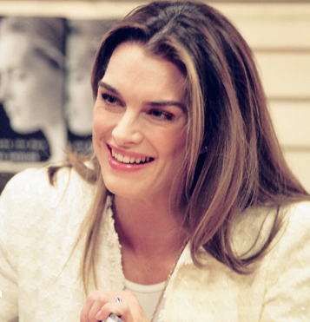
Famously Mentally Ill – Brooke Shields
She talked about her disabling Post Partum Depression in her book, “Down Came the Rain: My Journey Through Postpartum Depression.” She admits that she had difficulty bonding with her baby and later thought of hurting it and even killing herself.

Slide 20
Famously Mentally Ill - Others
Leo Tolstoy, author
Charles Dickens, author
John Keats, poet
Michelangelo, artist
Bette Midler, entertainer
Charles Schultz, cartoonist
Dick Clark, entertainer
Irving Berlin, composer
Rosemary Clooney, singer
Jimmy Piersall, baseball player. Boston Red Sox
Burgess Meredith, actor
Peter Illyich Tchaikovsky, composer
Charlie Pride, singer
Sylvia Plath, poet and novelist
Janet Jackson, singer
Patty Duke, actress
Roseanne Barr, comedian
Marlon Brando, actor
Maurice Bernard, actor
Buzz Aldrin, astronaut
Margot Kidder, actress
Jonathon Winters, comedian
Pat Conroy, author
Ernest Hemingway, author
Tennessee Williams, playwright

Slide 21
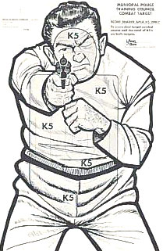
Why do we Stigmatize?
Categorizing, labeling, comparing, and evaluating events is a natural linguistic process
We all do it!!!, But it is BAD!
So after this discussion I would like everyone here to stop having those stigmatizing thoughts
Don’t think about chocolate cake!
What are the numbers?

Slide 22
Happiness is not normal
“The single most remarkable fact about human existence is how hard it is for humans to be happy.”
(Hayes, Strosahl, & Wilson, 1999)

Slide 23
The Assumption of Healthy Normality
By their nature humans are psychologically healthy
Suffering is abnormal
Abnormality is a disease or syndrome driven by unusual pathological processes
We need to understand these processes and change them

Slide 24
The Major Reason to Suspect this is False
The ubiquity of human suffering
“Sorrow comes to all...Perfect relief is not possible, except with time. You cannot now realize that you will ever feel better and yet you are sure to be happy again.”
- Abraham Lincoln

Slide 25
Major Traditions accept Suffering as Normal
Buddhist tradition states that pursuit of pleasure/happiness can only continue what is ultimately an unquenchable thirst. In the end, only aging, sickness, and death are certain and unavoidable.

Slide 26
Major Traditions accept Suffering as Normal
Old testament says:
  Genesis 3:17 - And unto Adam he said, Because thou hast hearkened unto the voice of thy wife, and hast eaten of the tree, of which I commanded thee, saying, Thou shalt not eat of it: cursed is the ground for thy sake; in sorrow shalt thou eat of it all the days of thy life.

Slide 27
Major Traditions accept Suffering as Normal
New testament says:
  1 Peter 4:12 - Beloved, think it not strange concerning the fiery trial which is to try you, as though some strange thing happened unto you.

Slide 28
Major Traditions accept Suffering as Normal
The Quran endorses suffering as natural as well:
  90:4 - Verily, we have created man into a life of pain, toil and trial.
  2:155-156 - And most certainly we should try you by means of fear, hunger, and loss of worldly goods, of life or of labor’s fruit. But give glad tiding unto those who are patient in adversity, who when the calamity befalls them, say, “Verily unto God we belong and verily unto him we shall return”

Slide 29
Normality of Suffering
High lifetime incidence of major psychiatric disorders
High treatment demand
High rates of divorce, sexual concerns, abuse, violence, prejudice
Destructive behaviors are common (e.g., addictive behaviors, self-harm)

Slide 30
The Example of Suicide
6-Year-Old Commits Suicide
A 6-year-old girl was killed today when she stepped in front of a train, telling two siblings and a cousin that she wanted "to become an angel and be with her mother." The girl was identified as Jackie Johnson; the authorities said her mother, Carla Johnson, had a terminal illness. Jackie's death was ruled a suicide.
-New York Times, June 17, 1993

Slide 31
We is They
We are all wearing an “I’m fine” Mask!
  Annual prevalence of Axis I Disorders – 25%*
  Lifetime prevalence of Axis I Disorders – 46%*
Everyone suffers, some more than others
  What is something that bothers you that you usually do not share with anyone? (Think of this)
  How does this make you feel?
  Now, get rid of it, throw it away, don’t think about it!
  What are the numbers?
Mental illness is in every family, occupation, ethnic group, social class, etc…
Who would choose to suffer, given the option?
Joe the Bum
*Ronald C. Kessler; Wai Tat Chiu; Olga Demler; Ellen E. Walters. (2005). Prevalence, Severity, and Comorbidity of 12-Month DSM-IV Disorders in the National Comorbidity Survey Replication. Archives of General Psychiatry, 62:617-627.

Slide 32
The Solution to Stigmatization
It is not to rid the world of bad thoughts and feelings
It is to be aware of our attitudes and stereotypes
and
It is to suspend action based on our attitudes and stereotypes, then acting on our values (e.g., equality)

Slide 33
Questions
& Answers

