Slide 1
Cultural Competence
Joan Wiggins
Pablo Rubio
CIT Academy
October 2012

Slide 2
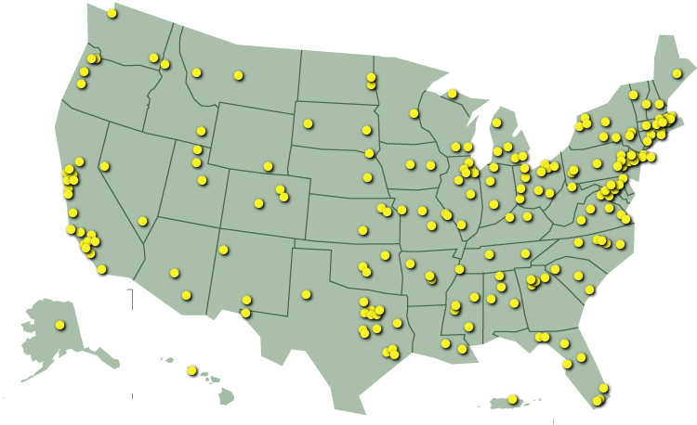
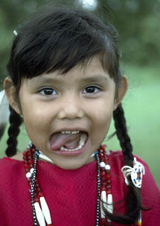
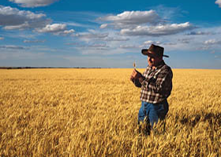
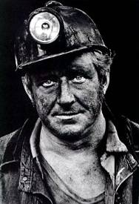
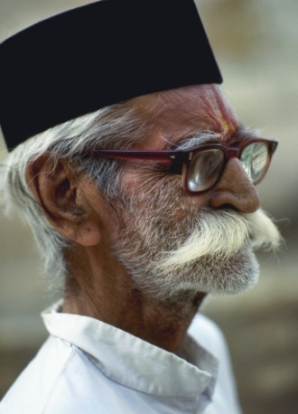
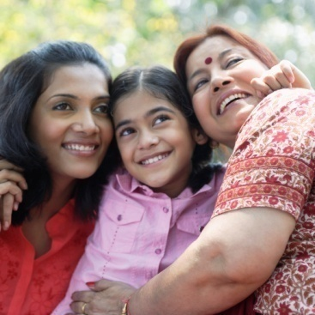
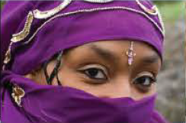

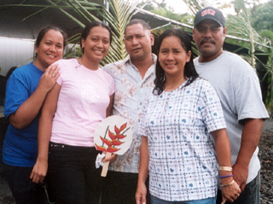
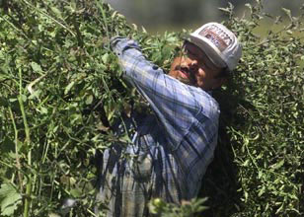
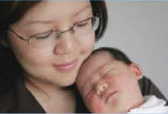
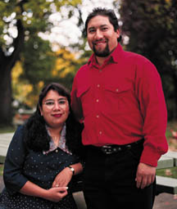
Everyone has a culture:
Everyone has a culture…
Source: Taylor, NCRR, 2007

Slide 3
Culture
What do we mean?
“Meanings, values, and behavioral norms that are learned and transmitted in society and within social groups.”
Source: Guarnaccia, 2006

Slide 4
Everyone has a culture:
Sometimes cultures overlap
Cultures can include:
  Race
  Religion
  Certain jobs: Military, law enforcement
  Gender
  Sexual Orientation

Slide 5
Culture
What do we mean?
Culture powerfully influences cognition, self-concept, feeling, and activities.
Source: Guarnaccia, 2006

Slide 6
Culture
What do we mean?
Culture has a strong impact on diagnostic processes and treatment decisions.
Source: Guarnaccia, 2006

Slide 7
Culture Counts!
Culture influences:
How people communicate and manifest their symptoms
Their style of coping
Their willingness to seek treatment
Their expectations of law enforcement
Their family and community support
Source: Culture, Race, and Ethnicity; A Supplement to Mental Health:
A Report of the Surgeon General, 2001

Slide 8
Cultural Competence defined:
A set of congruent skills, attitudes, policies, and structures, which come together in a system, agency, or among professionals and enable that system, agency or those professionals to work effectively in the context of cultural differences.
Institute for Education Leadership

Slide 9
Cultural Responsiveness defined:
The flexibility to interact effectively with and appreciate the variations in each family’s preferred methods, modes and environments for building relationships and strengths.
Institute for Education Leadership

Slide 10
Cultural Competence and CIT
Breaks down barriers that impede communication and limit the effectiveness of intervention.
Assists officers in being able to better detect and react to or defuse a threat.
Increases officer and public safety.
Increases success in dealing with mental health situations.

Slide 11
Cultural Competence and CIT
Cultural competence provides a framework for assessing and understanding each family’s unique rules, roles, habits, activities, and beliefs in the context of their cultural and ethnic identity.
Institute for Educational Leadership

Slide 12
Cultural Competence
3 Elements
Reflect awareness of the diversity of the populations with which the system is working
Acknowledge variations in acceptable behaviors, beliefs and values in assessing and treating a person’s mental health or problems.
The knowledge, skills and attitudes to work within consumers’ and their families’ values and reality conditions.
Institute for Educational Leadership

Slide 13
Cultural Competence a 4th element
Become aware of the stereotypes you carry, and make an effort to set them aside when interacting with people of other cultural/ethnic/racial groups.

Slide 14
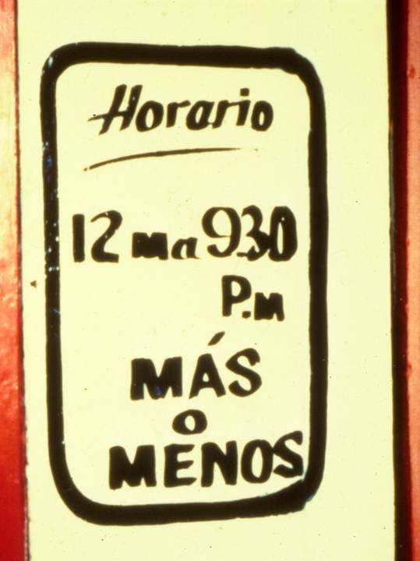
Cultural Differences
An office somewhere in South America…
Hours of Operation
12 noon to 9:30 P.M. MORE or LESS
Source: Levine, 2001

Slide 15
Let’s Hear if for Cultural Sensitivity!
What Happens When Culture and Language are not Considered

Slide 16
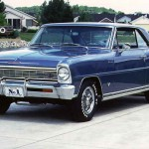
Let's Hear it for
Cultural Sensitivity!
Almost but not quite......
When General Motors introduced the Chevy Nova in South America, it was apparently unaware that "no va" means "it won't go."
Notes:
Add nova image

Slide 17
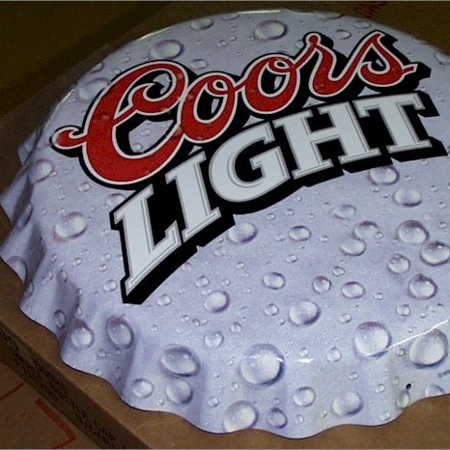
Let's Hear it for
Cultural Sensitivity!
Almost but not quite......
Coors put its slogan “Turn it Loose” into Spanish, where it was read as “suffer from diarrhea”.
Notes:
Add nova image

Slide 18
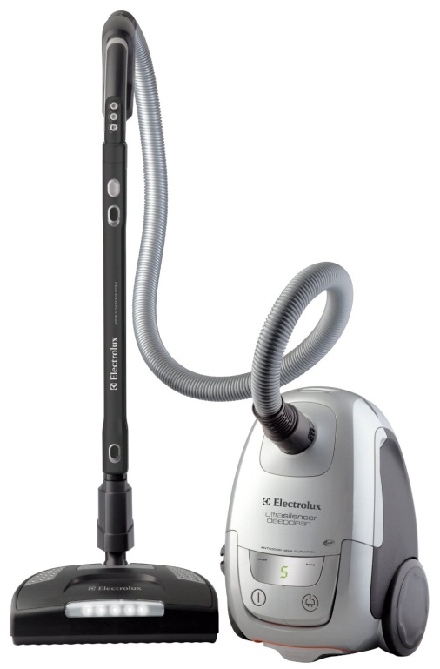
Let's Hear it for
Cultural Sensitivity!
Almost but not quite......
Scandinavian vacuum manufacturer
Electrolux used the following in an
American campaign:
"Nothing Sucks like an Electrolux."
Notes:
Add nova image

Slide 19

Let's Hear it for
Cultural Sensitivity!
Almost, but not quite...
When Parker Pen marketed a ballpoint pen in Mexico, its ads were supposed to say "It won't leak in your pocket and embarrass you." However, the company mistakenly thought the Spanish word "embarazar" meant embarrass. Instead the ads said that "It won't leak in your pocket and make you pregnant.”
When Parker Pen marketed a ballpoint pen in Mexico, its ads were supposed to say "It won't leak in your pocket and embarrass you." However, the company mistakenly thought the Spanish word "embarazar" meant embarrass. Instead the ads said that "It won't leak in your pocket and make you pregnant.”

Slide 20
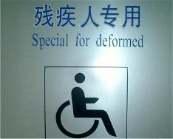
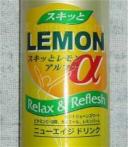

Let's Hear it for
Cultural Sensitivity!
Almost but not quite.....

Slide 21

Let's Hear it for
Cultural Sensitivity!

Slide 22
Let's Hear it for
Cultural Sensitivity!
COUNTRY MOVIE WHY TITLE CHANGED
TITLE
The Spy Who
Hugged Me
Spaniards viewing La Espia Que Me
Achucho will know that “hugged me” is
a translation of achucho--but that the
word has a double meaning.
Spain
The Spy Who
Shoot Me
L’Espion Qui M’a Tire offers the French
a chance to giggle at the other meaning
tirer, the verb usually translated as
“to shoot.”
France
The Spy In
Secret Missionary
Position
One of Germany’s top 007 films was
James Bond on a Secret Mission.
Powers’s Spion in Geheimer
Missionarsstellung makes the mission
missionary.
Germany

Slide 23
Let's Hear it for
Cultural Sensitivity!
COUNTRY MOVIE WHY TITLE CHANGED
TITLE
Latin
America
The Seductive
Spy
Because each Latin American country
has its own idioms, New Line chose
El Espia Seductor because it would be
understood throughout the region.
The Spy Who
Nailed Me
Njosuarinn Sem Neglani Mig. It makes
them laugh in Iceland. Need we say
more?
Iceland
Austin Powers:
Deluxe
The Japanese won’t go for sexual
references, so by calling Powers Deluxe,
the distributors hope to convey
something hip and new.
Japan

Slide 24
Cultural Response to Illness
Different cultures treat illness differently—family and societal norms are different in different cultures.
Acceptable treatment varies
    No treatment
    Herbal remedies
    Traditional medicine
    Mainstream medical care
    Spiritual Healing (exorcism)

Slide 25
Cultural Response to Illness
The effects of culture on mental health “have been historically underestimated—and cultural effects do count.”
US Surgeon General, 1999

Slide 26
Cultural Response to Illness
The newest version of the diagnostic manual finally includes references to the roles culture plays in mental illness diagnosis and treatment.
US Surgeon General, 1999

Slide 27
Relevance of Mental Health Issues to the Public
There is a significant gap between the evidence of the magnitude and impact of mental disorders and the public understanding of mental health problems.

Slide 28
Relevance of Mental Health Issues to the Public
There is also a significant gap in the way different cultures view mental disorders.

Slide 29
Magnitude and Impact of Mental Disorders
Mental disorders:
  Are among the most prevalent classes of chronic diseases in the general population
  Co-exist within themselves, with substance use disorders, and with many medical conditions
  Typically have much earlier ages of onset than other chronic diseases

Slide 30
Magnitude and Impact of Mental Disorders
Mental disorders:
  Only a minority with mental health needs receive treatment in the preceding year
  Are among the most disabling of all chronic diseases

Slide 31

Among the top ten main causes of disability,
five are mental disorders:
        major depression
        schizophrenia
        bipolar disorders
        alcohol use
        obsessive-compulsive disorders
    All five mental disorders appear by age 24!

Slide 32
Mental Health Disparities
Since the 1980s, studies have shown that minorities are more likely to:
  delay or not seek mental health care,
  receive less adequate care,
  terminate care earlier.
What this means for law enforcement is officers may have a high incidence of crises involving mental illness in minors.

Slide 33
2 things you can do now…
Become familiar with the culture of the people you serve
Become familiar with how you are perceived by the people you serve
www.firnonline.org

Slide 34
Words of Wisdom
"Every [person] is in certain respects
a. like all other [people],
b. like some other [people],
c. like no other [people]."
Kluckhon & Murray, 1953

Slide 35
NAMI Ventura County
CONTACT INFORMATION
(805) 641-2426
1355 Del Norte Road
P.O. Box 1613, Camarillo, CA 93011
www.namiventura.org
namiventura@gmail.com

