Slide 1
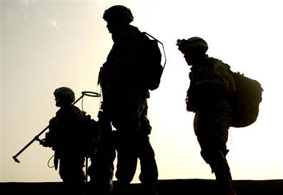
Working with Veterans
Created by Marc Castellani, Ph.D.
Presented by Carolyn Cardwell
W.G. Hefner VAMC
Salisbury, NC
(704) 638-9000

Slide 2
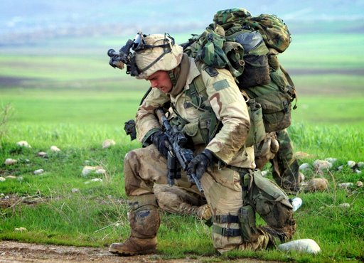
Topics to Consider
What are common diagnoses following combat?
PTSD
Traumatic Brain Injury (TBI)
Are Veterans more violent than civilians?

Slide 3

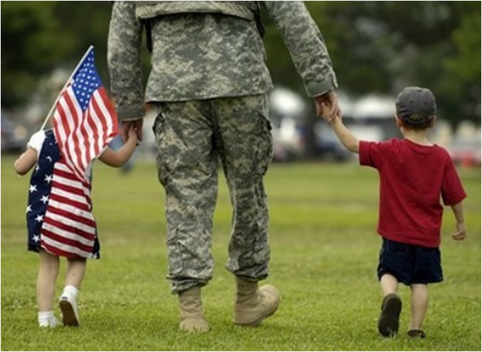
Additional concerns to keep in mind
Family concerns
Spouse used to them not being around
Children have grown
Social concerns
Feel estranged or “different” from civilians
Miss camaraderie of unit
Other environmental concerns
Physical and mental health issues
Unemployment
Financial concerns
Notes:
Unfinished business
Life is simpler, more focused in a war zone
Hypervigilance: survival in war depends on being aware at all times of your surroundings and reacting immediately to sudden changes, like sniper fire or mortar attacks.
Need to be emotionally in control while in combat; can seem cold or detached
Driving: in combat, unpredictable, fast, rapid lane changes, keeping other vehicles at a distance, straddling the middle line to avoid IED’s and VBIED’s. In combat, driving this way is necessary to avoid danger. What will that look like here?

Slide 4
Common Reactions to Spending Time in a War Zone
Reactions that Affect Daily Activities or Physical Body
Trouble sleeping, overly tired
Stomach upset, trouble eating
Headaches and sweating when thinking of the war
Bad dreams, nightmares
Lack of exercise, poor diet or health care
Rapid heartbeat or breathing
Existing health problems worsen
Reactions that Affect Behavior
Trouble concentrating
Jumpy, easily startled
Being on guard, always alert
Excessive drinking, smoking or drug use
Flashbacks or frequent unwanted memories
Avoiding people or places related to the war
Problems doing regular tasks at work or school

Slide 5
Common Reactions to Spending Time in a War Zone
Emotional Reactions
Irritable or angry
Experiencing shock, being numb, or unable to feel happy
Feeling nervous, helpless or fearful
Feeling sad, guilty, rejected or abandoned
Edginess, easily upset or annoyed
Feeling hopeless about the future
Reactions that Affect Your Relationships
Feeling withdrawn, detached and disconnected
Emotional shutdown resulting in loss of intimacy
Mistrust of others
Being overly controlling or over-protective
Having lots of conflict

Slide 6
Anger
Trained to be aggressive to survive in combat
Anger is easy to access, and can mask more difficult emotions (sadness, depression, guilt)
Often directed towards people who “don’t do what they’re supposed to do” (road rage)
Anger at what they went through (feeling betrayed, victimized
Anger at feelings of fear or loss of control
Anger from physical tension, insomnia/exhaustion

Slide 7
Adrenaline Train
Develops from high levels of intensity while in combat
Expressed through hyperactive behaviors
Combat Veterans may seek out high-paced, high-risk behaviors that require alertness to match their internal state
Can also mask more painful feelings

Slide 8
Guilt
Can result from both actions the Veteran took and ones s/he didn’t
Most Veterans feel guilty about experiencing fear
Often feel responsible for bad outcomes
Guilt comes from acting against your moral values and doing things contrary to your beliefs
Veterans are required to follow orders
Survivor Guilt
Moral Dilemmas: Some Veterans question their religious beliefs or practices

Slide 9

Grief
Bereavement
Universal sense of loss following the death of someone close to you
Symptoms tend to less after 6 months, though pain of loss can last for years
Traumatic Grief
Occurs when you lose someone under violent or sudden circumstances
More common if it’s witnessed, if you feel responsible or powerless, if there are multiple losses close together, if you’re angry at someone else you hold responsible, or if you can’t mourn at the time
Lasts much longer than bereavement, and can persist indefinitely

Slide 10
Mental Health Outcomes from Iraq and Afghanistan Wars Information from 2007
Veterans treated at VA medical centers since their return home from a war zone: 263,909 (35% of eligible Veterans)
Diagnosed by VA with a mental health conditions: 100,580 (38% of patients)
Diagnosed by VA with PTSD: 52,375 (21% of patients)
Diagnosed by VA with substance abuse or dependency: 43,933 (17% of patients)
The youngest group of OEF/OIF Veterans (age, 18-24 years) were at greatest risk for receiving mental health or PTSD diagnoses

Slide 11
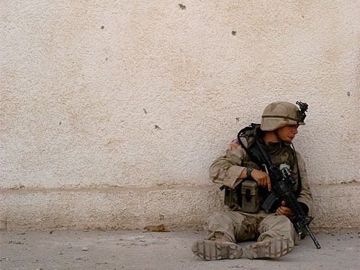
Combat Exposure in the NCS
Lifetime prevalence of PTSD = 39% among combat veterans
Male combat vs. all other male trauma
Higher lifetime PTSD prevalence
Greater likelihood of delayed onset
Greater likelihood of unresolved symptoms
Prigerson et al., 2001
Notes:
NCS: National Comorbidity Survey
The baseline NCS, fielded from the fall of 1990 to the spring of 1992, was the first nationally representative mental health survey in the U.S. to use a fully structured research diagnostic interview to assess the prevalences and correlates of DSM-III-R disorders. The baseline NCS respondents were reinterviewed in 2001-02 (NCS-2) to study patterns and predictors of the course of mental and substance use disorders and to evaluate the effects of primary mental disorders in predicting the onset and course of secondary substance disorders.

Slide 12

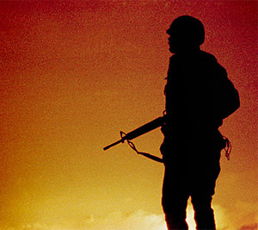
PTSD Prevalence in Vietnam and Gulf War Veterans
Vietnam
National Vietnam Veterans Readjustment Study; nationally-representative sample of >3000 theater and era veterans and civilians
Lifetime PTSD: 31% men, 26% women
Current PTSD (1986-87): 15% men, 8% women
Gulf War
Population sample of >11,000 Gulf War veterans
Current PTSD = 10%
Iraq and Afghanistan Wars
Hoge 2004: Iraq and Afghanistan combat units screening positive for PTSD, depression, or generalized anxiety
Iraq 15-17%
Afghanistan 11.2%
Kang et al., 2003; Kulka et al., 1988

Slide 13
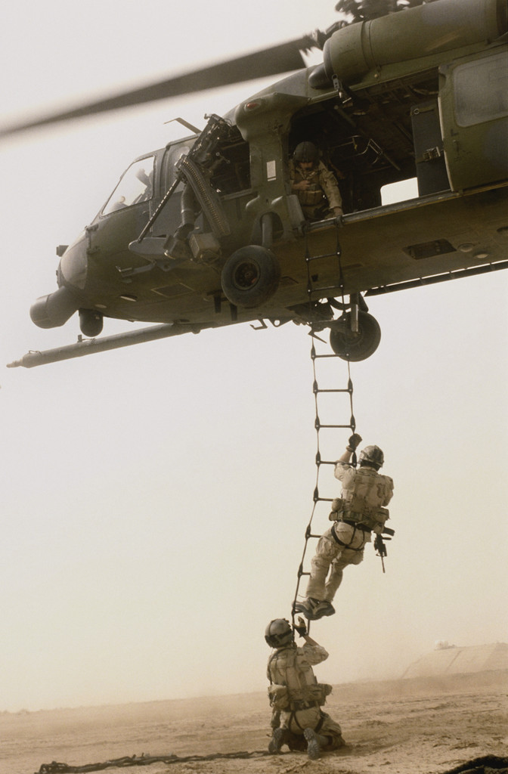
PTSD and Functioning in Veterans
In NCS, combat-related PTSD vs. PTSD due to other causes:
↑ unemployment
↑ being fired
↑ divorce or separation
↑ spousal abuse
In NVVRS, PTSD vs. no PTSD:
↑ unemployment
↓ health & well-being
↑ limitations due to physical functioning
↑ violence perpetration
Kessler et al., 1999

Slide 14
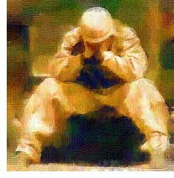
PTSD in Crisis
Speak softly
Use de-escalation strategies
Orient to present
Ask if Veteran
Exhibit respect
Validate
Allow time
Offer help
Notes:
Recognize that Veteran is still “on alert.” Don’t sneak up on them.

Slide 15
Traumatic Brain Injury 20,000 cases and climbing
TBI:
Impairs frustration tolerance
Decreases problem solving ability
Decreases mental processing speed
Affects impulse control
Can lead to agitation & aggression, both in early stages of recovery and chronically.
Severity of TBI is critical
Notes:
From explosions, there are several levels of injuries. Primary is unique to blasts and results from the impact of the over-pressurization wave on the body. Secondary occurs from shrapnel and flying debris. Tertiary results from people being thrown into other objects by a blast. Quaternary are illnesses, injuries or diseases not due to any of these other levels, and may include complications from other diseases.

Slide 16
How does Veteran status interact with violent behavior?
Notes:
Must make split-second decisions that are lethal in a highly ambiguous environment. Kill or be killed. Anger keeps soldiers pumped up, alert, awake and ALIVE!
Soldiers need to learn to delay decision-making.
“It’s not always about me, and it’s not always that important.”
Need to have a firearm at all times, even going to bathroom or in shower. They feel naked or vulnerable without their weapon. While in combat zone, they still developed and followed strict rules for weapons safety; what are the local rules?

Slide 17
DOJ Bureau of Statistics (data collected through 2004)
“Compared to other men in the U.S. resident population, male Veterans have had lower incarceration rates. Among adult males, the incarceration rate of Veterans (630 prisoners per 100,000) was less than half that of non-Veterans (1,390 prisoners per 100,000”. (Emphasis added)

Slide 18
Veterans in Jails and Prisons
Veterans constitute 10.4% of US Adults
Veterans are 11.7% of Jail inmates
Veterans are 9.4% of State and Federal Prison inmates
Bureau of Justice Statistics, 2004; US Census Bureau, 2006

Slide 19
Veterans in State and Federal Prison
The majority of Veterans in State (54%) and Federal (64%) prison served during a wartime period, but a much lower percentage reported seeing combat duty (20% of State prisoners, 26% of Federal prisoners)

Slide 20
DOJ Press Release, April 2007
Vietnam-era Veterans (36 percent) were the largest group of wartime service Veterans in state prisons, followed by Veterans of the 1990-91 Persian Gulf War (14 percent).
Only 4 percent of the Veterans in state prison had served prison time since operations began in Afghanistan and Iraq (using 2004 data).

Slide 21
Take home messages
Veterans in general are less likely than the general population to behave violently.
Persons with a MH diagnosis are more at risk for violent behavior, but only slightly.
Substance abuse or dependence alone increases probability of violence.
Substance Abuse plus mental illness dramatically increases risk compared to general population (as much as 20 times).

Slide 22

If You Remember Five Things
PROVE you care
Patience
Respect
Orientation
Validation
Empathy
Notes:
“To my mind, empathy is in itself a healing agent…because it brings even the most frightened person into the human race. If a person is understood, he or she belongs.”
Carl Rogers

