Slide 1
Verbal De-escalation Skills: The Basics
Memphis Police Department
Crisis Intervention Team
October 23, 2013
Thomas M. Kirchberg, Ph.D., ABPP
Chief Psychologist
V A Medical Center, Memphis

Slide 4
Plan of Learning
Crisis, Intervention, Team
Emotional Crises impose suffering
Empathic understanding
Active listening & Active observing
Filter or “noise”
Restatement & Reflection
Exercise
Questions
“I” statements
Genuineness
Acceptance
Skills practice

Slide 5
Plan of Learning
Crisis, Intervention, Team
Emotional Crises impose suffering
Empathic understanding
Active listening & Active observing
Filter or “noise”
Restatement & Reflection
Exercise
Questions
“I” statements
Genuineness
Acceptance
Skills practice

Slide 6
Crisis
An emotionally stressful event or traumatic change in a person’s life
A point in a story or drama when a conflict reaches its highest tension and a solution must be found

Slide 7
Intervention
To compel or prevent an action
To maintain or alter a condition

Slide 8
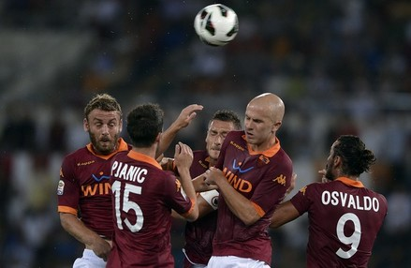


Team
A number of persons associated together in work or activity
A group on the same side
asroma.it
DoD photo by Staff Sgt. Jim Goodwin, U.S. Marine Corps. (Released)
University of Memphis CIT Center

Slide 9


2012 London Olympics Women’s Marathon: Tiki Gelana, Tirunesh Dibaba , Mary Keitany, and Priscah Jeptoo
Photo Run
with permission

Slide 10
Crisis
People are in crisis when they:
perceive an event or situation as an intolerable difficulty that exceeds their resources and coping mechanisms.
face an obstacle to important life goals.
Crisis creates physiological arousal in the form of anxiety which disrupts a person’s capacity to think clearly—it hurts too much
James, R.K. & Gilliland, B.E. (2013). Crisis Intervention Strategies (7th ed.) . Belmont, CA: Brooks/Cole

Slide 11


Slide 12
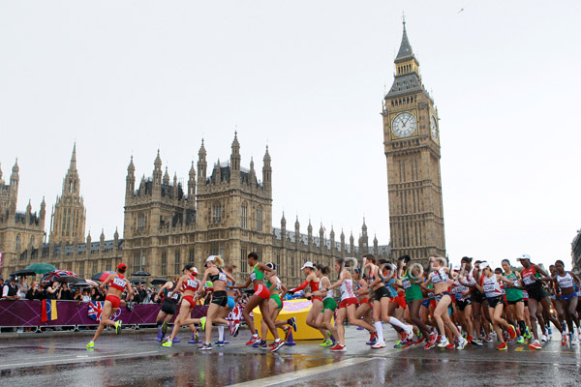
Photo Run with permission

Slide 13
Crisis…continued
My body struggles to maintain physical homeostasis, equilibrium or balance—on a hot day, I need water and shade
My mind also struggles to maintain a similar balance—a steady state of psychological functioning
James, R.K. & Gilliland, B.E. (2001). Crisis intervention strategies (4th ed.) . Belmont, CA: Brooks/Cole

Slide 14
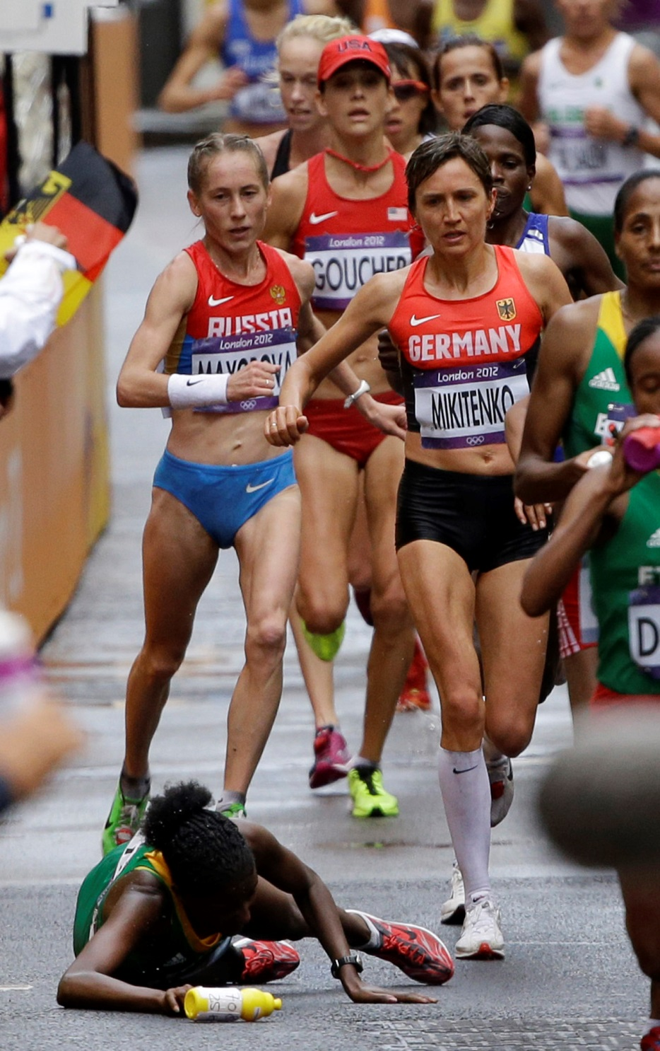
Licensed for use by AP

Slide 15
Crisis Intervention
The focus of crisis intervention is not on past crises and not on chronic factors contributing to crisis.
The focus of crisis intervention is on what is happening here and now.
Crisis intervention involves intense, immediate, and short-term effort.
James, R.K. & Gilliland, B.E. (2013). Crisis Intervention Strategies (7th ed.) . Belmont, CA: Brooks/Cole

Slide 16

Photo Run with permission

Slide 17
Crisis Intervention…continued
Crisis intervention is psychological “first aid”.
Crisis intervention is not psychotherapy.
The Crisis Intervention Team Officer assists people in crisis to begin returning to baseline functioning without acting out.
Crisis intervention is not solving the person’ s problems.
Human beings have the will to solve their own problems.
James, R.K. & Gilliland, B.E. (2001). Crisis intervention strategies (4th ed.) . Belmont, CA: Brooks/Cole
Brown, L. (2008). Cultural competence in trauma therapy: Beyond the flashback. Washington, DC: American Psychological Association.

Slide 18

2:23:07
Photo Run with permission

Slide 19

Photo Run with permission

Slide 20
Crisis Intervention Team: A Community Partnership
CIT Officers belong to a larger team
other law enforcement officers
mental health providers
National Alliance on Mental Illness (NAMI)
consumers and family members
hospital staff
victim advocates for domestic violence & sex abuse
officers of the court
clergy
McCutcheon, J., Roland, J., Mann, M.P., Schneidmiller, D., & Jones, E. (2013). Responding to calls with suicidal suspects: Practical command and psychological considerations. The Police Chief, 80, 5, 32-35; Tucker, A.S., Van Hasselt, V., Vecchi, G.M., Browning, S.L. (2011). Responding to persons with mental illness. FBI Law Enforcement Bulletin, 80, 10, 1-6.

Slide 21
Essential character strengths and skills for effective CIT performance
Professional experience
Attention to safety
Self-awareness
Capacity to remain calm and in control
Good Listening
Supportive Skills
Problem solving skills
Assertiveness
Ability to analyze
Commitment to training and knowledge
Creativity & flexibility
Energy & strength
Engaged in life
Resilience
Courage

Slide 22
The Basics
Crisis: Temporary
Intervention: Skills to be learned
Team: Provides safety / backup / consultation / support so the CIT Officer can use crisis intervention skills

Slide 23

Photo: University of Memphis CIT Center

Slide 24
Plan of Learning
Crisis, Intervention, Team
Emotional Crises impose suffering
Empathic understanding
Active listening & Active observing
Filter or “noise”
Restatement & Reflection
Exercise
Questions
“I” statements
Genuineness
Acceptance
Skills practice

Slide 25
Emotional crises impose suffering
Depression
Psychotic Episode
“gray drizzle of horror”
“a smothering confinement”
“a howling tempest in the brain”
suicidal and homicidal ideation
Styron, W. , (1990). Darkness Visible: A Memoir of Madness. New York: Random House
delusions of guilt, persecution, physical decay, and impending death
visual hallucinations and perceptual distortions
auditory hallucinations
rapid fluctuations of consciousness
increasing paranoia and intense panic
Kiser, S. (2004). An existential case study of madness. Encounters with divine affliction. Journal of Humanistic Psychology, 44, 441.
Saks, E. (2012). A tale of mental illness from the inside. www.ted.com/talks

Slide 26
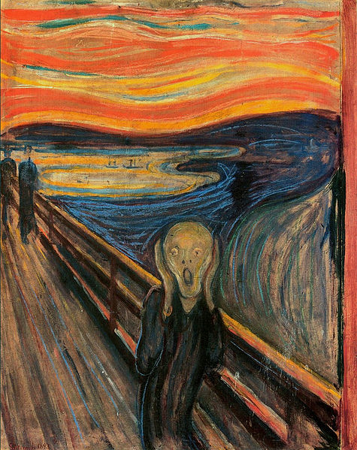
The Scream

Slide 27
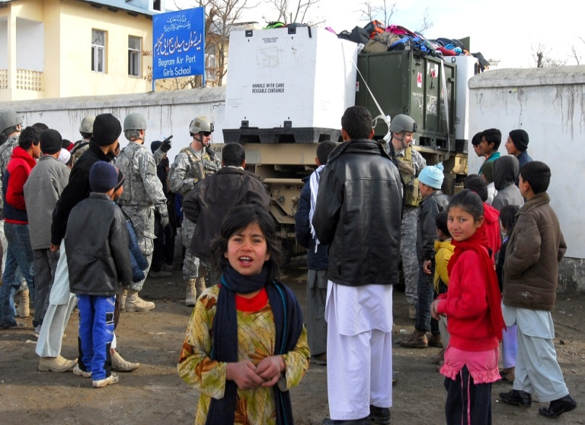
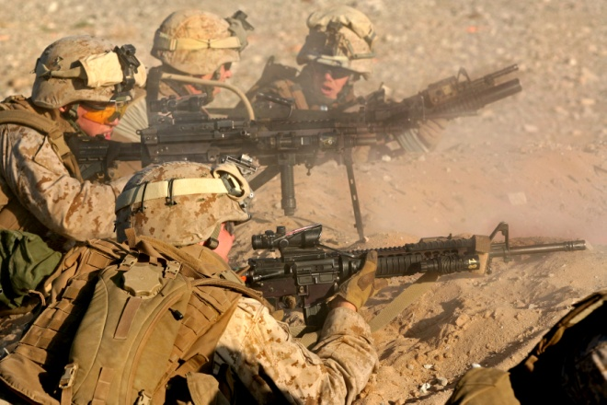
Psychological Anguish of War
Sleep disturbance
Nightmares
Flashbacks
Physiological distress
Detached from people
Loss of loving feelings
Alcohol and drugs
Irritability
On guard
American Psychiatric Association. (1994). Diagnostic and statistical manual of mental disorders (4th ed.). Washington, DC: Author.
Photo: http://www.defense.gov/photos/ U.S. Army photo by Sgt. Lynne Eickstedt ; U.S. Marine Corps photo by Lance Cpl. Kelsey J. Green

Slide 28
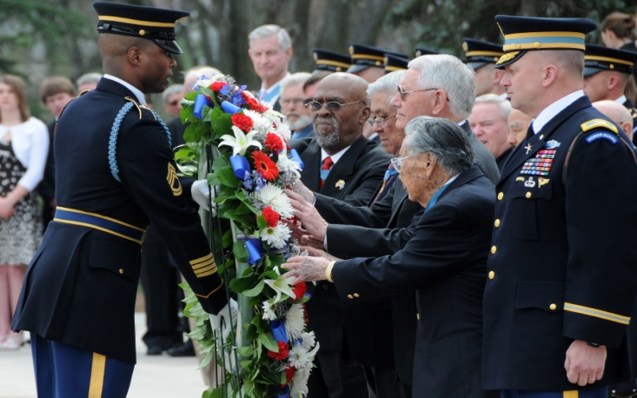

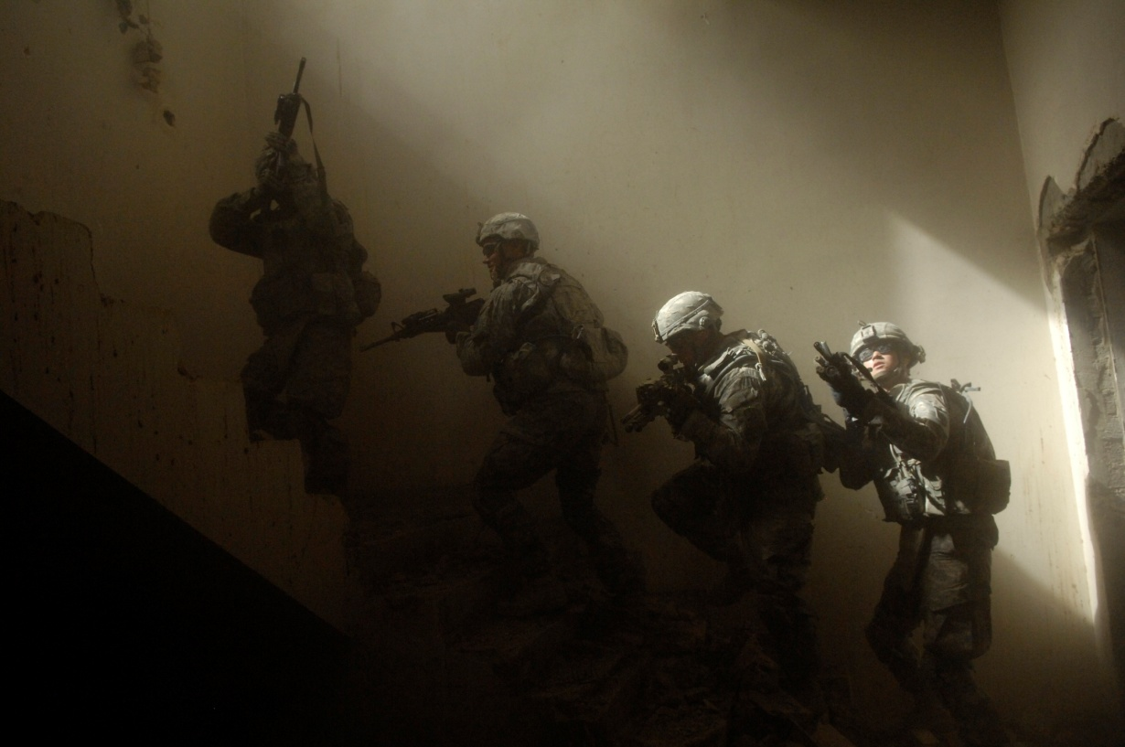
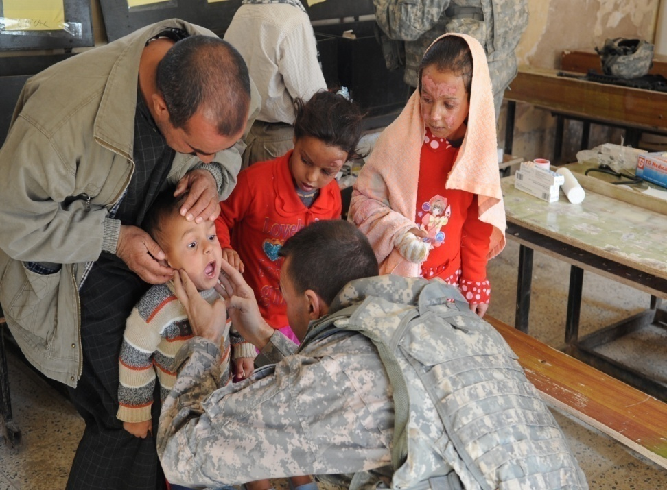
Moral Anguish of War
Guilt
Accident guilt
Survivor guilt / Luck guilt
Collateral damage guilt
Shame
“War takes place in a different time and space…I know I am the same person who was doing those things. And that’s what tears at your soul.”
Moral injury
“What does God think of me?”
Maguen, S. & Litz, B. (2012). Moral Injury in veterans of war. PTSD Research Quarterly, 23 (1), 1-6.; Sherman, N. (2010). What good soldiers bear. America, 202, 11-15. Sherman, N. (2010). The untold war; Inside the hearts, minds, and souls of our soldiers. New York: Norton
DoD photo by Petty Officer 2nd Class Kim Smith, U.S. Navy. (Released) ; DoD photo by U.S. Navy Petty Officer 2nd Class Willam ; DoD photo by Senior Chief Petty Officer Kevin S. Farmer, U.S. Navy. (Released)

Slide 29
“…if an incident rises to the level of police involvement and if the responding officers understand the Veteran’s perspective, they have a good chance of defusing it. Indeed, the best friend and best hope the combat Veteran may have in a situation escalating out of control is the informed police officer or negotiator.”
Etter, D., McCarthy, L., & Asken, M.J. (2011). Police Negotiations with war veterans: Seeing through the residual fog of war. FBI Law Enforcement Bulletin, 80, 7, 1-10.

Slide 30
Plan of Learning
Crisis, Intervention, Team
Emotional Crises impose suffering
Empathic understanding
Active listening & Active observing
Filter or “noise”
Restatement & Reflection
Exercise
Questions
“I” statements
Genuineness
Acceptance
Skills practice

Slide 31
Basic Skills for the CIT Officer
Empathic Understanding
Genuineness
Acceptance
Rogers, C.R. (1957). The necessary and sufficient conditions of therapeutic personality change. Journal of Consulting Psychology, 21, 95-103; Norcross, J.C. (Ed.) . (2002). Psychotherapy relationships that work: Therapist contributions and responsiveness to patients. New York: Oxford University Press.

Slide 32
Empathic Understanding
The ability to understand another’s concerns and feelings
Leads to compassion
Sets the stage for successful crisis resolution
Carkhuff, R. (1969). Helping and human relations. Vol. 1: Selection and training. New York: Holt, Rinehart, and Winston; Gilliland, B.E., James, R.K., & Bowman, J.T. (1989). Theories and strategies in counseling and psychotherapy (2nd ed.). Englewood Cliffs, NJ: Prentice Hall ; Regini, C. (2004). Crisis intervention for law enforcement negotiators. FBI Law Enforcement Bulletin, 73, 10, 1-6.

Slide 33
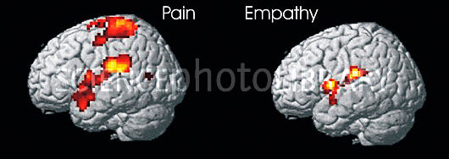
Empathy: Bridge to another’s feelings
Brain response to pain, magnetic resonance imaging (MRI) computer models. Two brains are shown from the side, front of brains at left. The brain at left is that of a person experiencing pain (active brain areas are yellow/red). The brain at right is that of a person watching someone experience pain, producing a response known as empathy, where they are able to imagine the pain the other person is feeling. The MRI scan confirms that similar brain areas are activated in empathy, but that areas producing the actual sensation of pain (one at top of brain) are not triggered.
Singer, T., Seymour, B., O’Doherty, J., Kaube, H., Dolan, R.J., Frith, C.D. (2004). Empathy for pain involves the affective but not sensory components of pain. Science, 303, 1157-1162. Image: Wellcome Department of Imaging Neuroscience

Slide 34
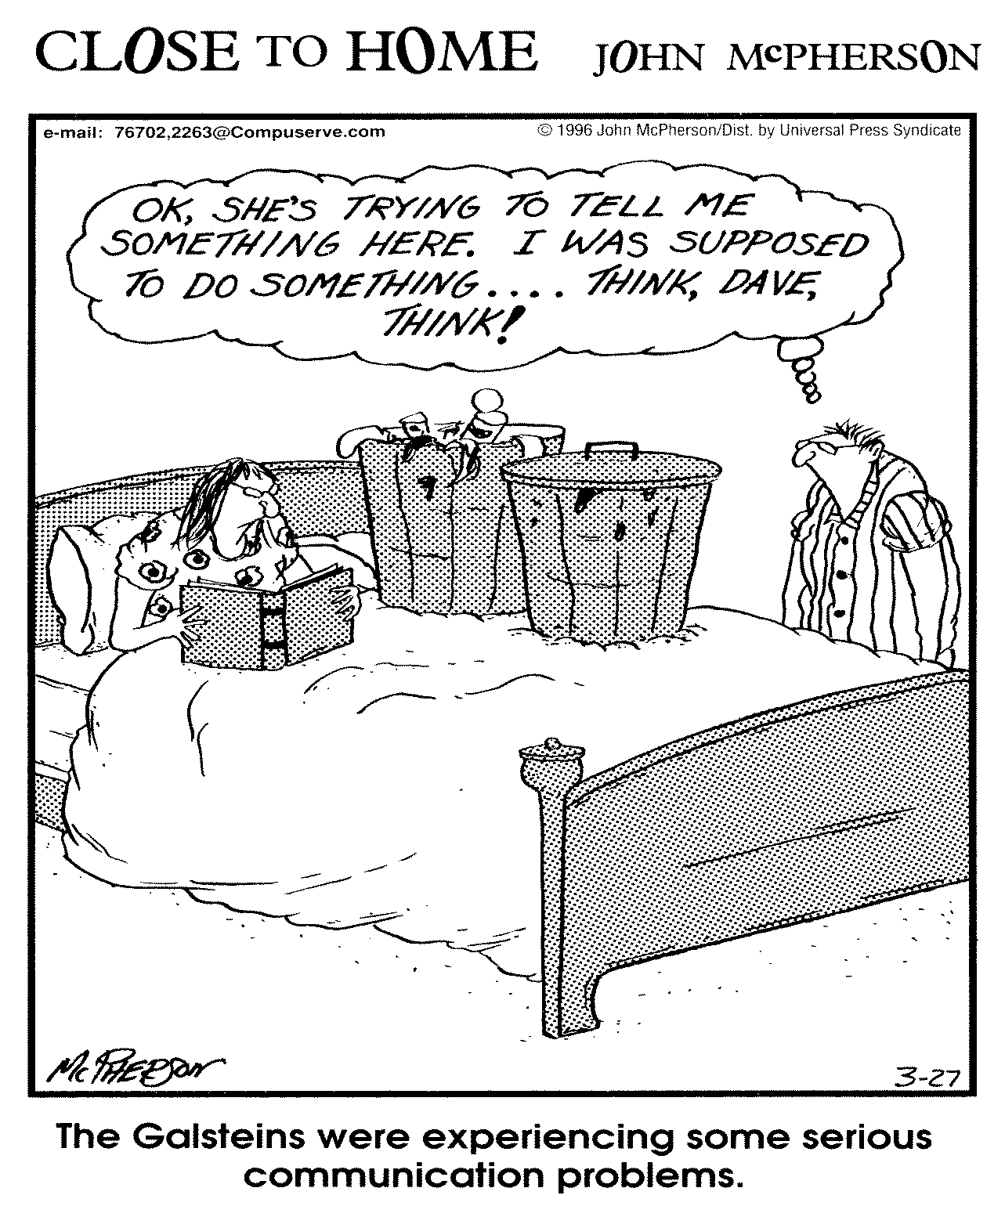
CLOSE TO HOME ©1996 John McPherson. Reprinted with permission of UNIVERSAL UCLICK. All rights reserved.

Slide 35

Active Listening
You
Ear
Eyes
Undivided attention
Heart

Slide 36
Active Listening
Focusing on the consumer and his/her world—Blocking out distractions
Attending to words, voice tone, and body language—Fully Engaged
Making sure I understand what the consumer is saying and feeling about the crisis situation—Checking In
Egan G. (1975). The skilled helper. Monterey, CA: Brooks/Cole; Carkhuff, R. & Pierce, R.M. (1975). Trainer’s guide: The art of helping. Amherst: Human Relations Press; Etter, D., McCarthy, L.B., Asken, M.J. (2011). Police negotiations with war veterans. FBI Law Enforcement Bulletin, 80, 7, 1-10.

Slide 37
Emotional Communication
Albert Mehrabian established the importance of three elements in any face-to-face communication:
Words used
Tone of voice
Body Language
Congruence among all three elements is essential for effective communication.
Mehrabian, A. (1971). Nonverbal betrayal of feeling. Journal of Experimental Research in Personality, 5, 64-73.

Slide 38
Mehrabian’s Rule
If the speaker’s words are inconsistent with the speaker’s tone of voice and / or the speaker’s body language,
…the listener will be more influenced by the speaker’s tone of voice and body language.
Mehrabian, A. (1972). Nonverbal communication. New Brunswick: Aldine Transactions
Parkinson, B. (2005). Do facial movements express emotions or communicate motives? Personality and Social Psychology Review, 9, 278-311.

Slide 39
Emotions and Communication

Slide 40
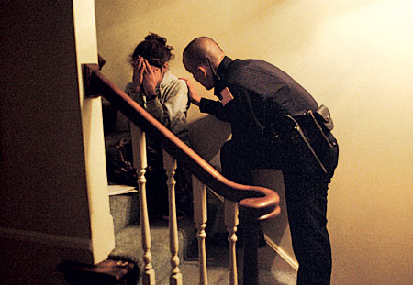
Empathic Understanding requires close attention to the complete message
words used
voice tone
rate of words spoken
facial expression
body language
Mehrabian, A. (1971). Nonverbal betrayal of feeling. Journal of Experimental Research in Personality, 5, 64-73.
Photo: University of Memphis CIT Center

Slide 41
I ask myself
Do the consumer’s words, voice tone, rate of speech, facial expression, and body language match?
Do my words, voice tone, rate of speech, facial expression, and body language match?
Smith-Haven, S.S. (1977) . Effects of nonverbal behavior on judged levels of counselor warmth and
empathy. Journal of Counseling Psychology, 24, 87-91; Haase, R.F., & Tepper, D. (1972). Non-verbal
components of empathic communication. Journal of Counseling Psychology, 19, 417-424.

Slide 42
Plan of Learning
Crisis, Intervention, Team
Emotional Crises impose suffering
Empathic understanding
Active listening & Active observing
Filter or “noise”
Restatement & Reflection
Exercise
Questions
“I” statements
Genuineness
Acceptance
Skills practice

Slide 43

Active Listening: The Key to Empathic Understanding
“…they have to know that you care before they care what you know.”
Sheeler, R. (2013). Nonverbal communication in medical practice. In D. Matsumoto, M.G. Frank, &H.S. Hwang (Eds.), Nonverbal communication: Science and Applications (pp237-246). Los Angeles: Sage.

Slide 44
Active Listening
Speaker

Slide 45
Active Listening
Speaker
Listener

Slide 46

Active Listening
Speaker
Filter
Listener

Slide 47
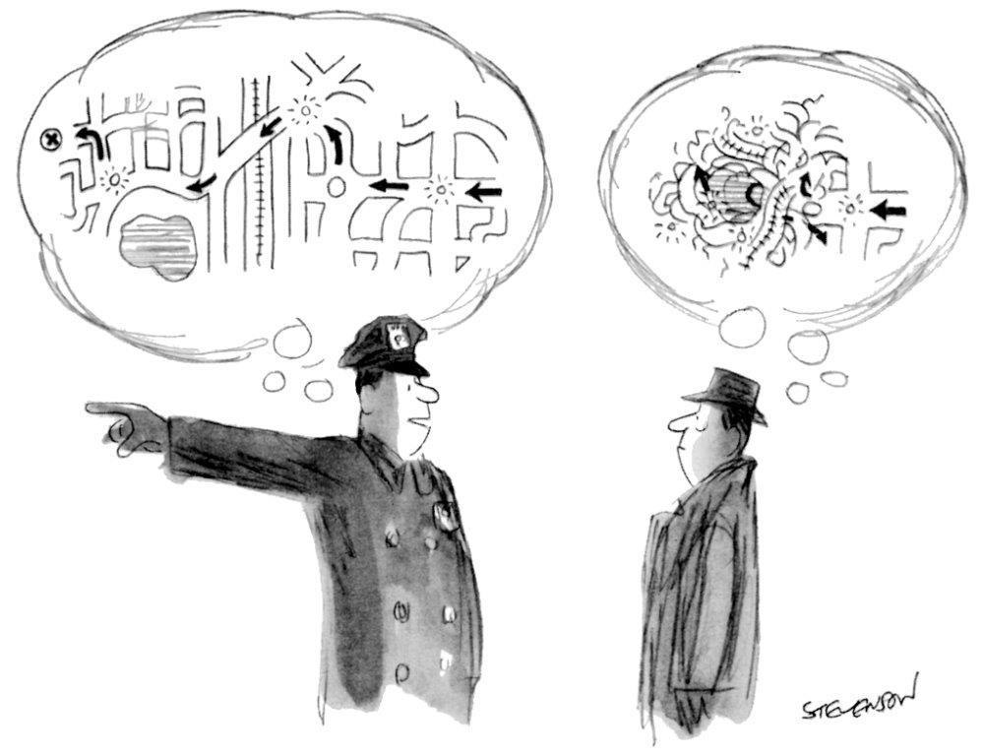
Licensed for use by Condenast

Slide 48
Filter
Back pain…
Money worries…
Argument with significant other…
“Damn, Lieu is on me about …”
“I just don’t measure up…”
“I know what these people are thinking”
“Alcoholics make me sick…”
“Here we go again…”
Life event
Self Concerns
Emotions
Disgust
Anger
Contempt
Shame
Fear
Matsumoto, D & Hwang, H.S. (2013). Facial expressions. In Matsumoto, D., Frank, M.G., Hwang, H.S.(Eds.) , Nonverbal Communication: Science and applications (pp. 15-52). Los Angeles: Sage

Slide 49
Filter
“I know how that is…”
“You know what I would do if I were you…”
“You shouldn’t think that way…”
“You’ll find another job..”
“God loves you…”
Thinking about my stuff
Giving advice
Getting off the topic

Slide 50
Plan of Learning
Crisis, Intervention, Team
Emotional Crises impose suffering
Empathic understanding
Active listening & Active observing
Filter or “noise”
Restatement & Reflection
Exercise
Questions
“I” statements
Genuineness
Acceptance
Skills practice

Slide 51
Active Listening requires: Checking out what I think I heard
Speaker
Filter
Listener

Slide 52
Active Listening requires: Accurate Restatement / Reflection
Speaker
Filter
Listener

Slide 53
Active Listening requires: Accurate Restatement / Reflection
Speaker
Filter
Listener
Restatement / Reflection

Slide 54
Active Listening requires: Accurate Restatement / Reflection
Speaker
Filter
Listener
Restatement / Reflection

Slide 55
Accurate Restatement
Restating what the consumer is saying about the crisis—the “facts” as he or she sees them
Consumer: “I don’t know what to do. My family doesn’t want me back home.”
CIT Officer: “Let me see if I understand you. You’re not sure where you can go when you get out of here. Your family doesn’t seem to want you back home.”

Slide 56
Accurate Reflection
Reflecting what the consumer is feeling about the crisis—the emotional state or emotional reaction to the situation
Consumer: “I’m sick and tired of them screwing with me.”
CIT Officer: “Let me make sure I hear what you are saying. You’re sick and tired of people harassing you.”
James, R.K. & Gilliland, B.E. (2001). Crisis Intervention Strategies (4thed.) . Belmont, CA: Brooks/Cole

Slide 57
Restatement & Reflection
Restatement
Consumer:
“I don’t know what to do. My family doesn’t want me back home.”
CIT Officer:
“Let me see if I understand you. You’re not sure where you can go when you get out of here. Your family doesn’t seem to want you back home.”
Reflection
Consumer:
“I’m sick and tired of them screwing with me.”
CIT Officer:
“Let me make sure I hear what you are saying. You’re sick and tired of people harassing you.”

Slide 58
Accurate Restatement / Reflection
Speaker
Filter
Listener
Restatement / Reflection

Slide 59
The Benefits of Restatement and Reflection
I am making sure that I correctly hear what the consumer / patient is saying.
The consumer recognizes that I am trying to understand their situation—building trust.
The consumer recognizes that I am affirming their feelings as real and legitimate—respect.
If I am mistaken, the consumer can correct my understanding.
The consumer is listening to me.

Slide 60
Empathic Understanding requires close attention to the complete message
When you observe something nonverbal that doesn’t fit—red flag—you have choices:
You can take note of a discrepancy and not engage.
OR
You can respond in a non-threatening way.
“You seem uncomfortable.”
Sheeler, R. (2013). Nonverbal communication in medical practice. In D. Matsumoto, M.G. Frank, & H. S. Hwang (Eds.), Nonverbal communication (pp. 237-246). Los Angeles: Sage.
Notes:
60

Slide 61
Plan of Learning
Crisis, Intervention, Team
Emotional Crises impose suffering
Empathic understanding
Active listening & Active observing
Filter or “noise”
Restatement & Reflection
Exercise
Questions
“I” statements
Genuineness
Acceptance
Skills practice

Slide 62
Empathic Understanding…continued
Open ended questions:
Start with: What, How or When and encourage the consumer to tell us more
“When did you get here?
If you observe a nonverbal red flag, you might ask,
“What more can you tell me about that?”
Request a description:
“Would you tell me about…?”
“Could you please tell me what is happening…?”
Avoid Why questions:
Why questions lead to defensiveness

Slide 63
The Benefits of Open Ended Questions
I am able to get more information.
I can check out red flag nonverbals.
I can assess the person’s level of dangerousness.
I can assess whether the consumer is in touch with reality.

Slide 64
Empathic Understanding…continued
Closed ended questions:
Start with:
“Are you…” “Do you…” “Will you…”
Request specific information:
“Are you thinking of harming yourself?”
“Are you hearing voices?”
Obtain a commitment:
“May I call the nurse...?”
“Will you agree to come with me?”

Slide 65
The Benefits of Closed Ended Questions
I am able to get critical information quickly.
I am able to begin formulating a plan of action immediately.

Slide 66
Owning or “I” Statements
“Owning” means taking responsibility
for what I am thinking, feeling and saying.
“I” statements are used sparingly since the focus is on the consumer.
“I” statements are essential for communicating what the CIT Officer needs.
“I” statements are essential for assisting consumers who need direction.
James, R.K. & Gilliland, B.E. (2013). Crisis Intervention Strategies (7th ed.) . Belmont, CA: Brooks/Cole .

Slide 67
Owning or “I” Statements
CIT: “I want you to tell me how many pills you have taken…”
CIT: “I don’t get it…can you tell me again?”
CIT: “I’m feeling confused…you look sad.”
CIT: “I disagree…I think you can do this.”
CIT: “Yes, I understand you are angry and upset but I want you to slow down so I can understand you…”

Slide 68
Owning or “I” Statements…continued
Broken Record
Using a clear and calm voice, the CIT Officer repeats a request for compliance.
CIT: “Yes, I understand you are angry and upset, but
I want you to slow down so I can understand you…Yes,
I understand how upset you are about someone messing with you, but right now, I need you to slow down and talk with me about getting things right for you…
Yes, I see how irritated you are, but right now, I want…..”

Slide 69
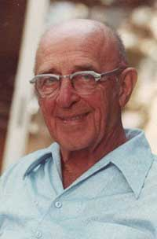
Empathic Understanding
“To my mind, empathy is in itself a healing agent … because it releases, it confirms, it brings even the most frightened person into the human race. If a person is understood, he or she belongs.”
Carl Rogers
Rogers, C.R. (1987). Rogers, Kohut, and Erickson: A personal perspective on some similarities and differences. In J. Zeig (Ed.), The evolution of psychotherapy (p. 181). New York: Brunner/Mazel.

Slide 70
Plan of Learning
Crisis, Intervention, Team
Emotional Crises impose suffering
Empathic understanding
Active listening & Active observing
Filter or “noise”
Restatement & Reflection
Exercise
Questions
“I” statements
Genuineness
Acceptance
Skills practice

Slide 71


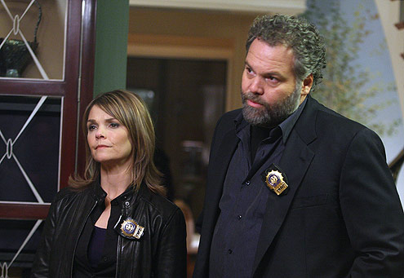
Genuineness
A CIT Officer is role free
not Dr. Phil, not Judge Judy,
not Detective Goren, not a preacher…
A CIT Officer is real
A CIT Officer is sincere
Photos: Judge Judith Scheindlin-bahmore.files.wordpress.com; Vincent Donofrio-tvguide.com; Dr. Phil Mcgraw-imgpoptower.com

Slide 72
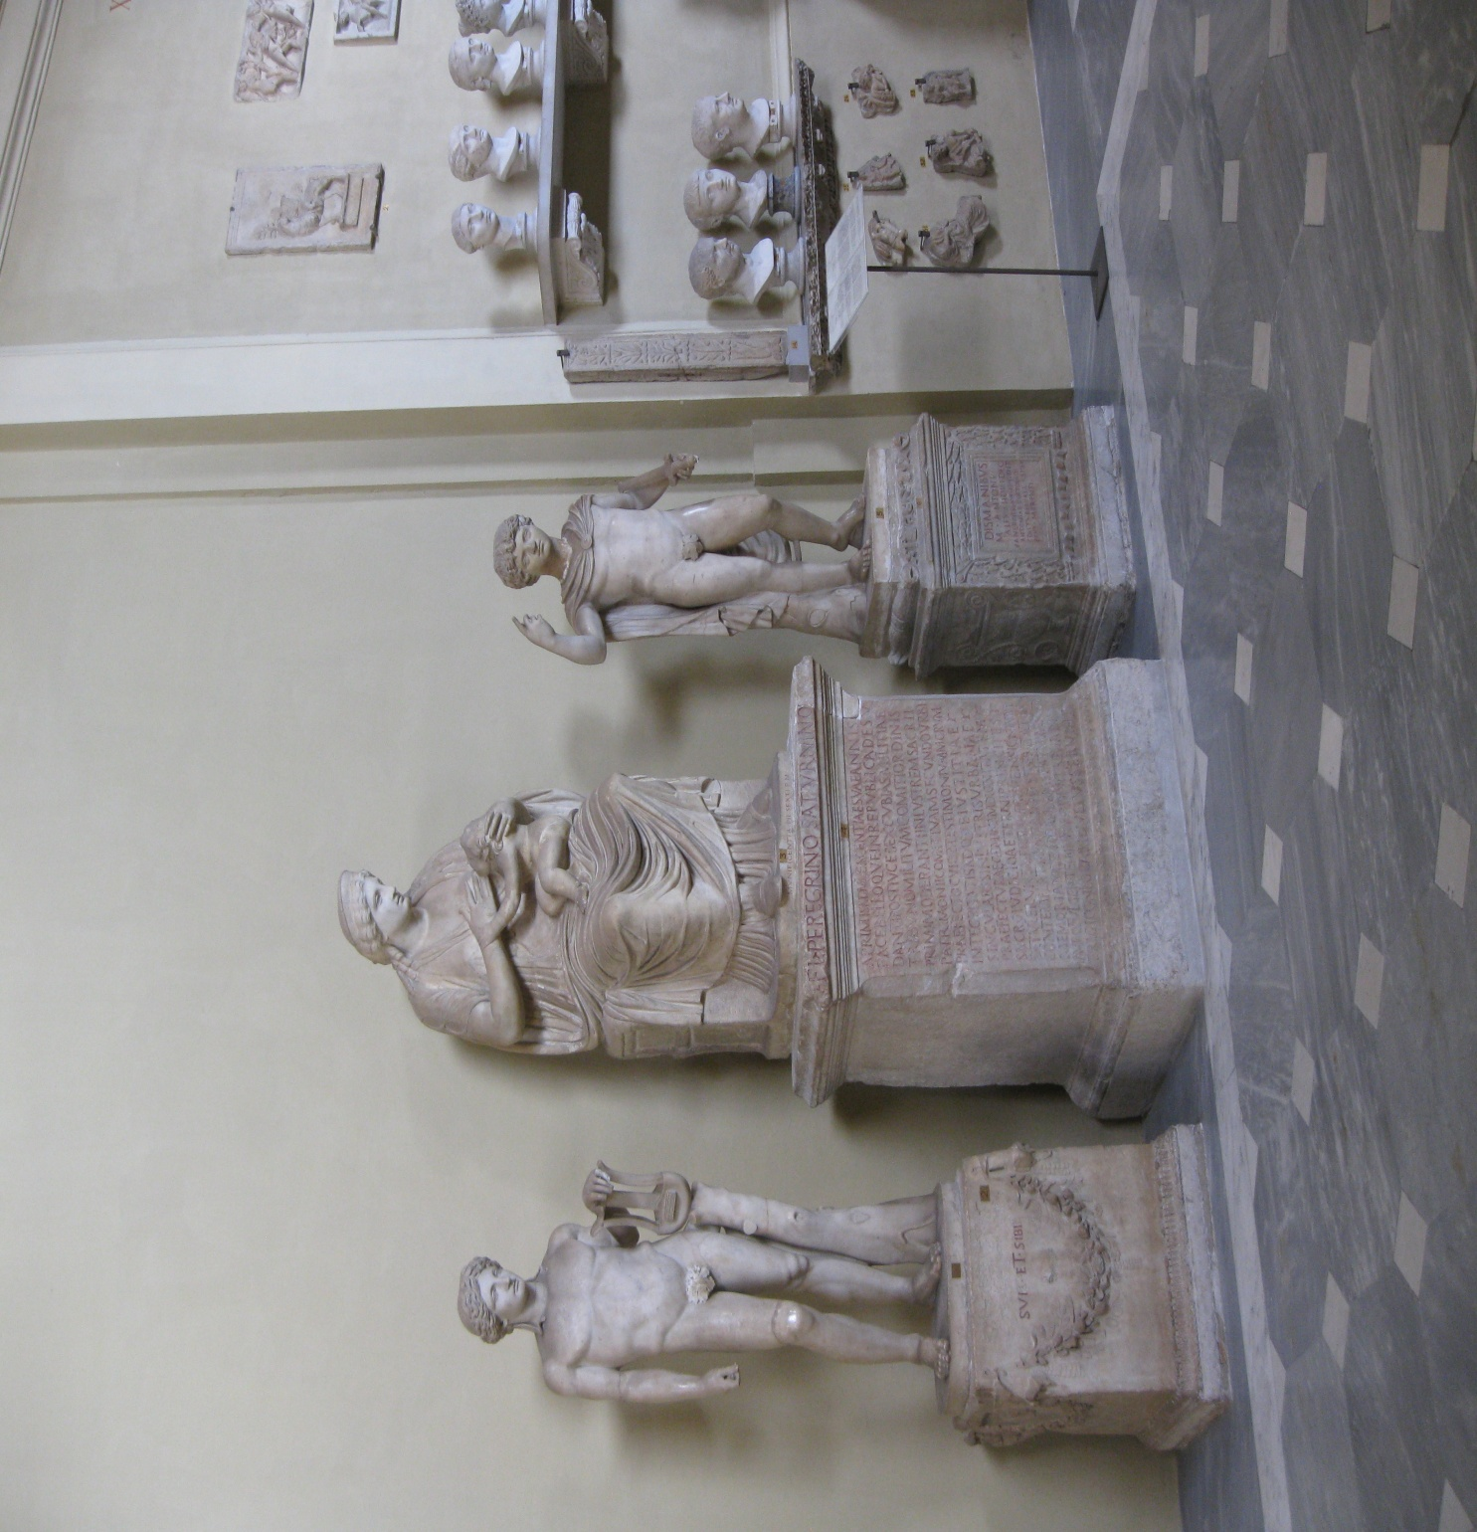
Photo: Thomas M. Kirchberg

Slide 73
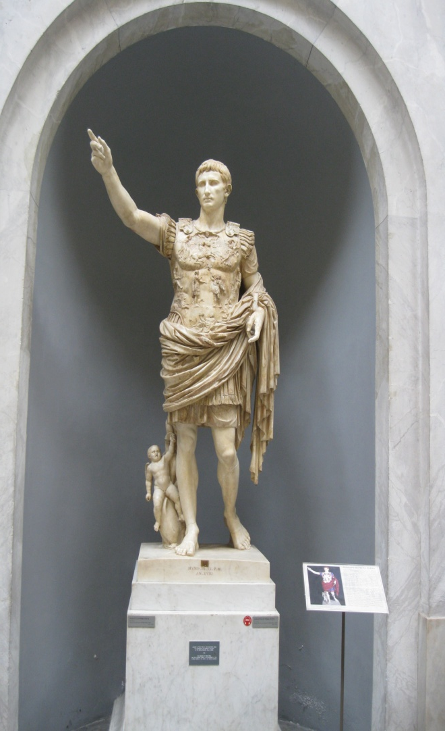
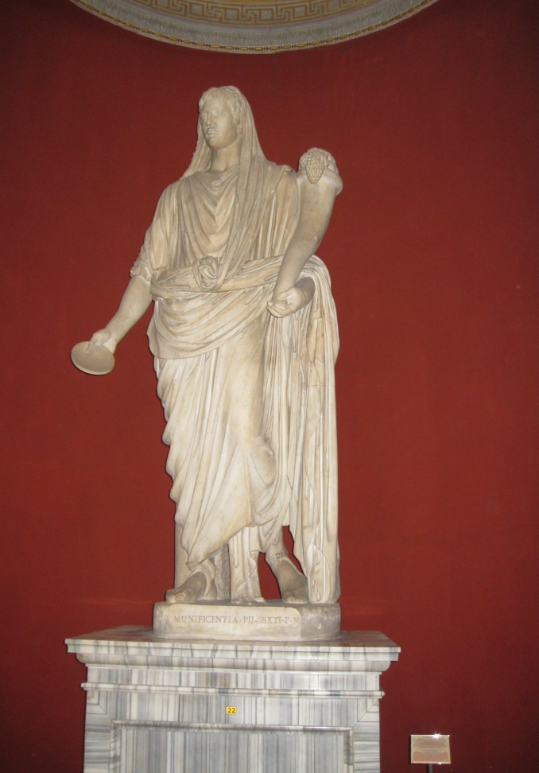
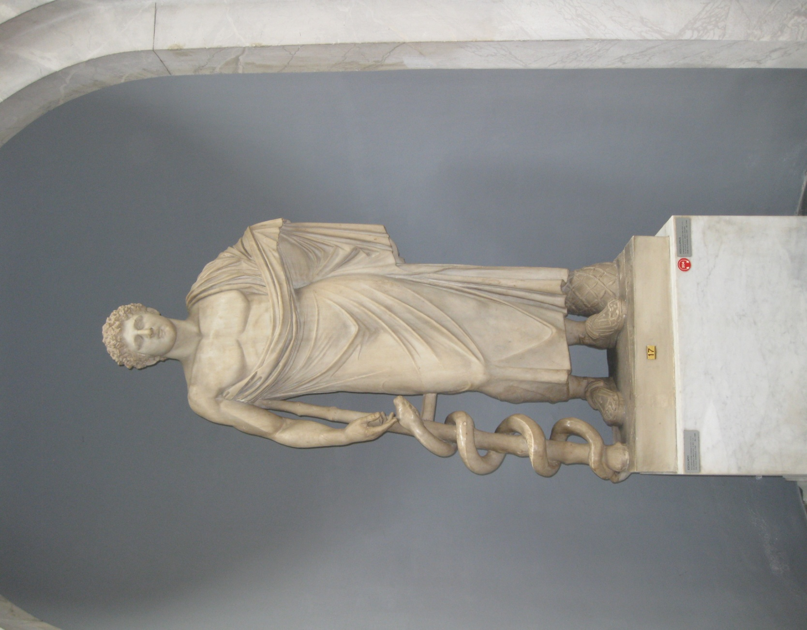
Photos: Thomas M. Kirchberg

Slide 74
Sincere
Photo: Thomas M. Kirchberg

Slide 75
Genuineness…continued
The CIT Officer is spontaneous and adaptable to changing situation.
not confined to rule book but able to think outside the box
CIT Officer: “I’m not sure what we can do. But I’m willing to work with you to figure something out.”

Slide 76
Genuineness…continued
Congruence—The CIT Officer’s words and gestures are consistent and instill confidence in the consumer, family members, …..
Officer and consumer are on the same side
Officer and consumer are on the same wavelength
Corey, G. (1977). Theory and practice of counseling and psychotherapy. Belmont, CA: Brooks/Cole; Krumboltz, J.D., & Thoresen, C.E. (1976). Counseling methods. New York: Holt, Rinehart, & Winston; Orlinsky, D.E., & Howard, K.I. (1986). Process and outcome in psychotherapy. In Garfield & Bergin, Handbook of psychotherapy and behavior change (3rd ed.) (pp.311-381). New York: Wiley.

Slide 77
Genuineness…continued
Immediacy or staying in the “here and now”
CIT Officer: “Stay with me now. Let’s work on this together. I want you to stop for minute and take a deep breath… That’s good…Thank you.”

Slide 78
Plan of Learning
Crisis, Intervention, Team
Emotional Crises impose suffering
Empathic understanding
Active listening & Active observing
Filter or “noise”
Restatement
Reflection
Questions
“I” statements
Genuineness
Acceptance
Skills practice

Slide 79
Stigma
68 % of Americans do not want someone with a mental illness marrying into their family.
58 % of Americans do not want people with mental illness in their workplaces.
Pescosolido, B. (2009). Journal of Health and Social Behavior, Vol. 41, No. 2.

Slide 80
Stigma
Americans are twice more likely today than in 1950 to believe people with mental illness tend to be violent.
The vast majority of people with mental illness are not violent.
A small subset—people experiencing serious psychotic symptoms—are more violent than the general population.
People with mental illness are actually 2.5 times more likely to be victims of violence.
Mental illness alone does not increase chances of violence—add alcohol / drugs / noncompliance with meds / biological or biochemical disorders.
Cordner, G (2006), People with mental illness. Washington, D.C.: Community Oriented Policing Services, U.S. Department of Justice; Elbogen, E. B. & Johnson, S. C., (2009). The intricate connection between violence and mental disorder Archives of General Psychiatry, 66 (2), 152-161; Hiday V.A., Swanson J.W., Swartz M.S., Borum R. & Wagner H.R. (2001). Victimization: A link between mental illness and violence? International Journal of Law and Psychiatry, 24 (6), 559-572.

Slide 81
The Two Faces of Stigma
Public Stigma
Stereotype:
“All people with mental illness are dangerous.”
Prejudice:
“I agree, people with mental illness are dangerous and I’m afraid of them.”
Discrimination:
“I don’t want to be near them and won’t hire one at my job.”
Self Stigma
Stereotype:
“People with mental illness are incompetent.”
Prejudice:
“I have a mental illness, so I must be incompetent.”
Discrimination:
“Why should I even try to get a job? I’m an incompetent mental patient.”
Corrigan, P. , (2004). How stigma interferes with mental health care. American Psychologist, 59, 614-625.

Slide 82
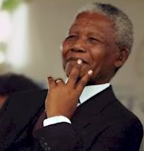
Public Stigma and Self Stigma
“We put down briefly in Khartoum, where we changed to an Ethiopian Airways flight to Addis. Here I experienced a rather strange sensation. As I was boarding the plane I saw the pilot was black. I had never seen a black pilot before, and the instant I did I had to quell my panic.
How could a black man fly an airplane?
But a moment later I caught myself: I had fallen into the apartheid mind-set, thinking Africans were inferior and that flying was a white man’s job. I sat back in my seat and chided myself for such thoughts. Once we were in the air, I lost my nervousness and studied the geography of Ethiopia…..”
Mandela, Nelson R. (1994). Long walk to freedom: The autobiography of Nelson Mandela. New York: Little, Brown and Company (pp. 254-255).

Slide 83
Acceptance
The consumer has a right to have his or her own feelings, thoughts, or behaviors.
The CIT Officer respects the dignity of each person without regard to sex, race, age, sexual orientation, cleanliness, etc.
Acceptance is not easy when consumer is behaving in bizarre or hostile manner.

Slide 84
Communicating Acceptance
Person in Crisis
CIT Officer
Fearful
Anxious
Angry / hostile
Insecure
Paranoid
Acting strangely
Speaking bizarrely
Poor personal hygiene
Respectful Introduction
“Please”
“Thank you”
“Smiling when appropriate”
Considers: “What if this person were a member of my family, a friend, a co-worker?”
Demonstrates courage

Slide 85
Plan of Learning
Crisis, Intervention, Team
Emotional Crises impose suffering
Empathic understanding
Active listening & Active observing
Filter or “noise”
Restatement
Reflection
Questions
“I” statements
Genuineness
Acceptance
Skills practice

Slide 86
Skills Training
Skills Training uses real situations with experienced CIT Officers as consumers.
We all feel uncomfortable in Skills Training.
We all make mistakes in Skills Training.
Skills Training is a learning experience.
Feedback will be constructive.
We will be working as a team to assist one another in skills development.

Slide 87
Skills Training
Introduce yourself:
CIT: “Hi. My name is _______.
I’m a Crisis Intervention Team Officer with the _____ Police/Sheriff’s Department.
Can you tell me your name?”
Ask Open-Ended Questions: What—How—When ?
Use Positive Reinforcement:
CIT: “I appreciate…Thank you…That’s helpful.”
Use Restatement:
Consumer: “I don’t know what to do. My family doesn’t want me here.”
CIT: “You’re not sure where you can go tonight. Home doesn’t seem like the best place right now.”
Use Reflection:
Consumer: “I’m sick and tired of them taking my check.”
CIT: “You’re fed up with people taking advantage of you.”

