Slide 1
Major Court Cases and Legal Issues that Impact Interaction with Persons who Have a Mental Illness
Crisis Intervention Team (CIT)
Supplemental Instruction
Notes:
No Notes

Slide 2


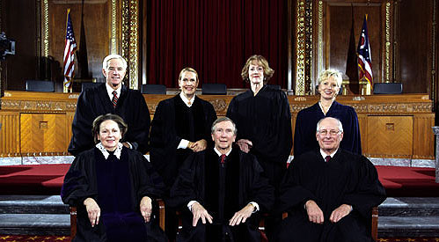
Ohio Supreme Court Decision
In re Miller (1992), 63 Ohio St.3d 99, 585 N.E.2d 396.
Notes:
No Notes

Slide 3
In re Miller—Facts
1989—38-year old man transported to Mansfield General Hospital & involuntarily committed to the psychiatric ward
Civilly committed through the Richland County Probate Court
Man tried to appeal but eventually agreed to voluntary commitment
Notes:
Was transported by Mansfield Officers, but neither a narrative or any kind of documentation was left with the hospital
Hospital staff engaged in an ORC 5122.11 non-emergency commitment process
Appeal was dropped and man agreed to be committed voluntarily

Slide 4
In re Miller—Facts
In the affidavit, the psychiatrist wrote, “The patient has been progressively confused, delusional, and paranoid. His sense of reality is altered, grandiouse (sic) and at times, out of touch with reality.”
Notes:
Direct quote from the case opinion—including the misspelling
Obviously language is clinical and diagnostic

Slide 5
In re Miller—Court Says…
“When commitment is against a person’s will, it is particularly important that the statutory scheme be followed, so that a patient’s due-process rights receive adequate protection.”
  Statutes in question are O.R.C § 5122.10 and 5122.11, with definitions from 5122.01 (B)
Notes:
First issue is that officers did not follow ORC 5122.10 to the letter and supply an affidavit of any kind—see next slide
Second issue was language by the doctor that will be addressed on subsequent slides

Slide 6
In re Miller—Court Says…
Court noted that § 5122.10 requires that a written statement must be given to such hospital (or alternative crisis center) by the police officer stating the circumstances under which such person was taken into custody and the reasons for the police officer’s belief
  Court said that statement would “ensure a minimal level of probable cause exists…”
Notes:
Fairly self explanatory

Slide 7
In re Miller—Court Says…
Court also noted that the affidavit “must contain ‘facts’ which necessarily relate the happening of things that have been done, or of events that have taken place.”
  Additional mention of “concrete” facts
Notes:
“Facts” and/or “concrete facts” mentioned repeatedly

Slide 8
In re Miller—Court Says…
Court listed facts as defined in Black’s Law Dictionary (6th Ed., 1990)
  “[a] thing done; an action performed or an incident transpiring; an event or circumstance; an actual occurrence; an actual happening in time or space or an event mental or physical; that which has taken place
Notes:
Definition was found in the case opinion to focus on the path the court was taking

Slide 9
In re Miller—Take Away
If you take a person into custody pursuant to ORC § 5122.10 and it is against the person’s will:
  Must provide a statement of fact of some sort (in Columbus, the method is to use the ODMH DMH-0025 Application for Emergency Admission form—”Pink Slip” along with an “Aid and Transport” incident report)
  Must also provide facts and not use diagnostic terms in the statement of belief
Notes:
Extrapolated from opinion, but not so vague reference is made in the opinion itself
Do not use language such as “appeared to be depressed” or “appeared to be paranoid” but instead relate the signs and symptoms that your senses noted. (ex. Subject mentioned that he couldn’t get out of bed for two days or that the subject mentioned that the CIA was out to get him because he knew things)
Elaborate as much as possible

Slide 10
In re Miller—Take Away
Side Issue—May have to complete a new “pink slip” if you locate a person who has “eloped” from a psychiatric crisis center
  Short time frame—use existing “pink slip” or use previous “pink slip” as a reference and add new facts based on your observations
  Longer time frame—may need to articulate new facts to establish probable cause to take custody and complete new “pink slip”
Notes:
This is based on the opinion and on some interpretation by magistrates and judges in other counties (Miami County as an example). Police Legal Advisor for Columbus P.D. concurs, but also cannot provide bright line time frame. Need to look at whether there has been time to change the previous fact pattern to a new one.
No “bright line” on the time frame and the need to complete an entirely new narrative is based on what the person has done since he/she “eloped” (term used by mental health centers for a person who has left the facility against advice). Officer responding to the call will need to assess these issues
Officers can use the information from the previous “pink Slip” narrative and/or make contact with the person(s) who supplied the previous narrative and/or any information that was used in the preparation of the narrative. DON’T completely discount the previous narrative.

Slide 11
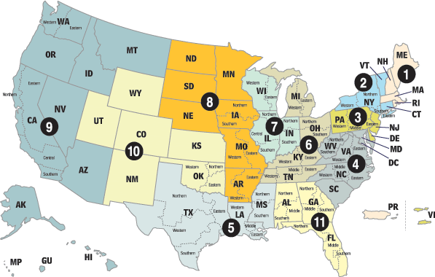

U.S. Sixth Circuit Court of Appeals Decision
Fisher v. Harden, 398 F.3d 837, 841 (6th Circuit 2005)
Notes:
This case is specifically covered in the new OPOTC “Handling the Special Needs Population” lesson plan (16 hours) that is required for every basic academy class that started on or after August 1, 2006. The lesson plan is expansive and replaced the former 3-hour lesson plan.

Slide 12
Fisher v. Harden—Facts
77-year old man took his rifle, a tripod, and a folding chair to go and shoot groundhogs eating the area crops
  On a railroad grade about 250 yards from a county road
A passer-by saw the man and thought it might be a suicide attempt
  Called into the sheriff’s office and reported a possible suicide attempt—said man had his feet tied to the tracks
Notes:
All taken from the written opinion

Slide 13
Fisher v. Harden—Facts
Two deputies arrived and used overhead speaker to get man’s attention
Man stood up, gathered his items, and walked towards deputies along tracks
Deputies noticed man was carrying rifle and ordered him to lay down the weapon
Initially man didn’t acknowledge, but did finally cooperate at about 200 yards
Notes:
Used PA system to get man’ attention, but it is unclear as to whether the deputies knew the man had a rifle until he got up to move and picked it up.
It appears that the man did not initially hear or understand the commands until he had walked approximately 1/5 of the way back to the deputies

Slide 14
Fisher v. Harden—Facts
Deputies acknowledged they recognized that man was older, and that he didn’t do or say anything out of the ordinary
Kept weapons trained on him and then ordered him to lie face down on the roadway and handcuffed him
Man goes into immediate cardiac arrest
  Life flighted to hospital—Lived but was permanently disabled
Notes:
Also taken directly from the opinion
Although it claims that Fisher went into immediate cardiac arrest, the deputies handcuffed him and left him lying face down on his stomach after they unsuccessfully tried to stand him up. It appears that they did not know or did not realize that Fisher was in distress and one of them walked away to retrieve the items that were laid on the ground earlier. A woman who lived nearby and another deputy arrived on the scene “shortly thereafter” and the woman advised that Fisher suffered from a heart condition. The newly arrived deputy listened to the neighbor, realized that Fisher was in distress, and called for medical assistance after taking the handcuffs off of Fisher.

Slide 15
Fisher v. Harden—Facts
42 USC §1983 suit filed in Federal Court
Defendants did not contest that man was seized, but advocated that the seizure was valid as part of a Terry stop
Also conceded that they were not responding to a report of criminal conduct and that they never suspected that the man was engaged in or about to be engaged in a crime
Notes:
Discuss the two portions of a valid “Terry” Stop—Reasonable suspicion that criminal activity is taking place and a reasonable belief that the person may have a weapon that could cause harm to the officer.
Last bullet point may lead student to realize that parts of the “Terry” stop are missing

Slide 16
Fisher v. Harden—
Court Says…
Decline to adopt a rule that would apply Terry v. Ohio to mental health seizures
Defendants were unable to demonstrate they had probable cause to believe that man was a danger to himself or others
“Deputies forced the man to the ground and handcuffed him without any suspicion of criminal activity, without frisking him for additional weapons, and without asking any questions”
Notes:
Court said that they were “disinclined” to adopt a rule to apply “Terry” to mental health seizures, but that in this case, the deputies were not even able to articulate that they had a valid “Terry” stop.
Key on the fact that they failed to ask the man any additional questions or frisk him before or after they handcuffed him.

Slide 17
Fisher v. Harden—Court Says…
“In the present case, the information presented to the officers was much more vague. The [deputies] were investigating an unconfirmed report that an individual was suicidal. Fisher was not in the company of an obviously distressed companion. And, the deputies failed to question him. Rather, they drew their guns, ordered Fisher to the ground, and handcuffed him.”
Notes:
Court questions the veracity of the information that the Deputies had
May want to mention that since Fisher got up and walked towards the deputies, it was obvious that his feet were not tied to the tracks. This should have caused serious doubt about the veracity of the information that was called into the Morrow County Sheriff’s Office.

Slide 18
Fisher v. Harden—Take Away
“It is clearly established that an officer may not affect a mental health seizure without probable cause.”
If you are responding to an unconfirmed report that a person is mentally ill and/or suicidal, you need to confirm the information in some manner
Notes:
Key on issue that the officer needs to corroborate given information in some manner

Slide 19
Fisher v. Harden—Take Away
Gather additional facts from family, friends, other witnesses and any past run data
Interact with the person who is suspected of having a mental illness and gather information from your own senses as to whether a crisis is taking place and whether that crisis meets the established criteria for custody under ORC §5122.10
Notes:
If it is not an emergency situation, gather as much information/intelligence as possible so that you are an informed officer who is making the decision about taking a person into involuntary custody under ORC 5122.10. The informed officer also needs to know the criteria from ORC 5122.01 that is listed on a “pink slip”

Slide 20
U.S. Sixth Circuit Court of Appeals Decision
Griffith v. Coburn, 473 F.3d 650.
(Sixth Circuit 2007)

Slide 21
Griffith v. Coburn—Facts
Mother approached township police department in Michigan
Wanted son hospitalized because he was “acting strangely”
Police said son was not danger to self or others based on mother’s explanation
Son had outstanding traffic warrant
Officers offered to arrest son to get help
Notes:
May want to discuss issues surrounding the use of an minor outstanding warrant to obtain mental health services. There are other avenues that should have been explored.

Slide 22
Griffith v. Coburn—Facts
Officers entered to find son passive
Told him they had a warrant, he denied it and turned back to the TV
  Officers moved the table in front of the son after believing that he was knowingly ignoring them, precipitating a struggle
Once subdued, son went into respiratory distress and died
Mother brought 42 USC §1983 lawsuit against the police department
Notes:
Based only on case narrative, it appeared that officers used standard criminal investigation skills when dealing with a person who was mentally ill. These tactics can backfire, and they did

Slide 23
Griffith v. Coburn—Facts
Officers asked for summary judgment and to be afforded qualified immunity
  One officer used a lateral vascular neck restraint (later found to have been improperly applied)
Notes:
For those who are aware of the difference, there is no mention that the trained technique was the LVMPD LVNR (lateral vascular neck restraint) created by Jim Lindell. There are others that are taught.

Slide 24
Griffith v. Coburn—
Court Says…
Based on evidence and testimony, officer’s actions were unreasonable based on “totality of the circumstances”
Court looked at the agency’s own force continuum
Court added one other relevant factor—Officers knew subject “…was experiencing some sort of mental or emotional difficulty sufficient to cause his mother to seek help from the police department.”
Notes:
Totality of the circumstances in this case consisted of a minor traffic warrant and some information from mother that her son was “acting strangely.”
The agency’s own force continuum was analyzed

Slide 25
Griffith v. Coburn—Court Says…
Referenced another 6th Circuit case—Champion v. Outlook Nashville, Inc., 380 F. 3d 893, 904 (6th Cir. 2004) and further applied it to mentally ill individuals
That case involved police interaction with a developmentally disabled individual who died after being maced and restrained by Metro Nashville police officers
Notes:
Instructor may want to familiarize himself/herself with the Champion v. Outlook case in the event that questions are asked. Subject in that case was autistic.

Slide 26
Griffith v. Coburn—Court Says…
“It cannot be forgotten that the police were confronting an individual whom they knew to be mentally ill or retarded, even though the Officers may not have known the full extent of [his] autism and his unresponsiveness. The diminished capacity of an unarmed detainee must be taken into account when assessing the amount of force exerted.”
Notes:
Direct verbiage from the case citation in Champion v. Outlook Nashville

Slide 27
Griffith v. Coburn—Take Away
Judges are not saying that you have to take unreasonable risks with a person who has a mental illness
Judges do say that if you go into a situation with an unarmed arrestee who is mentally ill or has a diminished capacity and you know you may have to use force, you have to consider the person’s mental illness or developmental disability when assessing the type and amount of force to be used
Notes:
Second Bullet—Although the case did not specifically relate a custodial situation under ORC 5122.10, it may be inferred that the type and amount of force in a mental health custody situation will likely be looked at in the same vein. This case referred to the intent of the officers and that intent was to make an arrest on a minor traffic warrant.
Unfortunately, there is no reference point for said assessment (bullet #2), just an admonishment that officers have to consider the person’s capacity to understand your instructions and/or commands before deciding on the level of force. In a split second situation, this will be difficult at best. If you have time, you need to take this information into account when deciding upon a course of action.

Slide 28
Griffith v. Coburn—Take Away
Officers responding on a run should make every effort to obtain information on a person’s mental illness or developmental disability so that they can assess the level of force that should be used
  If the run is rapidly evolving, an assessment may not be possible

Slide 29
Griffith v. Coburn—Take Away
Officers responding to a run at Netcare, other mental health facilities, group homes, or other like locations should presume that the subject of the run has a mental illness or developmental disability and should gather information from present staff members about the mental illness, any tactics that have been unsuccessful before, and any medical concerns if an exigency does not exist

Slide 30
Griffith v. Coburn—Take Away
In this case, and those like it, officers continue with force or escalate the use of force when a person does not respond because they believe the person is being non-compliant when in fact, the non-compliance may be due to the mental illness

Slide 31
Griffith v. Coburn—Take Away
Officers should be constantly assessing whether a lack of response is intentional or due to a prevailing mental illness
Officers should also be cautious of using restraint techniques that may affect the person adversely due to medical conditions that officers are made aware of
  Use other techniques or devices if possible and have EMS respond to the scene right away

Slide 32
U.S. Sixth Circuit Court of Appeals Decision
Ziegler v. Aukerman et al, 06-2618. (Sixth Circuit 2008)

Slide 33
Ziegler v. Aukerman et al—Facts
Plaintiff went to hospital for an outpatient referral at 8 PM
  Brought by husband because she was “depressed and suicidal”
Plaintiff in first half hour was alleged to have reported that she was suicidal and planned to drive her car into a tree
At 9:40 PM, plaintiff left and staff notified police

Slide 34
Ziegler v. Aukerman et al—Facts
Plaintiff reappeared at 11:00 PM and police were then told not to go to her home
Plaintiff was then evaluated by a nurse and determined to have a mental illness that “caused her to pose a risk of serious physical injury to herself or to others within the near future”

Slide 35
Ziegler v. Aukerman et al—Facts
The nurse completed her statement and gave it to a doctor
Doctor met with plaintiff and determined that she needed to be hospitalized and completed a “clinical certificate”
Plaintiff decided “..that the law did not allow the hospital to hold her and she announced her intention to leave”

Slide 36
Ziegler v. Aukerman et al—Facts
Plaintiff did leave and the police were called to locate her and bring her back because she was suicidal
  Dispatcher was told that a “certificate” had been completed
Officer arrived and took plaintiff into custody “outside her house…on the walkway or driveway connected to the house” based on the information provided

Slide 37
Ziegler v. Aukerman et al—
Court Says…
“A showing of probable cause in the mental health seizure context requires only a ‘probability or substantial chance’ of dangerous behavior, not an actual showing of such behavior”
“Courts evaluate the existence of probable cause from the perspective of a reasonable and objective person in the position of the seizing official”

Slide 38
Ziegler v. Aukerman et al—
Court Says…
Court also addressed exigent circumstances exception to the warrant requirement
  Hot pursuit of a fleeing felon
  Imminent destruction of evidence
  Need to prevent a suspect’s escape
  Risk of danger to the police or others

Slide 39
Ziegler v. Aukerman et al—
Court Says…
Court noted that the exigency at issue is most frequently applied “…where the government actors were performing ‘community caretaker’ functions rather than traditional law-enforcement functions”
Officer has to show that there was a “…risk of serious injury posed to himself or his fellow officers or others that required swift action”

Slide 40
Ziegler v. Aukerman et al—
Court Says…
Court also addressed exigent circumstances exception to the warrant requirement
  Hot pursuit of a fleeing felon
  Imminent destruction of evidence
  Need to prevent a suspect’s escape
  Risk of danger to the police or others
Court noted that the exigency at issue is most frequently applied when government actors were performing “community caretaker

Slide 41
Ziegler v. Aukerman et al—
Take Away…
If a person “elopes” on a pink slip, you can use that document as probable cause to bring him/her back
  Still subject to time frames and changes in fact patterns
Make be able to use exigent circumstances exception to force entry when criteria #1 or criteria #2 is checked

Slide 42

Questions?

Slide 43
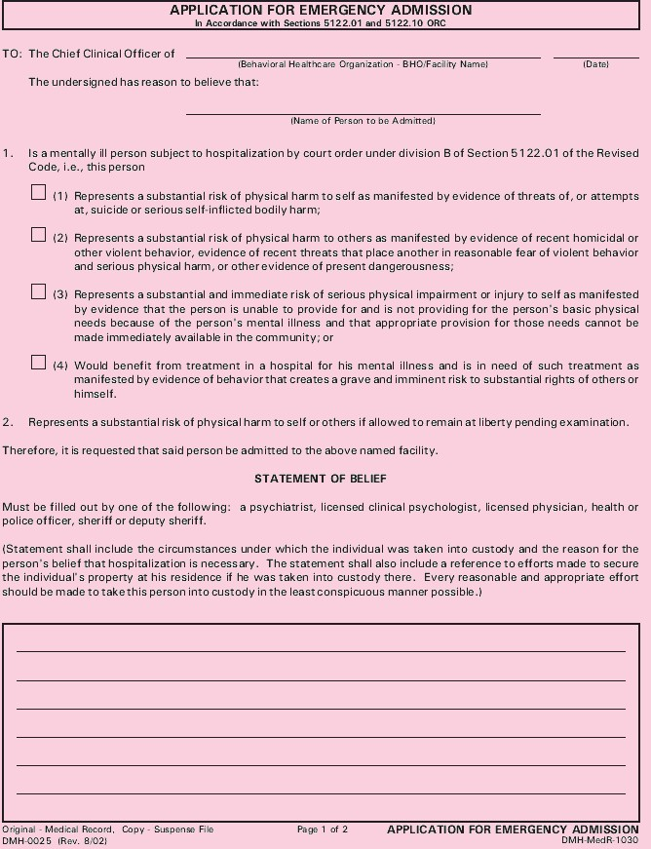
Pink Slip

