Slide 1


TRAUMATIC BRAIN INJURY (TBI)
LAW ENFORCEMENT CONSIDERATIONS
Prepared and presented by
LT Robert Smith -Veterans Affairs Police - Reno

Slide 2

WHAT IS TBI?
Traumatic Brain Injury is defined as a jolt or blow to the head (closed injury), or a penetrating head wound (open injury) that disrupts the function of the brain.
Not all head injuries result in TBI, but there are many cases where a head injury is not externally visible, yet results in TBI.

Slide 3
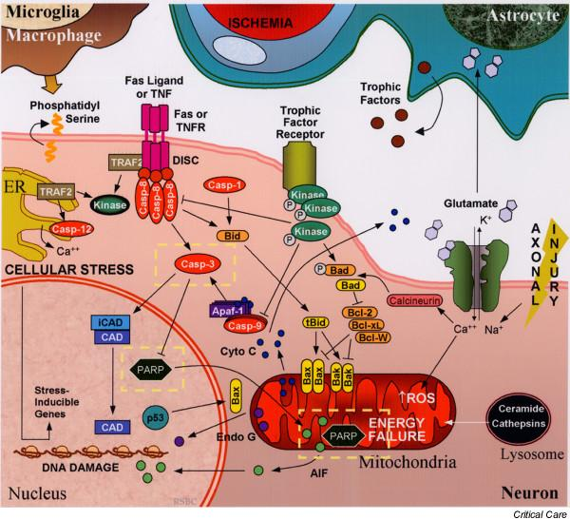
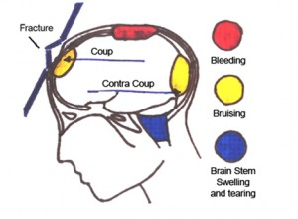
TBI @ WORK IN THE BRAIN

Slide 4
NEUROLOGICAL/MEDICAL CONDITION WITH PSYCHOLOGICAL SIGNS AND SYMPTOMS
What’s going on “under the hood” is a NEUROLOGICAL / MEDICAL condition that manifests itself in a way that presents as a PYSCHOLOGICAL disorder.
It is not a mental illness, but it may co-exist with a mental illness or other psychological disorder (and often co-exists with alcohol/drug abuse), thus making it difficult to diagnose and treat.

Slide 5
TBI IS A RESULT OF PHYSICAL TRAUMA
While some psychological disorders can result from chemical or emotional abuse/trauma, TBI is the result of physical trauma to the brain.
This trauma is often overlooked due to a lack of outward signs of injury, such as in the case of whiplash or a jolt or impact to the head which leaves little or no mark.
TUMORS and BLAST CONCUSSION are also causes of TBI.

Slide 6
BLAST / CONCUSSION
Not just the pressure entering the head through the ears, eyes, nose and mouth – pressure experienced THROUGHOUT the body reverberates through the blood and spinal fluid in waves, shocking the entire brain and causing the same EXITO-TOXICITY (explained later) as physical impact and internal shifting of the brain within the skull.
These injuries are most frequently overlooked, as there is no reported head injury.

Slide 7
SIMPLY PUT: A SHORT IN THE BRAIN’S CIRCUITRY
As we all know, the brain is a VERY complex communication center.
The communication receptors become damaged (AXONAL INJURY) and the information is not received properly by the parts of the brain needing it.
While this is a problem throughout the brain, the interruption of communication relating to the FRONTAL LOBE results in behaviors that are of significant concern to law enforcement and society in general, because sudden shifts in behavior, often involving violence, can occur with no precipitators whatsoever.

Slide 8
CHEMICAL DAMAGE
While TBI is the result of physical trauma, it should be noted that chemical damage can occur subsequent to the traumatic event.
This is called EXITO-TOXICITY * When an axon is stretched and damaged, the brain responds by releasing many neurotransmitters. The neurotransmitters in turn may cause chemical damage to the brain.

Slide 9
SYMPTOMS
Persistent headaches and/or neck pain
Difficulty remembering, concentrating or making decisions
Slowness in thinking, speaking , acting or reading (hesitation)
Getting lost or easily confused (often accompanied by acute frustration)
Feeling tired all the time, having no energy or motivation
Mood changes (feeling sad or angry for no apparent reason)
Changes in sleep patterns (increase or decrease in ability to rest)
Light-headedness, dizziness or loss of balance
Nausea (sudden, unexpected onset)
Increased sensitivity to lights, sounds or distractions
Blurred vision or eyes tiring easily
Loss of sense of taste or smell
Ringing in the ears (tinnitus)

Slide 10
SEVERITY / RECOVERY FACTORS
As with PTSD, the severity of symptoms and chances of / rate of recovery differ, depending upon how stable the person was (social / emotional / mental stability) when the harmful event occurred.
The severity of the injury and length of LOC (Loss of Consciousness) are also very critical factors.
Diagnosis and treatment are obviously key factors!

Slide 11
BEHAVIORS
Many of the symptoms often cause irritability, especially when multiple symptoms are present.
A person suffering from TBI may suddenly become hostile and violent.
Depending on the areas of the brain affected, normal inhibitions are absent, along with ability to reason or think rationally.

Slide 12
BEHAVIOR INCONSISTENCY
It is important to note that there may be a complete absence of consistent behaviors, and that a person’s behaviors and affect can change suddenly without precipitators.
You may be making progress with calming or reasoning, then suddenly the person explodes with anger and animation.

Slide 13
SIMILARITIES TO MANIC DEPRESSIVE DISORDER
While many of the behaviors may seem similar to those suffering from Manic Depressive Disorder (Bi-Polar Disorder), the frequency and extremes of the symptoms have sudden onset, as opposed to the “cycle” of MDD/BPD.
Self-Medication is also frequent among TBI victims, regardless of their awareness of the cause of their experiences.

Slide 14
SAFETY
Among all aforementioned symptoms and behaviors, it is paramount to keep in mind the possible absence of inhibition and reason or logic. This creates a significant concern in terms of Officer Safety and the safety of others.
If TBI co-exists with PTSD and/or other psychological disorders, safety considerations are much higher.

Slide 15
SCREENING QUESTIONS
You can ask the person if they have ever suffered a head injury, whiplash or brain tumor, if the answer is yes, ask how long ago this occurred, and if the person has a medical care provider assisting them.
Ask if they have been present or near any significant blast or explosion.
Ascertain whether or not they are on any medications to help them with the trauma.

Slide 16
SCREENING QUESTIONS
If the person states they were present near a blast or explosion, even if they had hearing protection in, remember, the pressure reverberating though the body can cause the damage.
ASK the person if they ever felt dizzy or experienced headaches or nausea shortly after the experience.

Slide 17
KEEP IN MIND…
While Officer Safety and the safety of others must always be first, while dealing with a person who has, or may have TBI, keep in mind that their erratic behaviors and sudden turns are not within their control.
Even if they are aware they suffer from TBI, the sudden changes in their feelings and perceptions can cause them just as much anguish and concern as it does you or others!

Slide 18
How Common Is This?
With significant advancements in medical technology, our combat warriors are surviving medical trauma at an unprecedented rate. This equates to MANY more wounded warriors returning home, and we don’t store them in a secret compound, tucked away from society – they are having to adjust to a non-combat environment – in our society. You will be encountering them in situations where they are truly in a crisis.
The number of veterans returning home with TBI, PTSD and a myriad of other disorders is staggering.
Over 1.6 MILLION American Warriors have served in Operation Iraqi Freedom and Operation Enduring Freedom (Afghanistan) since 2001. The vast majority of those service men and women have encountered severe trauma, be it mental, physical or both.

Slide 19
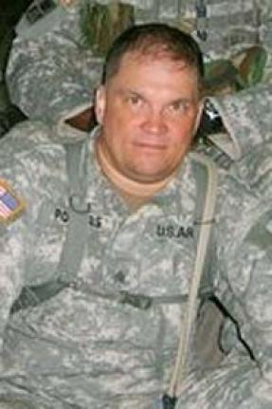
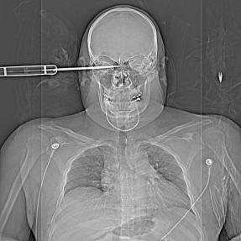
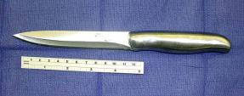
One Example… SGT Powers
Advanced medical technology is bringing more wounded warriors back than ever before.
In July 2007 SGT Daniel Powers, a Military Police Airborne soldier, was stabbed in the side of the head with a 9-inch knife by an Iraqi insurgent (teenager).

Slide 20
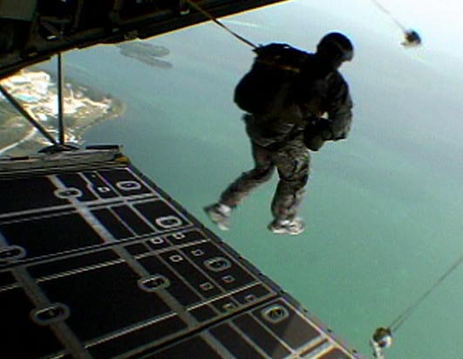
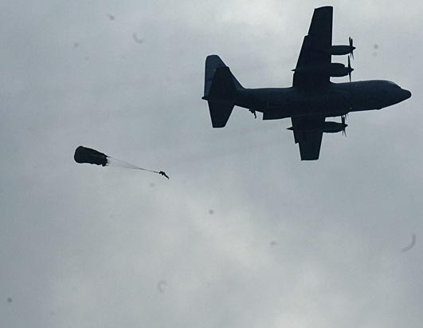
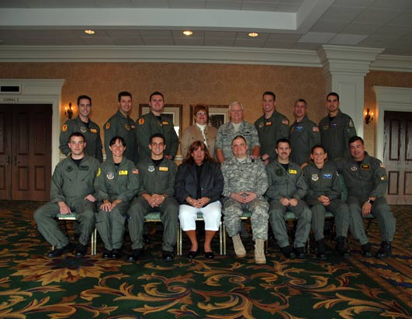
SGT Powers – Returned to Duty
Due to superior medical support, SGT Powers recovered from this injury, and on 23 June 2009, he took his first jump, signifying his return to full duty.
SUCCESS!

Slide 21
EDUCATE YOURSELF!
It is highly recommended to seek further information on Traumatic Brain Injury.
Use Google or Bing to find resources by searching Traumatic Brain Injury or TBI. Here are a few good starting points: www.mirecc.va.gov/visn19/docs/Brenner_AAS_2010_website.pdf www.ninds.nih.gov/disorders/tbi/tbi.htm

Slide 22
QUESTIONS?
THANK YOU FOR YOUR TIME AND ATTENTION!
STAY SAFE!!
This concludes the presentation on Traumatic Brain Injury – Law Enforcement Considerations
If you have questions that I am unable to answer at this time, please email me at Robert.Smith36@va.gov and I will either find the information you need or direct you to our staff of professionals at the Reno VA Medical Center.

