Slide 1

Understanding & Responding to PTSD and TBI
Espy Garcia, LMSW

Slide 2
Disclaimer
The views expressed in this presentation are strictly those of the presenter. They do not represent those of the Veteran’s Health Administration or The United States Government.

Slide 3
Objectives
What is PTSD?
What is TBI?
Recognizing Signs of PTSD and TBI
Post Traumatic Stress Disorder (PTSD) and Traumatic Brain Injury (TBI): Importance for Law Enforcement
PTSD and TBI: Effective Law Enforcement Response
PTSD and TBI: Resources for Help
An Iraq Veteran’s Personal Account

Slide 4
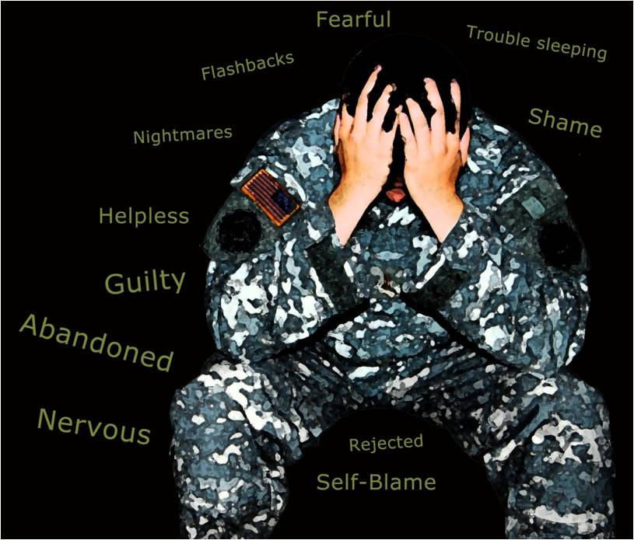
What is Post Traumatic Stress Disorder (PTSD)?

Slide 5
An anxiety disorder that can occur after a person experiences, witnesses or learns of an event or events that involve actual or threatened death, serious injury or violation of body of self or others and responds to this event with intense fear, helplessness or horror.
The anxiety is diagnosed as PTSD when it lasts for at least one month and makes it difficult for the person to function normally in everyday life.
(U.S. Department of Veterans Affairs, “Understanding PTSD,” www.ptsd.va.gov; American Psychiatric Association, Diagnostic and Statistical Manual of Mental Disorders IV-TR, pages 463-468, 2000)

Slide 6

3 Types of Stressors
Intentional Human
Unintentional Human
Acts of Nature/ Natural Disaster

Slide 7
Intentional Human (Man-made, Deliberate, Malicious)
Combat, civil war, resistance fighting
Abuse
Sexual
Physical
Emotional
Torture
Criminal assault, violent crime
Being held hostage; POW
Hijacking
Racism/ hate-crimes
Terrorism
Bombing (Hiroshima, Oklahoma City)
Witnessing homicide, assault, etc.
Sniper attack
Witnessing parent’s fear reactions
Alcoholism (effects on family)
Participating in violence
Suicide or other forms of sudden death

Slide 8
Unintended Human (Accidents, Technological Disaster)
Industrial (i.e. crane crashes down)
Fire, burns (i.e. oil rig catches fire)
Explosion
MVA, plane crash, train wreck, shipwreck
Nuclear disaster
Collapse of sports stadium, building, etc

Slide 9
Acts of Nature/ Natural Disaster
Hurricane
Tornado
Flood
Earthquake
Avalanche
Fire
Drought/famine
Animal attack
Sudden/life-threatening illness
Sudden death (heart attack, loss of unborn child, etc)

Slide 10
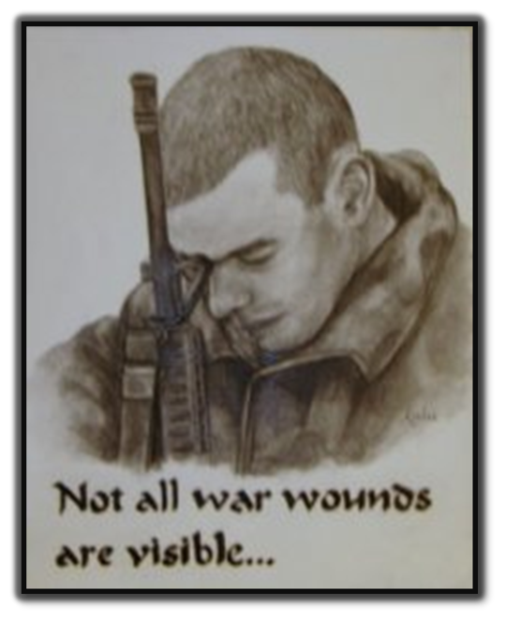
Symptoms of PTSD

Slide 11
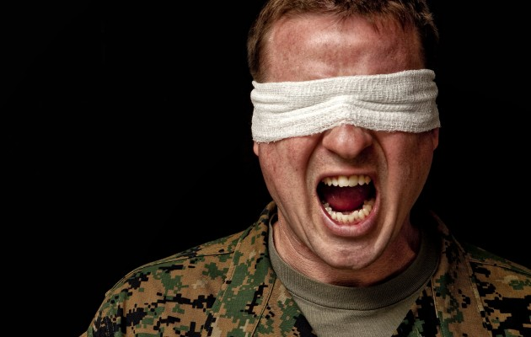
3 Main Symptom Clusters
Reexperiencing
Avoidance or numbing
Arousal

Slide 12
Reexperiencing
The trauma is reexperienced in at least one of the following ways:
Intrusive, unwanted thoughts, images or perceptions about the trauma
Nightmares
Acting or feeling like the trauma is recurring (flashbacks)
Intense distress upon exposure to internal or external cues (triggers) that symbolize or resemble an aspect of the trauma
Reacting physiologically upon exposure to such cues
Notes:
Flashbacks often triggered by insomnia, fatigue, stress or drugs

Slide 13
Avoidance or Numbing
Avoid thoughts, feelings or conversations that remind one of the trauma
Avoid activities, places or people that remind one of the trauma
Restricted range of feelings
Inability to recall part of the trauma
Decreased interest in activities
Estranged from others
A sense of doom or shortened future
Notes:
Trying to numb feelings: numb both painful and negative: “I don’t know how to have fun anymore.
People who go through combat feel that they are different and that no one could ever relate: they fear judgement and so the secrets lead to feeling estranged from others.
Doom: “No matter how good life seems, trouble is coming.”

Slide 14
Arousal or being “keyed up”
Symptoms of increased arousal:
Difficulty falling or staying asleep
Irritability or anger outbursts
Difficulty concentrating
Hypervigilance
Exaggerated startle response

Slide 15
Trauma Exposure is Common!
61% of men and 51% of women experience at least one traumatic event in their lifetime
About 7-8% of people will have PTSD at some point in their lives.
Most common Exposures: witnessing severe injury or death, being involved in fire, flood or disaster, or being involved in life threatening accident
Men are more likely to experience: Physical attacks, combat or being threatened by weapon
Women are more likely to experience: rape, sexual molestation, childhood neglect and abuse
(U.S. Department of Veterans Affairs, “How Common is PTSD?” www.ptsd.va.gov/public/pages/howcommon-is-ptsd.asp, reviewed/updated 6/15/2010)

Slide 16
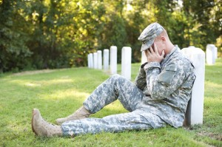
Prevalence of PTSD in Combat Veterans
11-20% of Operation Enduring Freedom and Operation Iraqi Freedom Veterans
10% of Gulf War Veterans
30% of Vietnam War Veterans

Slide 17
Consequences of PTSD
People with PTSD may also have other problems:
Mood or anxiety problems
88% of men and 79% of women with PTSD had at least one other psychiatric disorder
Shattered assumptions
Hostility
Physical symptoms

Slide 18
Consequences of PTSD
Reenacting the trauma/“We hope this time to make things right”
Going into high-risk or rescue oriented-professions
Marrying an abuser
Engaging in high-risk behaviors (rock climbing, speed racing, skydiving)
Engaging in illegal behavior
Notes:
Van der Kolk

Slide 19
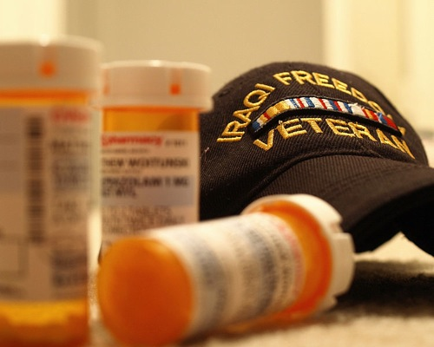
Consequences of PTSD
Substance Abuse:
Among women in treatment for substance abuse, 30%-59% have current PTSD
Among men in substance abuse treatment, 11-38% have current PTSD

Slide 20

Consequences of PTSD
40 times more likely to have academic failure
30 times more likely to be a teenage parent
60 times more likely to experience marital problems
150 times more likely to be currently unemployed.

Slide 21
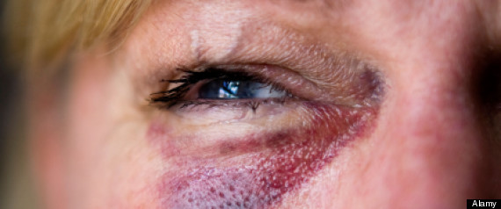


Consequences specific to Veterans
National Comorbidity study:
Unemployment
Being fired
Divorce or separation
Spousal abuse
Notes:
People with combat related PTSD versus PTSD due to other events

Slide 22

Consequences of PTSD
Legal Problems
Higher rates of aggressive behavior
National Vietnam Veteran’s Readjustment Survey found that on average, veterans with [untreated] PTSD committed 13.3 violent acts in the prior year, compared with 3.54 acts for veterans without PTSD

Slide 23
Triggers
Sight (seeing black garbage bags reminds a veteran of body bags)
Sound (backfiring car sounds like gunshot)
Smell (smell of aftershave reminds of sexual assault)
Taste
Body sensations (touch, pain)
Significant dates or seasons
Stressful events (argument with spouse triggers memories of parents arguing violently)
Out of the blue
Combinations

Slide 24
Triggers
Warm, damp day or strong rain
Vietnam
Throat swab during medical exam
Oral rape
Lasagna & milk cartons
Firemen recovering bodies of children buried in a cafeteria by an earthquake
Firecrackers
Gunshots, combat
Dark clouds, strong winds
Tornado
Peace sign
War Protestors

Slide 25
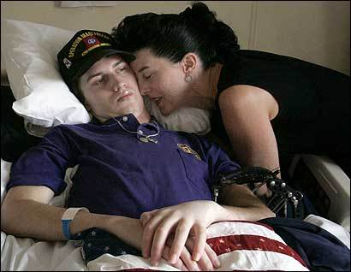
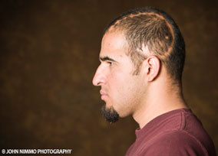
What is Traumatic Brain Injury (TBI)?

Slide 26
Traumatic Brain Injury
A blow or jolt to the head or a penetrating injury that disrupts the functioning of the brain. Not all blows or jolts to the head result in TBI.
The severity of such an injury may range from mild to severe (mild-moderate-severe TBI)
A TBI can result in short or long term problems with independent function.

Slide 27
Traumatic Brain Injury
Blast injuries are primary causes of injury or death in OEF/OIF
69.4% of Wounded in Action caused by blast or explosion
62% of blast injuries result in Traumatic Brain Injury (TBI)
85% of TBIs are closed head injuries which means that only 15% have visible wounds

Slide 28
Prevalence of TBI
45,000 to 360,000 Operation Enduring Freedom and Operation Iraqi Freedom service members suffer from TBI
Most TBI in OEF/OIF service members is classified as mild, with 163,181 cases of mild TBI recorded through May 15, 2011
(Defense and Veterans Brain Injury Center, “TBI Numbers,” http://dvbic.org/TBINumbers.aspx)

Slide 29
Symptoms of TBI
Physical symptoms
Visual problems such as blurry vision or eyes tiring easily, headaches, lightheadedness or dizziness, increased sensitivity to sounds or lights, balance problems, ringing in ears, and/or excessive fatigue
Cognitive symptoms
Memory problems, decreased concentration, being more easily distracted, difficulty being organized, slowed thinking, trouble putting thoughts into words, and/or impairment in judgment, decision-making, or problem-solving
Emotional/behavioral symptoms
Sadness or anxiety, irritability and angering more easily, listlessness, feeling more overwhelmed, a change in usual interests or behavior, being more impulsive or having difficulty appropriately restraining certain behaviors, and/or sleep problems.
(U.S. Department of Veterans Affairs, “Traumatic Brain Injury and PTSD,” www.ptsd/va/gov/public/pages/traumatic_brain_injury_and_ptsd.asp, reviewed/updated 6/15/2010; U.S. Department of Defense and Force Health Protection and Readiness, “TBI and PTSD Quick Facts,” http://www.nashia.org/docs/quick_white.pdf)

Slide 30
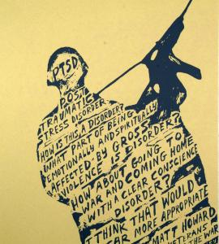
Recognizing PTSD & TBI

Slide 31
PTSD and mild TBI symptoms
PTSD
Insomnia
Memory Problems
Poor concentration
Depression
Anxiety
Irritability
Emotional numbing
Avoidance
Intrusive symptoms
TBI
Insomnia
Memory Problems
Poor concentration
Depression
Anxiety
Irritability
Headache
Dizziness
Fatigue
Noise/Light intolerance

Slide 32

Police Contacts with Returning Veterans

Slide 33
The most frequent acts that may bring some veterans in contact with police may include the following:
Domestic disputes or complaints of family abuse – due to stress within the household/failure to adjust to being home.
Disputes with others
Traffic stops as a result of aggressive/reckless driving: Some veterans who drove in convoys may find themselves inadvertently speeding, down the middle of the road, and failing to stop at stop signs and traffic signals.
Suicidal or other types of mental health crisis: i.e: barricaded subject

Slide 34

Legal Problems: Specific Causal Factors

Slide 35
Changes in Cognition
Flashbacks: survivors might commit an aggressive or criminal act believing they are in danger
Perceived threat: Worldview and belief marked by themes of danger and mistrust may increase likelihood of aggression
Beliefs about justice:
Belief in need for vigilantism in order to remedy perceived wrongdoing
Disregard for authority or indifference to the law because of prior perceived and/or actual abuse by authority figures

Slide 36
Heightened Arousal
Triggering of the “fight” instinct may lead to violence
Hyper vigilance may be severe enough to represent paranoia, prompting a person to take defensive actions
Exaggerated startled response may prompt instinctive or impulsive actions when a person feels threatened

Slide 37
Emotional Reactivity
Heightened distress may interfere with ability to make well-reasoned responses
Guilt may lead survivors to commit acts likely to result in punishment or death
Numbing may prompt criminal behavior because the individual has:
Diminished empathy for the victim
Difficulty feeling remorse
Difficulty appreciating the severity of consequences of behavior
Numbing can also prompt sensation-seeking behavior

Slide 38
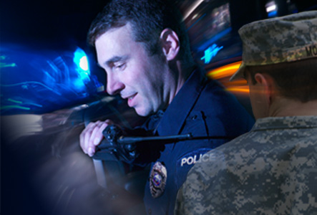
Law Enforcement: Effective Responses to PTSD and TBI

Slide 39
Gather Information
Notice possible signs of PTSD and TBI
IF SAFE, ask if person is a veteran or in the military
Follow-up questions: branch of military, where they did basic training, if/where they deployed
Minimize distractions
Go to quiet protected area if possible to minimize hyper vigilance
Undivided attention
To counter problems with concentration

Slide 40
Communicate Effectively
Speak in a calm, matter of fact voice(word, voice, and body)
Loud voices can be a trigger
May need to repeat questions or requests
Veteran may be having trouble processing due to flashback, trigger, etc.
Allow for silence (if appropriate)
Use active listening skills
Reassure the person that everything is okay and that they are safe
Explain any police procedures you may have to make, prior to making them and make sure the person understands what you are about to do.
Remind the person of his or her current location and situation.

Slide 41
Remember…
PTSD and TBI is not a “get out of jail free card”
The key lies in opening the lines of communication with soldiers in crisis and expressing a willingness to listen to their stories.
War changes people in ways still not fully comprehended
Warriors want to be treated with respect, and they have little tolerance for half-truths or disingenuous talk
Thank the Veteran for his or her service

Slide 42
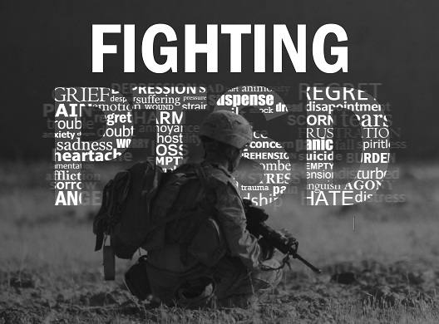
PTSD and TBI: Resources for Help

Slide 43
Treatment for PTSD and TBI
Good treatments are available: Please recommend help when veterans need it!
PTSD: Vet Centers (DC & Alexandria) & DC VA Medical Center are experienced in treating combat-related PTSD
TBI: Polytrauma Services at DC VA Hospital provides neuropsychology, physical therapy, occupational therapy, speech therapy and various other therapies to help veterans recover

Slide 44
Vet Center Information
FREE: No co-pay for services
Walk-ins are welcome
Confidential
Two male counselors (Veterans), two female counselors (1 Veteran and 1 Civilian) & one Outreach Worker
Location: 6940 S. Kings HWY, Suite 204
Alexandria, VA 22310
Phone: 703-360-8633
http://www.vetcenter.va.gov/

Slide 45
Veterans Justice Outreach
Purpose of program
Avoid unnecessary criminalization of mental illness and extended incarceration among Veterans by ensuring that eligible Veterans in contact with the criminal justice system have access to Veterans Health Administration mental health and substance abuse services.
POC:
Washington DC VA Medical Center
Karen Carrington
http://www.justiceforvets.org/

Slide 46
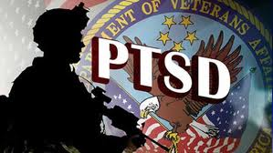
?

Slide 47


Slide 48
An Iraq Veteran’s Personal Account Michael Hemingway

