Slide 1

CIT and Veteran Soldiers Returning from War

Slide 2
Overview
Discuss Iraq/Afghanistan veteran profile
Review Historical Perspectives of PTSD
Discuss pathologies of combat:
- Incidence of Disorders
- Post Traumatic Stress Disorder (PTSD)
- Mild Traumatic Brain Injury (mTBI)
Provide insight into dealing with academic challenges facing the combat veteran population.
Apply practical learning techniques and solutions to common learning difficulties with combat veterans

Slide 3
Iraq/Afghanistan Veteran Profile
Gender: 85% male; 15%female.
Military service: 40% of those deployed are National Guard/Reserve.
Age: “older population”.
Since October 2001 >1.74 million men and women deployed to Iraq and Afghanistan; 280,000 re-deployed.
89% reported being ambushed or attacked.
93% reported being shot at.
86% reported knowing someone who was seriously injured or killed.
(NCPTSD 2008)

Slide 4
Mental Health Problems Plague Returning Veterans
One in three Iraq veterans have suffered from Post Traumatic Stress Disorder, (PTSD) major depression or generalized anxiety.
One in six Afghanistan veterans have suffered from PTSD, major depression or generalized anxiety.
Many unreported cases due to stigma perceived

Slide 5
Incidence of
PTSD in the Veteran population
About 30% of men and women who have been in a war zone experience Post Traumatic Stress Disorder.
More than half of all male Vietnam veterans, and just under half of Vietnam female veterans have experienced clinically serious stress reaction symptoms.
Gulf War estimates are as high as 8%.
General population: prevalence of PTSD is 4-6%; 10% will have clinically diagnosable PTSD sometime in their lives.

Slide 6
Contributing Factors
Combat troops live 24/7 with terror for undetermined length of deployment
Warfare specialty vs. “support” personnel, all troops are at risk
Rules of engagement different in urban warfare/unable to identify enemy from “innocent” bystanders

Slide 7
Contributing Factors
Deployment extensions
Poor nourishment/water shortage
Austere living conditions
Issues from the home front
Pre-existing mental health issues not addressed
Being shot at/shooting another human being

Slide 8

What is
Post Traumatic Stress Disorder?
Post Traumatic Stress Disorder (PTSD) is a debilitating condition that can occur after exposure to a terrifying event or ordeal in which grave physical harm occurred or was threatened.

Slide 9
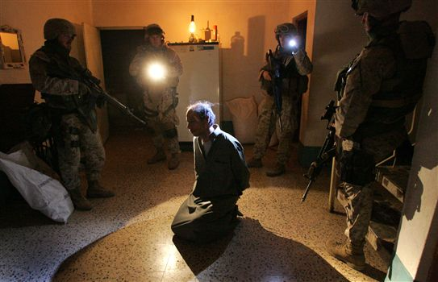
“PTSD is the inability to flip the switch from combat soldier to every day citizen to stop reliving the war at so high a frequency that it interferes with the ability to function.”
Betsy Streisand
U.S. News & World Report, Oct. 2006

Slide 10
PTSD:
Three Defining Symptoms
Spontaneous re-experiencing or reliving of event (flashbacks or hallucinations), intrusive memories, nightmares

Slide 11
PTSD:
Three Defining Symptoms
Acts as though danger is still present: Increased irritability, anger, difficulty sleeping, startles easy, hyper-arousal, misinterprets other’s intentions or actions as aggressive or dangerous, on the lookout for danger, hyper-vigilance

Slide 12
PTSD:
Three Defining Symptoms
Avoidance behavior (activities/situations/people/ conversations avoided which are associated with the trauma), difficulty remembering important details of event, thinks he/she has no future or that his/her lifespan may be shortened

Slide 13
Signs and Symptoms of
PTSD
Social impairment, detachment, loss of interest
Memory deficits
Concentration difficulty
Numbing, referred to as “a freezing of the heart”
“Hundred mile stare”
Anger outbursts
Feelings of intense guilt
Recurrent dreams/nightmares/frightening thoughts
Sleep disorders

Slide 14
Physical Changes Found In
PTSD
Elevated levels of stress hormones such as noradrenalin and adrenaline
Hyperactive sympathetic nervous systems; exaggerated increases in heart rate and blood pressure.
Reduction in the volume of the hippocampus
and amygdale region of the brain (emotions, learning and memory).
Alteration in brain processes.

Slide 15
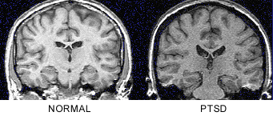
MRI View of
Post Traumatic Stress Disorder

Slide 16
What is Traumatic Brain Injury (TBI)?
Traumatic Brain Injury (TBI) is caused by a blow or jolt to the head or a penetrating head injury that disrupts the function of the brain.
Caused by external physical force to the head
The severity of injury to the brain ranges from mild and undetected, to severe and life threatening.
(DVBIC/CBHCO 2006

Slide 17
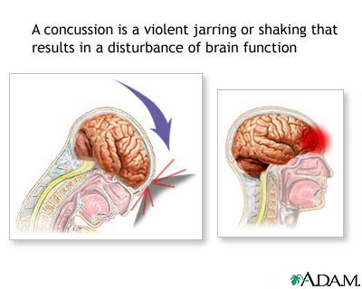

Slide 18
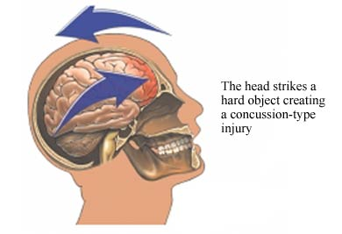

Slide 19
Mild Traumatic Brain Injury
(mTBI)
A “concussion” which results from a blow to the head and causes the brain to strike the skull
No structural damage to the brain
Occurs with or without loss of consciousness
Acceleration-deceleration injury
“Shaken Soldier” Syndrome
Closed head injury may be missed when more visible injuries require immediate attention.
mTBI may go undetected for several years.

Slide 20
Mild Traumatic Brain Injury mTBI
The “signature” injury/disability from current war.
In the war zone, the injury is caused by the sudden explosion from Improvised Explosive Devices (IED), Rocket-Propelled Grenades (RPG), land mines, roadside bombs.
Many have been exposed to six and as many as 20 bomb blasts.
15% of all wounded veterans have struggled with TBI

Slide 21
Combat Mechanism of Injury mTBI
Iraq characterized by different kind of weaponry: explosive munitions.
Blasts from IEDs and RPGs cause “over pressurization waves” upon detonation.
Understanding the complexity of this injury is critical to helping our troops achieve optimal transition.

Slide 22
Signs and Symptoms of mTBI
Mild Traumatic Brain Injury
Insomnia/sleep problems
Impaired memory
Poor concentration/attention
Depression
Anxiety
Irritability/mood changes
Headache
Dizziness/Imbalance
Excessive Fatigue: physical and mental
Noise/light intolerance
Ringing in the ears (tinnitus)
Vision change: blurred or vision

Slide 23
mTBI vs. PTSD:
Overlapping Signs and Symptoms
Mild Traumatic Brain Injury
Insomnia/sleep problems
Impaired memory
Poor concentration/attention
Depression
Anxiety
Irritability/mood changes
Headache
Dizziness/Imbalance
Excessive Fatigue: physical and mental
Noise/light intolerance
Ringing in the ears (tinnitus)
Vision change: blurred or double
Post Traumatic Stress Disorder
Insomnia/sleep problems
Impaired Memory
Poor concentration/attention
Depression
Anxiety
Irritability/mood changes
Stress symptoms
Emotional numbing/100 mile stare
Avoidance
* Diagnosis made through troop history/witnesses'’ account

Slide 24
Incidence of mTBI?
Estimated that 1 in 5 returning troops may have brain injury; (1 in 10 sustained a concussion or more in 2006)
20% of U.S. troops are coming home with S&S of mTBI, and are unaware
Why the increase in incidence?
Technological advances in battlefield gear, reduces deaths, increases severity of injuries to head and limbs.
Modern military medicine allows for life-saving trauma care in the war zone with immediate transport to definitive care and rehabilitation.

Slide 25
Obstacles to Treatment of PTSD and mTBI
Over forty percent of those experiencing mental health
problems associated with combat refuse treatment due
to fear that treatment will:
- hurt their image
- ruin their military careers/promotions
- cause negative perception from peers, family
and leadership
- limit civilian career opportunities

Slide 26
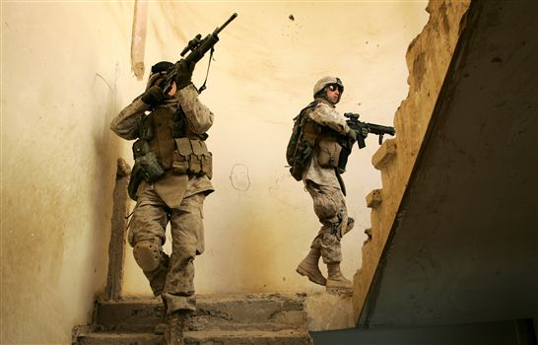
What type of Mental Health issues are our Veterans Returning
With

Slide 27
Better Trained - Knowledge of Weapons - Hand to Hand
Combat – Actual Combat Experience
The New York Times found 121 cases in which veterans of Iraq and Afghanistan committed a killing in this country, or were charged with one, after their return from war. In many of those cases, combat trauma and the stress of deployment ﾑ along with alcohol abuse,

Slide 28
Suicide in the veteran population
Male veterans are twice as likely as civilians of either gender to commit suicide
1000 suicides occur per year among veterans receiving VA care
5000 suicides occur per year among all living veterans

Slide 29
What do the statistics mean?
Veterans may be at higher risk for suicide.
We need to do more to reduce risk.
Suicides are preventable in most cases.

Slide 30
Tips for encouraging treatment:
Explain that there are trained professionals available
to help them.
Explain that treatment works.
Explain that getting help for this kind of problem is no
different than seeing a specialist for other medical
problems.
Tell them that getting treatment is his or her
right.
If they tell you that they have had treatment
before and it has not worked, try asking: “What if
this is the time it does work?”

Slide 31
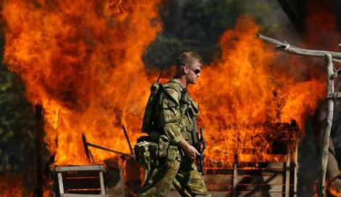
PTSD healing process must have balance
"PTSD is what we call the gift that keeps on giving. It impacts not just you, but your spouse and kids in the years to come. If you die, it's not contagious. If you lose a leg, your kids can't catch it. You come home with a load of mental baggage; it can pass on across the generations.”
Lt. Colonel Dave Grossman

Slide 32
Left unchecked, PTSD can worsen over time, but the vast majority of veterans begin losing PTSD after the first three months or so of returning home. Most veterans eventually return to normal and through a concept called Post Traumatic Growth.

Slide 33
