Slide 1
Addictive Diseases
State of Georgia
Crisis Intervention Team Training Program

Slide 2
A LIFE
SIGNIFICANT OTHER
FAMILY
HOBBIES
SPIRITUAL
FUTURE GOALS
SPORTS
LAUNDRY
WORK
SCHOOL
FRIENDS
COMMUNITY
LOAFING
EATING
HOME CARE
CHURCH
$ MANAGEMENT

Slide 3
A LIFE including alcohol and drug use
FAMILY
SIGNIFICANT OTHER
HOBBIES
SPIRITUAL GROWTH
PARTY!
DRINK & DRUGS
SPORTS
FUTURE GOALS
SCHOOL
LAUNDRY
FRIENDS
WORK
LOAFING
EATING
HOME CARE
$ MANAGEMENT
COMMUNITY
CHURCH

Slide 4
A LIFE including alcohol and drug abuse
SIGNIFICANT OTHER
LEGAL PROBLEMS
FAMILY
FUTURE GOALS
CHURCH
PARTY!DRINK & DRUGS
SCHOOL
SPORTS
HOME CARE
LAUNDRY
FRIENDS
HOBBIES
LOAFING
TROUBLE
WORK
EATING
SPIRITUAL GROWTH
COMMUNITY
$$ MANAGEMENT

Slide 5
A LIFE including drug and alcohol addiction
SPIRITUAL GROWTH
SPORTS
SCHOOL
HOPELESSNESS
LEGAL TROUBLE
DRUGS/
ALCOHOL
HOBBIES
LAUNDRY
DEPRESSION
FRIENDS
SICK
JOB PROBLEMS
CHURCH
COMMUNITY
FAMILY
$$ MANAGEMENT
SIGNIFICANT OTHER
HOME CARE
EATING
FUTURE GOALS

Slide 6
Definition of Addiction:
Chronic neglect of SELF
in favor of something or someone else.
~Stephanie Covington

Slide 7
Addiction Has Many Faces
Not all addicted persons are homeless or living in a “crack” house
Some addicts appear to be functional, but with a closer look substances are still a problem

Slide 8
Addiction
Addiction is a brain disease
Addiction is a primary, progressive, fatal illness.
A chronic disorder requiring multiple strategies and multiple episodes of intervention
Treatment works in the long-run
Treatment is cost-effective
Notes:
Slide Source: Peter Banys, M.D., Assoc. Clinical Prof. of Psychiatry, University of California at San Francisco, VA Medical Center, San Francisco.

Slide 9
Progression of Abuse to Addiction
Stage One- Experimenting
Stage Two- Seeking a Mood Swing
Stage Three- Preoccupation
Stage Four- Powerlessness/Addiction
Notes:
A novice individual is usually influenced by peers, and experiments with certain expectations of drug effect. The individual finds that a drug creates an effect, or that it may reduce internal discomfort.
Objectives 4 and 5

Slide 10
4 Cs of Addiction
Loss of Consistent Control over use
Compulsivity or Craving
Constantly thinking about addictive substance or process
Continued use in the face of adverse consequences
Notes:
30
28
34

Slide 11
Addiction Is Not What You Think
Drug use and behavior are reinforcing or rewarding
Reward pathway permanently altered
Engaging in compulsive behavior
Even when there are negative consequences
Loss of control in limiting intake
Craving: conscious and unconscious
Disease of the brain

Slide 12
Why do people take drugs?
They change the brain!!!
For the brain effects of drug use:
Reinforcement (“feel good” qualities)
Pleasure
Avoid negative feelings
Stop withdrawal
Try to restore normal brain function

Slide 13
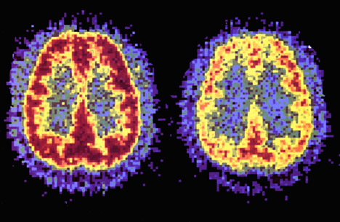
Addiction is a Brain Disease
Prolonged Use Changes
the Brain
in Fundamental and Lasting Ways
“Healthy” Brain
“Cocaine Addict” Brain
Notes:
FACULTY NOTE: (from NIDA teaching instructions – you may use this narrative text as a guide, but it does not need to be repeated word for word)
Positron emission tomography (PET) scan of a person on cocaine Cocaine has other actions in the brain in addition to activating reward. Scientists can now see how cocaine actually affects brain function in people. The PET scan allows us to see how the brain uses glucose; glucose provides energy to each neuron so it can perform work. The scans show where the cocaine interferes with the brain's use of glucose - or its metabolic activity. The left scan is taken from a normal, awake person. The red color shows the highest level of glucose utilization (yellow represents less utilization and blue shows the least). The right scan is taken from a cocaine abuser on cocaine. It shows that the brain cannot use glucose nearly as effectively – point out the loss of red compared to the left scan. There are many areas of the brain that have reduced metabolic activity. The continued reduction in the neurons' ability to use glucose (energy) results in disruption of many brain functions.
Image Source: National Institute on Drug Abuse (NIDA) Teaching Packet No. 5: “Bringing the Power of Science to Bear on Drug Abuse and Addiction” http://www.nida.nih.gov/pubs/teaching/Teaching5/Teaching3.html
Slide Source: Steve Hanson, MSEd Director, John L. Norris ATC New York State Office of Alcoholism and Substance Abuse Services
Instructions Source: National Institute on Drug Abuse (NIDA) Teaching Packet No. 2: “The Brain & the Actions of Cocaine, Opiates, and Marijuana” http://www.nida.nih.gov/pubs/teaching/Teaching4.html

Slide 14
How Does the Brain Work?
Through changes in the cells within the brain
Changes in brain cell activity and chemistry are produced by:
EXTERNAL environmental stimuli (e.g., putting hand on a hot stove)
INTERNAL biochemical stimuli (e.g., biological and behavioral changes produced by psychoactive drugs)

Slide 15
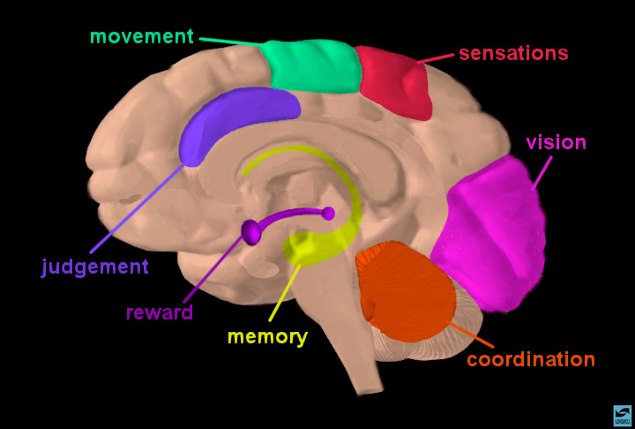
Brain Regions and Their Functions
Notes:
Brain Regions and Their Functions
Certain parts of the brain govern specific functions. For example, the cerebellum is involved with coordination; the hippocampus with memory. Nerve cells (neurons) are the basic unit of communication in the brain. Information is relayed from one area of the brain to other areas through complex circuits of interconnected neurons. Information via electrical impulses transmitted from one nueron to many others is done through a process called “neurotransmission.”

Slide 16
What Is the Relationship Between the Brain and Behavior?
Alterations of brain chemistry and/or structure can change:
Speech
Thinking and awareness
Emotions
Behavior, movement
Sensation (the 5 Senses)
Memory storage

Slide 17
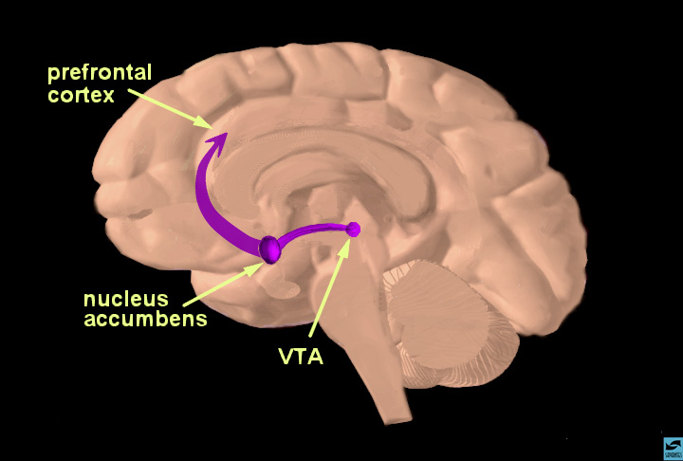
Brain Reward Pathways
Notes:
FACULTY NOTE: (from NIDA teaching instructions - you may use this narrative text as a guide, but it does not need to be repeated word for word)
Tell your audience that this is a view of the brain cut down the middle. An important part of the reward pathway is shown, and the major structures are highlighted: the ventral tegmental area (VTA), the nucleus accumbens and the prefrontal cortex. The VTA is connected to both the nucleus accumbens and the prefrontal cortex via this pathway and sends information to these structures via its neurons. The neurons of the VTA contain the neurotransmitter dopamine, which is released in the nucleus accumbens and in the prefrontal cortex (point to each of these structures). Reiterate that this pathway is activated by a rewarding stimulus. [Note: the pathway shown here is not the only pathway activated by rewards; other structures are involved too, but only this part of the pathway is shown for simplicity.]
Source: National Institute on Drug Abuse (NIDA) Teaching Packet No. 2: “The Neurobiology of Drug Addiction” http://www.nida.nih.gov/Teaching2/Teaching3.html

Slide 18
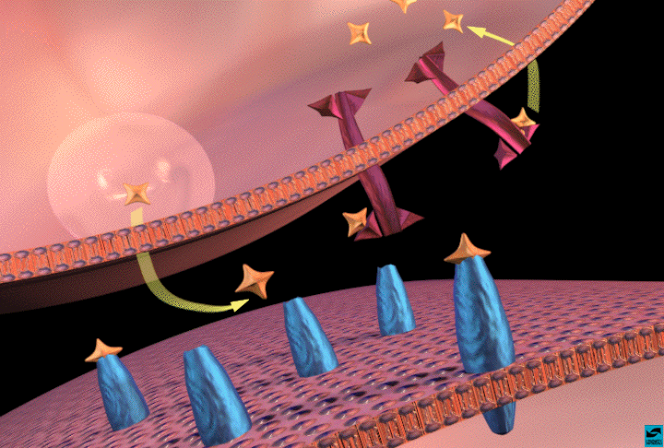
Dopamine Spells REWARD
Release
Recycle
Activate
Notes:
SLIDE ANIMATION NOTE: Slide initially loads without wording on the image. At approximately one-second intervals, the words “release,” “activate,” and “recycle” appear onscreen. You may wish to coordinate a brief introductory overview explanation with the animation and then expand on the explanation after the slide is complete.
FACULTY NOTE: (from NIDA teaching instructions – you may use this narrative text as a guide, but it does not need to be repeated word for word)
Explain that drugs concentrate in areas of the brain that are rich in dopamine synapses. Review dopamine transmission in the nucleus accumbens. Point to dopamine in the synapse and to dopamine bound to dopamine receptors and to uptake pumps on the terminal.
When drugs (cocaine is the drug in this example) are present in the synapse, they (represented in turquoise) bind to the uptake pumps and prevent them from removing dopamine from the synapse. This results in more dopamine in the synapse, and more dopamine receptors are activated. This causes many changes inside the cell that lead to abnormal firing patterns.
As a result, there are increased impulses leaving the nucleus accumbens to activate the reward system. With continued use of drugs (cocaine), the body relies on the drug to maintain rewarding feelings. The person is no longer able to feel the positive reinforcement or pleasurable feelings of natural rewards.
Source: National Institute on Drug Abuse (NIDA) Teaching Packet No. 1: “The Brain & the Actions of Cocaine, Opiates, and Marijuana
http://www.nida.nih.gov/pubs/teaching/Teaching4.html

Slide 19
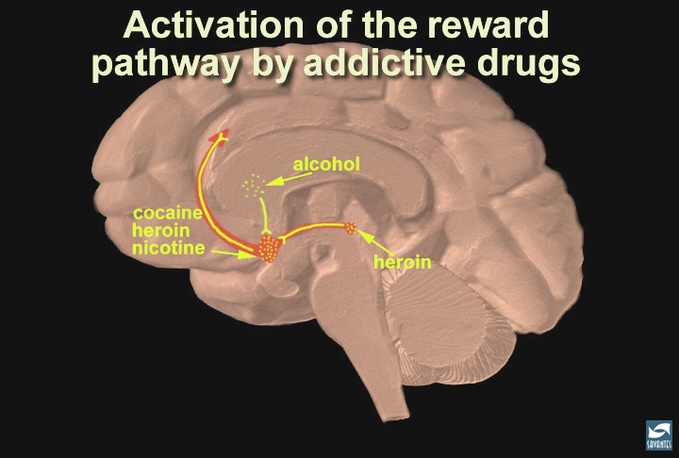
Activation of Reward
Notes:
FACULTY NOTE: (from NIDA teaching instructions – you may use this narrative text as a guide, but it does not need to be repeated word for word)
Summary: addictive drugs activate the reward system via increasing dopamine neurotransmission. In this slide, the reward pathway is shown along with several drugs that have addictive potential. Just as heroin (morphine) and cocaine activate the reward pathway in the VTA and nucleus accumbens, other drugs such as nicotine and alcohol activate this pathway as well, although sometimes indirectly (point to the globus pallidus, an area activated by alcohol that connects to the reward pathway). While each drug has a different mechanism of action, each drug increases the activity of the reward pathway by increasing dopamine transmission. Because of the way our brains are designed, and because these drugs activate this particular brain pathway for reward, they have the ability to be abused. Thus, addiction is truly a disease of the brain. As scientists learn more about this disease, they may help to find an effective treatment strategy for the recovering addict.
Source: National Institute on Drug Abuse (NIDA) Teaching Packet No. 2: “The Neurobiology of Drug Addiction” http://www.nida.nih.gov/Teaching2/Teaching5.html

Slide 20
Addiction as a Brain Disease
The brain of an addicted person is changed and does not function normally
Major differences between the addicted vs. non-addicted brain
metabolic activity
receptor availability
genetic expression
responsiveness to drugs
Notes:
24

Slide 21
The Disease of Addiction
Primary
Progressive
Chronic
Relapsing
Treatable
NOT curable, but you can recover

Slide 22
Substance Abuse
Is defined as: Continued use despite negative consequences as a result of use.
This stage of drug abuse is voluntary, preventable behavior.
Impacts relationships and obligations
Places self in hazardous situations
Recurrent legal problems
Notes:
Substance Abuse is defined as continued use or abuse of a substance despite negative consequences as a result of using. This stage of drug abuse is voluntary, preventable behavior.
Objective 4

Slide 23
Substance Dependence
Tolerance (need more or diminished effect)
Withdrawal (psychological and physiological problems from stopping use)
Unsuccessful efforts to cut down
Significant time and energy spent craving, obtaining or using substances
Impacts relationships and obligations
Use even with negative health consequences

Slide 24
Substance Dependence is a Brain Disease
Addicts have lost control over their drug use because of how the drugs have changed their brain chemistry
Compulsion to use is psychologically and physiologically driven
Notes:
Why Do Addicts Lose Control Over Their Use?
Although the onset of addiction begins with the voluntary act of taking drugs, the continued repetition of voluntary drug taking begins to change into involuntary drug taking, ultimately to the point that the behavior is driven by a compulsive craving for the drug. . Most individuals with addictions experience an uncontrollable compulsion to seek and use drugs.
This compulsion results from a combination of factors, including in large part, the dramatic changes in brain function produced by prolonged drug use. Addicts have lost control over their drug use because of how the drugs have changed their brain chemistry. Scientists describe addiction as a biological brain disease that is chronic and relapsing in nature.
People use drugs because they like what the drugs do to their brain chemistry. Once a person becomes addicted to a drug, that drug causes the brain to release “feel good” chemicals that reward a person for continuing to use a drug. All drugs of abuse go to one part of the brain called the “pleasure pathway.” Drugs hijack the naturally occurring reward system and interfere with the stimulation and release of dopamine, causing large amounts to be released over a short period of time.
Additionally, brain chemistry changes occur that cause a person to feel uncomfortable and unhappy when they are not using. Consequently, addicts who began to use drugs to feel good now use drugs to feel normal.
Objective 6

Slide 25
Addiction Risk Factors
Genetics
Young Age of Onset
Childhood Trauma (violent, sexual)
Learning Disorders (ADD/ADHD)
Mental Illness
Depression
Bipolar Disorder
Psychosis

Slide 26
Cognitive Deficits
Impaired attention
Memory problems – short-term loss
Impaired abstraction
Reduced problem-solving abilities
Loss of impulse control
Similar performance to those with brain damage
Notes:
Slide Source: Steve Hanson, MSEd, Director, John L. Norris ATC, New York State Office of Alcoholism and Substance Abuse Services and Peter Banys, M.D., Assoc. Clinical Prof. of Psychiatry, University of California at San Francisco, VA Medical Center, San Francisco.

Slide 27
Common Characteristics of Addicts
Unemployment
Multiple criminal justice contacts
Difficulty coping with stress or anger
Highly influenced by social peer group
Difficulty handling high-risk relapse situations
Notes:
Slide Source: “Responding to Substance Abuse: The Role We All Play,” The Substance Abuse Leadership Team (SALT) of the Franklin County Courts Conference, SAMSHA Grant No. 4U98 T100 846 and Peter Banys, M.D., Assoc. Clinical Prof. of Psychiatry, University of California at San Francisco, VA Medical Center, San Francisco.

Slide 28
Common Characteristics…
Emotional and psychological immaturity
Difficulty relating to family
Difficulty sustaining long-term relationships
Educational and vocational deficits

Slide 29
Misconceptions about Addiction What is it?
The DRUGS are the problem.
It’s SINFUL or a MORAL weakness
It shows a lack of WILLPOWER
It’s a LEARNED behavior
It’s “just” a STRESS response
It’s “just” due to an untreated PSYCHOLOGICAL problem

Slide 30
What is a Psychoactive Drug?
Drugs are Therapeutic chemicals
designed to have maximal benefit
with minimal risk of side effects or toxicity
Psychoactive Drugs change:
The Functioning of the Brain
Thinking
Behavior
Emotions
Sensation
Notes:
Drug use is as old as recorded history; nothing new!!
Alcohol (mead) was popular in the Paleolithic age (8000 B.C.)
Opium was used in Sumeria (4000 B.C.)
Marijuana known in China (2737 B.C.)

Slide 31
Classification of Psychoactive Drugs
Stimulants – cocaine, amphetamine, methamphetamine, caffeine
Nicotine
Psychotherapeutics – Prozac, Haldol, lithium
Opiates – morphine, codeine, heroin, methadone
Depressants – alcohol, barbiturates, inhalants, sleeping pills

Slide 32
Psychotherapeutic Drugs
Are used to restore mental health
Developed recently, beginning in the 1950s
Allow patients to resume normal lives
Some are potentially addicting and disrupt function
E.g., antianxiety drugs (Valium, Xanax and others) and sedatives (Seconal, Soma)
Most are Non-addicting:
antidepressants (Prozac, Zoloft, Paxil, Celexa, Effexor)
antipsychotics (Risperdal, Seroquel, Zyprexa, Haldol)
anticonvulsants (Depakote, Tegretol, Trileptal, Topamax)
and others

Slide 33
Definition of Alcoholism JAMA, 1992
Alcoholism is a primary, chronic disease
with genetic, psychosocial, and environmental factors influencing its development and manifestations.
The disease is often progressive and fatal.
It is characterized by continuous or periodic:
impaired control over drinking,
preoccupation with the drug alcohol,
use of alcohol despite adverse consequences,
and distortions in thinking, most notably denial.

Slide 34
Alcohol Use Disorders are Common in U.S.
14 million adults currently have an alcohol use disorder (11 million had disorders in the past or are in recovery)
1.8 million of those receive treatment
>50% of adults have immediate family member with AUD (RWJF 2001)
Percent of adults with...
Notes:
14 million, or 13% of adults have an AUD (AA/AD). An additional 11 million are in recovery. Only 1.8 million receive treatment.
According to a report released last month by the Robert Wood Johnson Foundation, >50% of adults have an immediate family member with an AUD. It also points out that combining nicotine, drug and alcohol abuse and dependence, substance abuse is the nation’s number one health problem
Last but not least, alcoholism is as common as many other medical conditions we care for as internists, such as arthritis, HTN and asthma.

Slide 35
What Drugs are Addicting? Drugs of Abuse and Dependence
Caffeine
Nicotine
Alcohol
Cannabis
Cocaine
Hallucinogens
Inhalants
Opioids
Amphetamines
Sedative-Hypnotics and Anxiolytics
PCP
Notes:
24
22
Drugs can affect almost every step in the communication between neurons. For example, drugs may bind to receptors in place of neurotransmitters, block neurotransmitters from entering or leaving neurons, or stop the chemical reactions that create neurotransmitters.

Slide 36
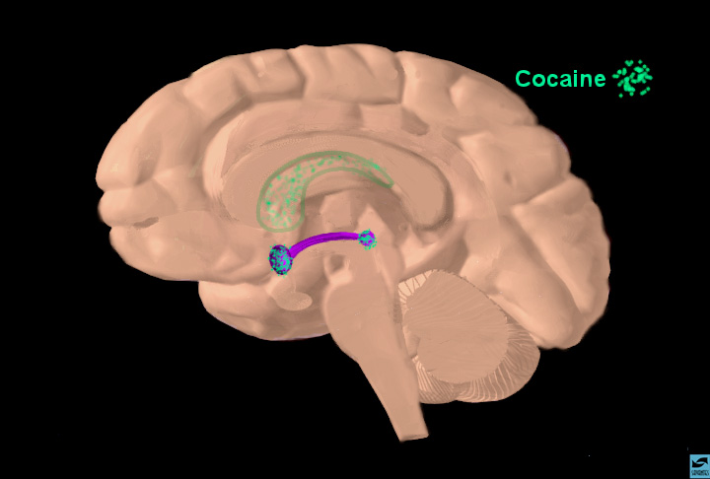
Where Cocaine Has Its Effects in the Brain
Notes:
Where Cocaine Has Its Effects in the Brain
Using cocaine as an example, we can describe how drugs interfere with brain functioning. When a person snorts, smokes, or injects cocaine, it travels to the brain via the bloodstream. Although it reaches all areas of the brain, its euphoric effects are mediated in a few specific areas, especially those associated with the reward pathway discussed in the previous slide.

Slide 37
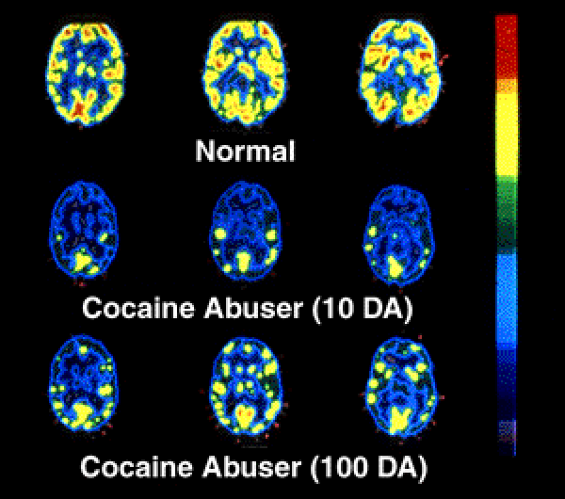
Notes:
FACULTY NOTE: (from NIDA teaching instructions – you may use this narrative text as a guide, but it does not need to be repeated word for word)
Long-term effects of drug abuse. This PET scan shows us that once addicted to a drug like cocaine, the brain is affected for a long, long time. In other words, once addicted, the brain is literally changed. Let’s see how... In this slide, the level of brain function is indicated in yellow. The top row shows a normal-functioning brain without drugs. You can see a lot of brain activity. In other words, there is a lot of yellow color. The middle row shows a cocaine addict’s brain after 10 days without any cocaine use at all. What is happening here? [Pause for response.] Less yellow means less normal activity occurring in the brain - even after the cocaine abuser has abstained from the drug for 10 days. The third row shows the same addict’s brain after 100 days without any cocaine. We can see a little more yellow, so there is some improvement - more brain activity - at this point. But the addict’s brain is still not back to a normal level of functioning... more than 3 months later. Scientists are concerned that there may be areas in the brain that never fully recover from drug abuse and addiction.
Source: National Institute on Drug Abuse (NIDA) Teaching Packet No. 5: “Bringing the Power of Science to Bear on Drug Abuse and Addiction” http://www.nida.nih.gov/pubs/teaching/Teaching5/Teaching3.html

Slide 38
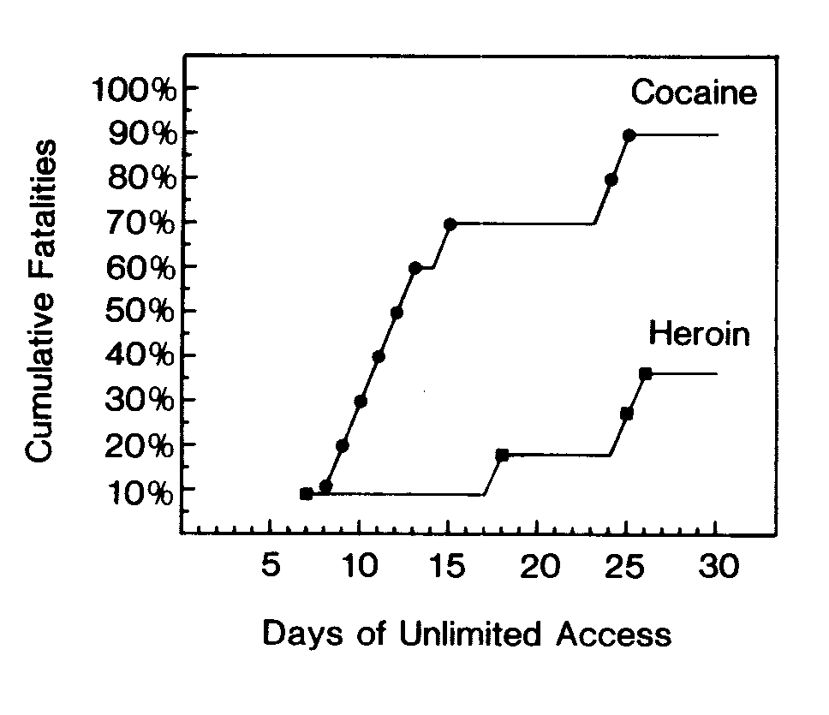
Laboratory Rats Will Self-Administer Cocaine
Until They Die
M.A. Bozarth and R.A. Wise (1985). Toxicity associated with long-term intravenous heroin and cocaine self-administration in the rat. Journal of the American Medical Association, 254, 81-83.
Notes:
Figure 3: Cumulative number of fatalities from intravenous cocaine hydrochloride and heroin hydrochloride self- administration during unlimited access to drug. Percentage of animals lost are depicted as function of days of continuous testing. Subject attrition due to catheter failure is not shown. Solid circles indicate deaths in cocaine group; solid squares, deaths in heroin group.
M.A. Bozarth and R.A. Wise (1985). Toxicity associated with long-term intravenous heroin and cocaine self-administration in the rat. Journal of the American Medical Association, 254, 81-83.
Toxicity Associated With Long-term Intravenous Heroin and Cocaine Self-Administration
in the Rat
Michael A. Bozarth & Roy A. Wise
Center for Studies in Behavioral Neurobiology
Department of Psychology
Concordia University
Montréal, P.Q. H3G 1M8 CANADA
Laboratory rats were given unlimited access to intravenous cocaine hydrochloride or heroin hydrochloride. Animals self-administering cocaine quickly developed a pattern of episodic drug intake, with periods of excessive cocaine self-administration alternating with brief periods of abstinence. Subjects allowed continuous access to intravenous heroin showed stable drug self-administration, with a gradual increase in daily heroin intake over the first two weeks of testing. The general health of the animals became markedly different: those self-administering heroin maintained grooming behavior, pretesting body weight, and a good state of general health; rats self-administering cocaine tended to cease grooming behavior, loose up to 47% of their pretesting body weight, and to show a pronounced deterioration in general health. The mortality rate for 30 days of continuous testing was 36% for animals self-administering heroin and 90% for those self-administering cocaine. These results suggest that cocaine is a much more toxic compound than heroin when animals are given unlimited access to intravenous drug.

Slide 39
TREATMENT WORKS!

Slide 40
Who needs treatment?
13 to 16 million Americans need treatment for alcohol and/or other drug abuse in any year
BUT…
Only 3 million receive care
Notes:
Slide Source: “Changing the Conversation,” Improving Substance Abuse Treatment: The National Treatment Plan Initiative, DHHS Pub. No. (SMA)00-3480 (2000) http://www.natxplan.org/news/vol2.pdf

Slide 41
National Institute on Drug Abuse (NIDA) Principles of Effective Treatment
No single treatment is appropriate for all individuals
Treatment needs to be readily available
Effective treatment attends to multiple needs of the individual, not just the drug use
An individual’s treatment and service plan must be assessed continually and modified as necessary to ensure that the plan meets the person’s needs

Slide 42
NIDA Principles or Effective Tx (cont’d.)
Remaining in treatment for an adequate period of time is critical for treatment effectiveness
Counseling and other behavioral therapies are critical components of effective treatment
Medications are an important element of treatment for many patients, esp. when combined with counseling or behavioral therapies
Addicted or drug-abusing individuals with co-existing mental disorders should have both disorders treated in an integrated way

Slide 43
NIDA Principles or Effective Tx (cont’d.)
Medical detoxification is only the first stage of addiction treatment and by itself does little to change long-term drug use
Treatment does not need to be voluntary to be effective
Possible drug use during treatment must be monitored continuously
Treatment programs should provide assessment for HIV/AIDS, Hepatitis B&C and other infectious diseases
Recovery from drug addiction can be a long-term process and frequently requires multiple episodes of treatment

Slide 44
Medical Detoxification
Detoxification safely manages the physical symptoms of withdrawal
Only first stage of addiction treatment
Alone, does little to change long-term drug use
Notes:
Medical Detoxification
Medical detoxification safely manages the acute physical symptoms of withdrawal associated with stopping drug use. However, medical detoxification is only the first stage of addiction treatment and by itself does little to change long-term drug use. While detoxification alone is rarely sufficient to help addicts achieve long-term abstinence, for some individuals it is a strongly indicated precursor to effective drug addiction treatment.

Slide 45
Medications for Drug Addiction
Alcohol and Benzodiazepines: Librium, Ativan, Phenobarbital (withdrawal is potentially fatal if left untreated)
Opiates: Buprenorphine, Methadone, LAAM, Naltrexone (withdrawal is uncomfortable, not life-threatening)
Nicotine: Patches, gum, buproprion, behavioral modification
Notes:
Medications for Drug Addiction
Medications are an important element of treatment for many patients, especially when combined with counseling and other behavioral therapies. Methadone and levo-alpha-acetylmethadol (LAAM) are very effective in helping individuals addicted to heroin or other opiates stabilize their lives and reduce their illicit drug use. Naltrexone is also an effective medication for some opiate addicts and some patients with co-occurring addiction to alcohol. For persons addicted to nicotine, a nicotine replacement product (such as patches or gum) or an oral medication (such as bupropion) can be an effective component of treatment. For patients with mental disorders, both behavioral treatments and medications can be critically important.

Slide 46
Motivation to Enter/ Sustain Treatment
Effective treatment need not be voluntary
Sanctions/enticements (family, employer, criminal justice system) can increase treatment entry/retention
Treatment outcomes are similar for those who enter treatment under legal pressure vs voluntary
Notes:
Motivation to Enter/Sustain Treatment
Treatment does not need to be voluntary to be effective. Strong motivation can facilitate the treatment process. Sanctions or enticements in the family, employment setting, or criminal justice system can increase significantly both treatment entry and retention rates and the success of drug treatment interventions. Individuals who enter treatment under legal pressure have outcomes as favorable as those who enter treatment voluntarily.

Slide 47
Effectiveness of Treatment
Goal of treatment is to return to productive functioning
Treatment reduced drug use by 40-60%
Treatment reduces crime by 40-60%
Treatment increases employment prospects by 40%
Drug treatment is as successful as treatment of diabetes, asthma, and hypertension
Notes:
Effectiveness of Treatment
According to several studies, drug treatment reduces drug use by 40 to 60 percent and significantly decreases criminal activity during and after treatment. For example, a study of therapeutic community treatment for drug offenders demonstrated that arrests for violent and nonviolent criminal acts were reduced by 40 percent or more. Methadone treatment has been shown to decrease criminal behavior by as much as 50 percent. Research shows that drug addiction treatment reduces the risk of HIV infection and that interventions to prevent HIV are much less costly than treating HIV-related illnesses. Treatment can improve the prospects for employment, with gains of up to 40 percent after treatment. (Note: Although these effectiveness rates hold in general, individual treatment outcomes depend on the extent and nature of the patient’s presenting problems, the appropriateness of the treatment components and related services used to address those problems, and the degree of active engagement of the patient in the treatment process.)

Slide 48
Self-Help and Drug Addiction Treatment
Complements and extends treatment efforts
Most commonly used models include 12-Step (AA, NA) and Smart Recovery
Most treatment programs encourage self-help participation during/after treatment
Notes:
Self-Help and Drug Addiction Treatment
Self-help groups can complement and extend the effects of professional drug addiction treatment. The most prominent self-help groups are those affiliated with Alcoholics Anonymous (AA), Narcotics Anonymous (NA), and Cocaine Anonymous (CA), all of which are based on the 12-step model and Smart Recovery. Most drug addiction treatment programs encourage patients to participate in a self-help group during and after formal treatment.

Slide 49
12-Step Programs
Alcoholics Anonymous
Narcotics Anonymous
Crystal Meth Anonymous
Gambling Anonymous
Al-Anon
Adult Children of Alcoholics (ACOA)
Double Trouble (dual diagnosis)

Slide 50
Cost-Effectiveness of Drug Treatment
Treatment is less expensive than not treating or incarceration (1 yr methadone maintenance = $4,700 vs. $18,400 for imprisonment)
Every $1 invested in treatment yields up to $7 in reduced crime-related costs
Savings can exceed costs by 12:1 when health care costs are included
Reduced interpersonal conflicts
Improved workplace productivity
Fewer drug-related accidents
Notes:
Cost Effectiveness of Drug Treatment
Drug addiction treatment is cost-effective in reducing drug use and its associated health and social costs. Treatment is less expensive than alternatives, such as not treating addicts or simply incarcerating addicts. For example, the average cost for 1 full year of methadone maintenance treatment is approximately $4,700 per patient, whereas 1 full year of imprisonment costs approximately $18,400 per person.
According to several conservative estimates, every $1 invested in addiction treatment programs yields a return of between $4 and $7 in reduced drug-related crime, criminal justice costs, and theft alone. When savings related to health care are included, total savings can exceed costs by a ration of 12 to 1. Major savings to the individual and society also come from significant drops in interpersonal conflicts, improvements in workplace productivity, and reductions in drug-related accidents.

Slide 51
If you treat an individual as he is he will stay as he is, but if you treat him as if he were what he ought to be and could be, he will become what he ought to be and could be. ~ Johann Wolfgang von Goethe

Slide 52
Presentation Prepared By:
Neil Kaltenecker, Director
Office of Addictive Diseases
Division of Mental Health, Developmental Disabilities, and Addictive Diseases
Georgia Department of Human Resources
Barbara D’Orio, MD, MPA
Associate Professor of Psychiatry
Emory University School of Medicine
Director of Adult Outpatient Psychiatric Services
Grady Health System

