Slide 1
Georgia CIT
Crisis Intervention Team

Slide 2
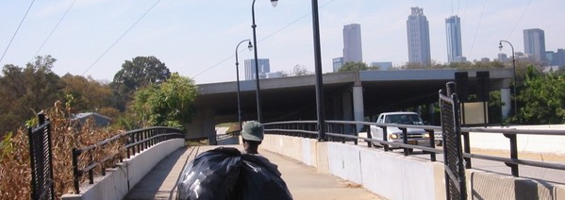
Georgia CIT Vision
Vision: | A Georgia where people with mental illness and other brain disorders are treated, not incarcerated

Slide 3

Georgia CIT Mission
Mission: Equip Georgia CIT Officers with the skills to assist people with mental illness and other brain disorders in crisis thereby advancing public safety and reducing stigma

Slide 4
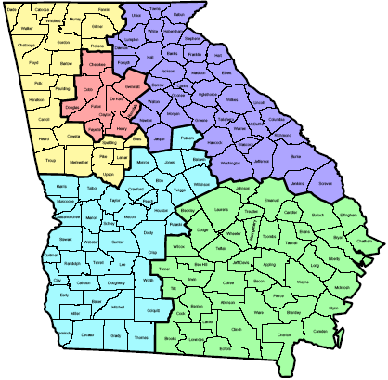
Statewide CIT Goal
Georgia Representatives(July 2004) Fulton County (December 2004) Cherokee County (February 2005) Fulton County (February/March 2005) Cobb County(March 2005) Barrow County (April 2005) Chatham County (May 2005) Dept of Corrections (June 2005)
GEORGIA
Goal: Certify 20% Georgia CIT Officers

Slide 5

Three-way Partnership
Law
Enforcement
& Public Safety
Community
MH/DD/AD
Providers
CIT

Slide 6
CIT Advisory Board
Law Enforcement | NAMI & Advocates | Community
Lt. Trudy Boyce, APD* Dir. Vernon Keenan, GBI Bill Kissel, Dept Corrections Harriett Lawrence, GPSTC Dr. Janet Oliva, GBI* Paul Maharry, Chiefs’ Assoc Tonya Welch, Sheriffs’ Assoc Ronnie Lane, GA DJJ | Lei Ellingson, Carter Center Nora Haynes, Dept of Ed* Dave Lushbaugh, NAMI* | Dr. Michael Compton, Emory* David Covington, Behavioral Health Link* Larry Fricks, DHR/Consumer Dir. Gwen Skinner, DHR DMHDDAD Dr. Keith Wood, Grady
CIT Steering Committee: Members denoted by * above plus the following: Don Daves, NAMI; Diane Reeder, NAMI; Mary Yoder, AADD

Slide 7
NAMI Family/Advocates
Crisis Intervention Team

Slide 8

Who/What is NAMI?
Family-based, grassroots, support and advocacy organization
We are the family members, treatment professionals and friends of persons with severe mental illness
We believe in recovery
We see mental illness and other brain disorders like any other disease, such as heart disease, diabetes or cancer

Slide 9

Police & Persons in Crisis
People with mental illnesses sometimes discontinue their medications. Other times they have never been to treatment.
The person may become agitated, experience psychosis or even feel suicidal.
When a crisis occurs, the police are often called to intervene.

Slide 10
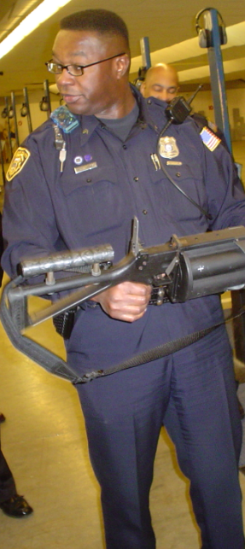
Memphis Model CIT
In 1987, an unarmed man with mental illness was shot and killed by Memphis police; a public outcry followed
In response, the Memphis PD and the local NAMI affiliate developed CIT (Crisis Intervention Team)

Slide 11
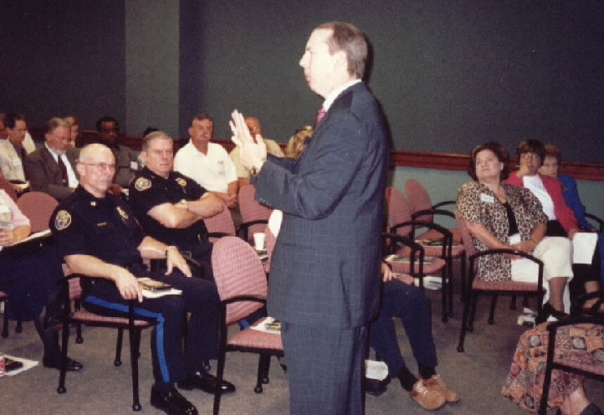
NAMI CIT Objectives
Whenever possible, ensure consumer receives treatment rather than jail
Avoid unnecessary force by ensuring the CIT officer recognizes a mental illness or other brain disorder
Ensure CIT officer has skills to de-escalate a person in crisis

Slide 12


Combating Stigma
Notice the differences in the way the media addresses a person with diabetes versus a person with mental illness.

Slide 13
Reducing Stigma
President’s New Freedom Commission
Report on Mental Health
Stigma motivates us to fear, reject, avoid, and discriminate against people with mental illnesses (common in US and Western nations)
Stigma leads others to avoid living, socializing, or working with, renting to, or employing people with mental illness, especially disorders like schizophrenia.
Stigma leads to low self-esteem, isolation, hopelessness.
Due to stigma, people with mental health problems may be ashamed, conceal symptoms or fail to seek treatment.

Slide 14
Law Enforcement
Crisis Intervention Team

Slide 15

All Volunteer Program
CIT are regular patrol officers who volunteered
Many CIT officers have family or friends with mental illness or other brain disorders
This program has to come from the heart

Slide 16


Immediate Response
911 dispatch identifies a call where a consumer with mental illness or other brain disorder is in crisis
The closest CIT officer is dispatched to the scene along with other law enforcement

Slide 17
Crisis Intervention
De-escalation Training
The CIT officer attempts from the beginning to use the consumer’s name
The CIT officer uses compassion, respect, listening skills and knowledge of crisis intervention stages
They explain the process to consumers and families

Slide 18
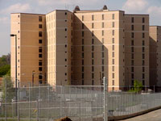
Positive CIT Outcomes
Decreased number of people with mental illness incarcerated
Decreased officer and consumer injuries
CIT officers become consumer advocates
Consumers more willing to call police for help

Slide 19
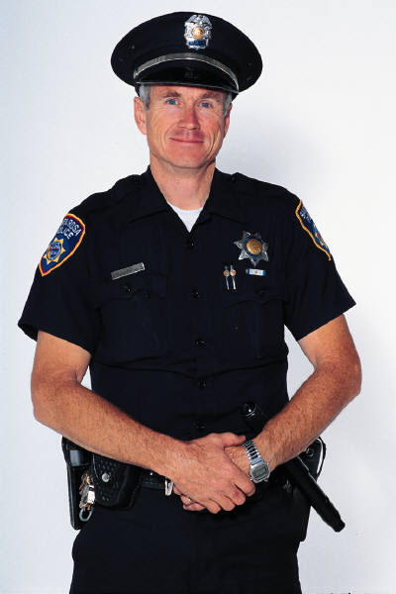

CIT Identification
Consumers can identify CIT officers by their Georgia Crisis Intervention Team pin
24/7 program
CIT officers are in charge upon arrival of the scene

Slide 20
Community Providers
Crisis Intervention Team

Slide 21
40-Hour CIT Curriculum
Monday | Tuesday | Wednesday | Thursday | Friday
Mental Illness and Other Brain Disorders | Site Visits/ Consumer Interaction | Mental Illness and Other Brain Disorders | De-escalation Skills | De-escalation Skills
Lunch | Lunch | Lunch | Lunch | Lunch
Mental Illness and Other Brain Disorders | Site Visits/ Consumer Interaction | De-escalation Skills | Mental Illness and Other Brain Disorders | Post-test & Graduation

Slide 22
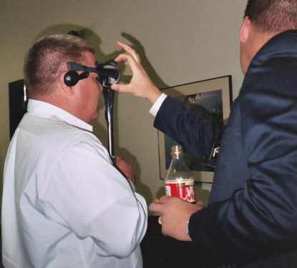
40-Hour CIT Curriculum
Volunteer experts from the community provide training
P.O.S.T. approved by the Georgia Peace Officer Standards and Training Council
Includes pre-test and post-test assessments

Slide 23
Community Services
“…the expectation that training by itself will resolve the issues of stigma is not realistic. Mere training is not enough to compensate when there is no infrastructure of services and care. To combat the devastating effects and trauma brought about by the stigma of mental illness requires a profound community outcry, joined with linkages to appropriate community service infrastructures” (Major Sam Cochran)

Slide 24

Emergency Receiving Site
15 Minutes to Drop Off Consumer for Evaluation

Slide 25

Single Point of Entry
SPOE
In Fulton/Clayton, professional counselors are available at 1-866-821-0465
24/7 psychiatric crisis line
Access and linkage to community services
Screening for intensive services, GRH/Atlanta, DeKalb Crisis, St. Jude’s & Newport Detox

Slide 26
Georgia CIT Summary
Crisis Intervention Team

Slide 27
New Freedom Commission
President’s Report on Mental Health
On April 29, 2002, the President identified three obstacles preventing Americans with mental illnesses from getting the excellent care they deserve:
  Stigma that surrounds mental illnesses,
  Unfair treatment limitations placed on mental health benefits in private health insurance, and
  The fragmented mental health service delivery system.

Slide 28



Georgia CIT Summary
Crisis Intervention Team
Connecting persons with mental illnesses and other brain disorders with treatment professionals

