Slide 1
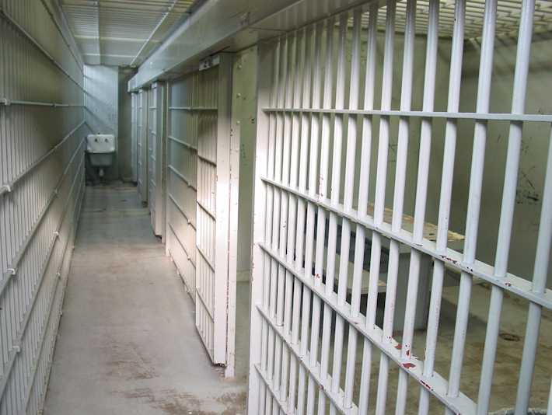
Jail
Diversion Programs

Slide 2

Persons with mental illness are more likely to come into contact with police
Minor offenses
More likely to be arrested if they live in communities with few intervention options for mental illness
Re-arrested more frequently
Does not mean that those with mental illnesses are inherently likely to be lawbreakers
Lack of support services increases the likelihood that they will behave in ways that bring them to the attention of LEOs

Slide 3
Officers often respond to “quality of life” crimes
(often seen in the homeless population with untreated MI)
petit larceny
aggressive panhandling
public urination
trespassing
public drinking/intoxication
Without more appropriate alternatives, LEOs are forced to arrest the subject and transport him/her to jail.

Slide 4
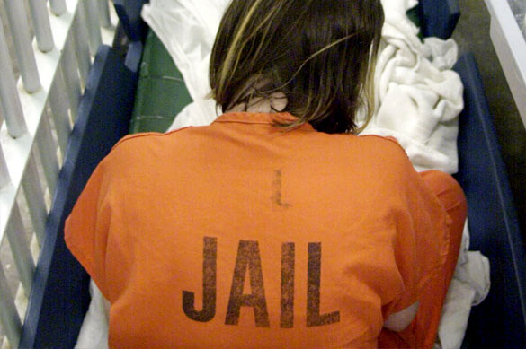
“Being thrown into the hostile world of the prisoner is almost certain to make any existing psychiatric condition worse”
~The American
Psychiatric
Association
(APA)
Notes:
The medications that the jail provides can change based on the budget. Sometimes they buy cheaper drugs that are not effective.

Slide 5

While they are imprisoned, many lose access to Medicare, Medicaid, and Social Security benefits
When they are released, many do not have assistance in re-applying for these entitlements.
Persons with mental illness are at high risk of
continuing to be untreated
remaining or becoming homeless
re-offending
making extensive use of costly emergency medical services
Those who commit the “nuisance” offenses may become involved in a cycle of arrest, short jail stays, and return to the streets without treatment only to commit more minor illegal acts that result in their re-arrest.

Slide 6
Cost of caring for inmates (per day):
Loudoun County $178.00
Arlington County $157.31
Fairfax County $150.90
Alexandria City $146.75
Prince William/Manassas Regional $114.60
Culpeper County $100.62
Fiscal 2010 Source: Commonwealth of Virginia Compensation Board
Notes:
Loudoun County $169.45-----Fairfax County $145.49---Alexandria City $135.10---Arlington County $133.94

Slide 7
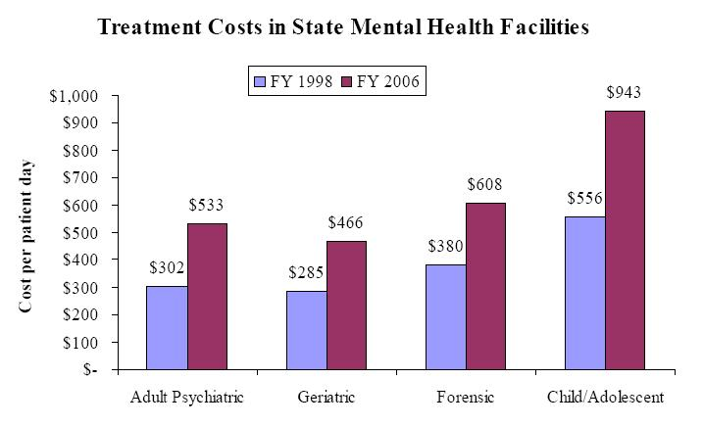
Notes:
I unfortunately do not have the updated costs. However, I assure you that these numbers will stay the same or increase. It is more expensive to treat the mentally ill, but that helps break the cycle of arrest.

Slide 8
Goals of Jail Diversion
Prevent inappropriate incarceration
Reduce jail time
Link detainees to appropriate services

Slide 9
Notes:
Instead of arrest YOU can take the person to DHS. DHS can help refer them to the ACCESS Program or YOU can take them to the ER for an evaluation.

Slide 10
Jail Diversion Process
Pre-Arrest Diversion
CIT Trained Officers
“Improve the outcomes of police interactions with people with mental illnesses”
de-escalating crisis situations
decreasing the use of force by officers
increasing access to community treatment options.
Emergency Services
DHS available 24/7

Slide 11
Police Response to MI Crisis Situation
Birmingham, Alabama:
Civilian “Community Service Officers” (6/921)
Specialized Response: 28%
20% Transported to Treatment, 3% Referred to Treatment, 64% Resolved on-scene
Arrest Rate: 13%
Knoxville, Tennessee:
“Mobile Crisis Unit”
Specialized Response: 40%
42% Transported To Treatment, 36% Referred To Treatment, 17% Resolved on-scene
Arrest Rate: 5%
Memphis, Tennessee:
CIT Trained Officers (130/1354)
Crisis Triage Center
Specialized Response: 95%
75% Transported to Treatment, 23% Resolved on-scene
Arrest Rate: 2%
Notes:
These numbers are from a couple of years ago. However, they show that officers with training similar to YOU have a low ARREST RATE with the Mentally Ill.

Slide 12
Jail Diversion Process
Post-Booking Diversion
Referred by Magistrates, Sheriff’s Pre-release program, Public Defender’s office, Court
deferred prosecution, deferred sentencing, mental health courts
Encourage persons with MI to voluntarily enter community-based treatment programs in lieu of jail sentencing
Non-violent crimes
Arrestee has serious mental illness
Staffed by DHS clinicians and Peer Counselors

Slide 13
Jail Diversion Process
In-Custody Education
Weekly meetings on the Mental Health Unit of the detention facility
Provide information about Judicial System, Mental Health Management, and Re-integration skills
Discharge Planning
Coordinate care and resources for individuals being discharged from mental health facilities
NGRI Acquitees
Provide supervision and care for individuals found NGRI

Slide 14
Jail Diversion Process
Re-Entry Programs
Prepare inmates for community life and to support them in living law-abiding lives after release.
Reduce the risk of:
Homelessness
Victimization
Substance abuse
Recidivism

Slide 15
Jail Diversion Process
Community Support
Coordinate with Probation and Parole
Link individuals with community-based services

Slide 16
Jail Diversion Benefits for Society
Alleviate jail overcrowding
Reduce cost of incarceration and unnecessary prosecution
Help consumers gain access to support services
Provide support and incentive for staying in treatment programs
Help end the cycle of repeated arrests and crisis care

Slide 17
Jail Diversion Benefits for LEOs
Safety
Use of CIT skills often reduces use-of-force
Improved Community Relations
Positive interactions with CIT officers will provide a more positive outcome for consumers
Consumers will be more willing to interact with officers
Reduce repeated police interaction with consumers
Increased Confidence when interacting with consumers

