Slide 1

THOMAS JEFFERSON AREA CRISIS INTERVENTION TEAM
CONTACT INFORMATION:
Thomas von Hemert—CIT Coordinator
(434) 970-3727 vonhemertt@charlottesville.org

Slide 2
WHY CIT???
HOW SUCCESSFUL
IS CIT??

Slide 3
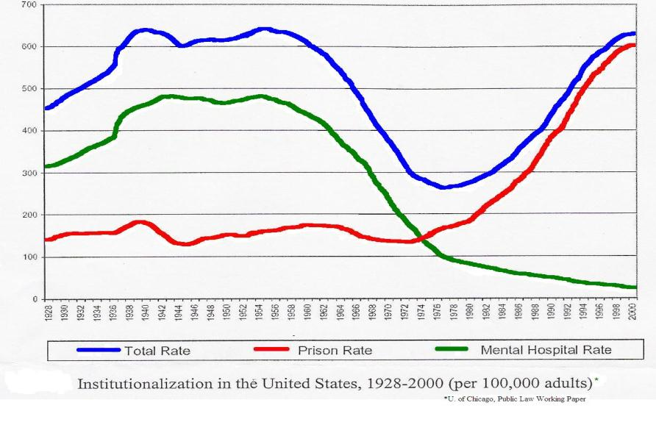

Slide 4
Mental Health Bed Loss In The Last 15-20 Years
Charter Hospital – 36
Culpeper Pine – 19
Western State – 100
Charter Westbrook – 60
UVA-Rucker 3 – 20
Total Loss = -235 Beds

Slide 5


Jail

Slide 6
REGIONAL JAIL | RATED CAPACITY | CURRENT COUNT | OPERATING AT
Central Virginia | 242 | 400 | 165%
Albemarle Charlottesville | 329 | 530 | 161%

Slide 7
Estimated Number of Inmates with Mental Illness in Our Local Prison Systems
Regional Jail | Current Count | Number of Inmates with Mental Illness(17-18%)
Central Virginia | 400
Albemarle-Charlottesville | 530
68 - 72
90 - 95

Slide 8
Costs of Jails and Prison
Virginia Taxpayers Dollars
Prison -- State
$23,000 per year per inmate
projecting the building of four new prisons by 2013 at $100 million each
Jail -- Local
$67.00 per day –ACRJ
Operating at 161% capacity
$47.00 per day –CVRJ
Operating at 165% capacity

Slide 9
The Need for CIT
There are 400 to 500 offenders with mental illness in Charlottesville/Albemarle area
3,200 to 3,500 people in Virginia jails on any given day have a mental illness -(Virginia Department of Correction)
Inmates with mental illness regularly experience recidivism rates above 70 percent -(National Institute of Corrections)
Incarceration of offenders with mental illness often exacerbates the problem for two reasons
1.) Predatory inmates mistreat and take advantage of inmates with mental illness.
2.) As with anyone who is taken advantage of, the experience is likely to cause a person with mental illness to increase symptoms, usually leading to an extended period of incarceration and added criminal charges. -Consensus Project Report
1/3 of our regional state psychiatric hospital’s (Western State Hospital) released forensic admissions are rearrested.

Slide 10
US Military Veterans
Veterans account for 21-25 % of all suicides in the US
VHA Undersecretary for Health Information Letter, December 11, 2009 and CDC National Violent DeatA Reporting System
Overall suicide rate for soldiers in 2006 was 17.3 per 100,000 soldiers
-US. Army
Overall suicide rate for citizens of US in 2005 was 11.05 per 100,000 citizens
-CDC

Slide 11
Post-Traumatic Stress Disorder (PTSD)
Symptoms include reliving the event, avoiding situations related to the event, feeling number, hyperarousal, feelings of shame and despair, depression, rage, physical symptoms
The rate of diagnosable
PTSD among returning
war Veterans
1 in 5
20%
=
New York Times, Department of Veterans Affairs

Slide 12
Region 10 CSB
Covering Charlottesville, Albemarle, Green, Nelson, Louisa, and Fluvanna
Trends in the Department of Emergency Services

Slide 13
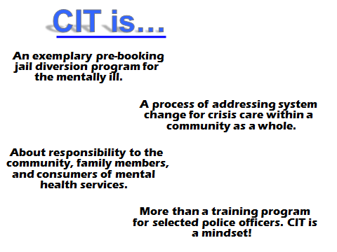

Slide 14
Sequential Intercept Model: Virginia

Slide 15
Sequential Intercepts
Best Clinical Practices: The Ultimate Intercept
I. Law Enforcement/Emergency Services
II. Post-Arrest:
Initial Detention/Initial Hearings
III. Post-Initial Hearings:
Jail/Prison, Courts, Forensic Evaluations & Forensic Commitments
IV. Re-Entry From Jails,
State Prisons, &
Forensic Hospitalization
Munetz & Griffin:
Psychiatric Services 57: 544–549, 2006
V. Community
Corrections &
Community
Support

Slide 16
Intercept 1
Law enforcement / Emergency services
Pre-booking Jail Diversion
Dispatch
911
COMMUNITY
Arrest
Local Law Enforcement
Notes:
Trainer Note:
This slide returns to the Sequential Intercept Model
Direct people to the handout
Be prepared to briefly describe each of these interventions
It is not necessary to describe all of these programs in detail; direct participants to handouts for more detailed information
Trainers will have information about each community prior to the training; this can help to determine which areas need more or less discussion
Emphasize the importance of cross-system collaboration
Emphasize the need for triage (drop-off) centers
MENTAL HEALTH DIVERSION OPTIONS: PRE-BOOKING
Psychiatric Emergencies
When a person experiences a mental health crisis or emergency in the community, the nature of he person’s behavior may warrant police involvement
Historically, police will either arrest the person due to the behavior or transport to a hospital emergency room
Police are usually required to stay with the person until a treatment disposition is made
Often the person is not eligible for hospital admission and no other options are available
Mobile Crisis Teams
Some communities utilize mobile crisis units
These programs deliver a team of mental health professionals to the person in the crisis situation or at specified satellite locations in the community
These services are often limited in the capacity to manage persons who are violent or intoxicated
Crisis Intervention Teams (CIT)
A police-based approach developed in Memphis, TN
Police officers are trained to intervene in a mental health crisis
With the ability to better recognize and respond to mental health issues, law enforcement officers can avoid arresting people with mental illness, and thereby they can be diverted from involvement in the criminal justice system
Dispatchers are also trained in many of these communities
In some communities, mental health advocacy programs train consumers to recognize a CIT pin or medallion, so that they can be reassured that the officer has received the necessary training to be helpful to them
(Steadman et al., 2000)
Specialized Crisis Response Site
A key aspect of crisis intervention is the availability of crisis triage centers or crisis stabilization units
These are central drop-off sites, available 24 hours a day
Co-location with substance abuse services at drop-off site can relieve officers of determining if the crisis is due to mental illness or substance abuse
A no refusal policy allows police officers to drop off persons in crisis and return to regular patrol duties
A no refusal policy means that regardless of the mental health criteria for involuntary treatment, the service uniformly accepts police referrals
(Steadman et al., 2001)
Community Service Officers
Developed in Birmingham (AL)
Community service officers assist police officers in mental health emergencies
Provide crisis intervention and some follow-up
Officers are civilian police employees with professional training in social work and related fields
Week days, coverage is 8:00 am to 10:00 pm;
Twenty-four hour coverage, weekends, holidays – a rotating schedule
(Steadman et al., 2000; Reuland, 2004)
System-wide Mental Assessment Response Team (SMART)
Developed in Los Angeles, California
Combined police/mental health provider secondary co-response
Provides a mental health evaluation unit and 24 hour hotline available to officers
(Reuland and Cheney, 2005)

Slide 17

VISION
Safety for the Officer,
Safety for the Community
Safety for the Person in Crisis

Slide 18

MISSION
CIT is designed to educate and prepare law enforcement officers who come into contact with people in crisis, to recognize the signs and symptoms of mental illness and to respond effectively and appropriately to the individual.

Slide 19

Notes:
Cindy – 1 minute

Slide 20
OBJECTIVES & OUTCOMES
Objective: Reduce officer injuries due to mental health crisis calls.
Outcome: Over four years (2008-2011) there were over 5,000 mental health crisis calls with NOT a single documented officer injury (Charlottesville, Albemarle, UVA).

Slide 21

OBJECTIVES & OUTCOMES
Objective: Reduce time that officers spend on mental health related calls.
Outcome: Reduced officer ECO / TDO time from an average of 4 to 6 hours per call to an average of 52 minutes (from time of dispatch to the time of releasing custody of patient at UVA hospital ER with Custody Exchange MOA with UVA Police Department).

Slide 22
OBJECTIVES & OUTCOMES
Objective: Based on the Virginia CIT Model, train a minimum of 25% of patrol officers within each law enforcement department to be trained in CIT.
Outcomes: Over 70% of all police officers (Charlottesville, Albemarle, UVA) instructed in 40-Hour Virginia Department of Criminal Justice Services (DCJS) accredited trainings.

Slide 23
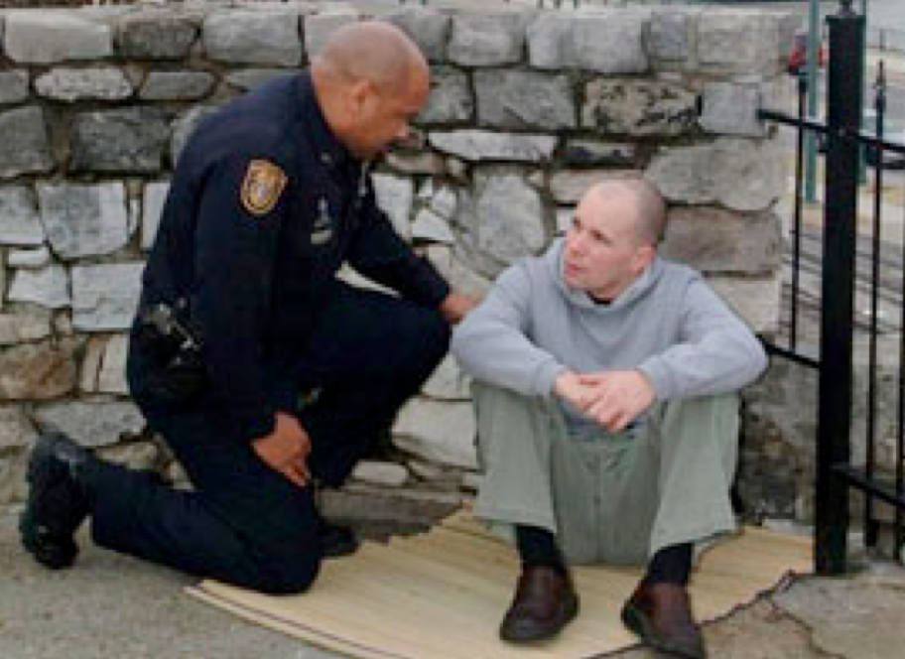
OUTCOMES (Continued)
Over 30% of county sheriff deputies within 8 of the 9 rural counties trained in the Thomas Jefferson Area CIT region.
100% of Emergency Dispatchers instructed within 8 of the 9 localities in the TJA-CIT area in 4-Hour CIT Training (currently increased to 8 hour trainings).
Trained over 600 officers within TJA-CIT area and throughout Virginia.

Slide 24

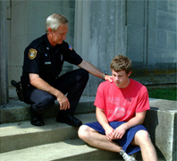
OBJECTIVES & OUTCOMES
Keep many individuals with mental illness out of the criminal justice system (when safe and appropriate).

Slide 25
Crisis Intervention System
25
Notes:
25

Slide 26
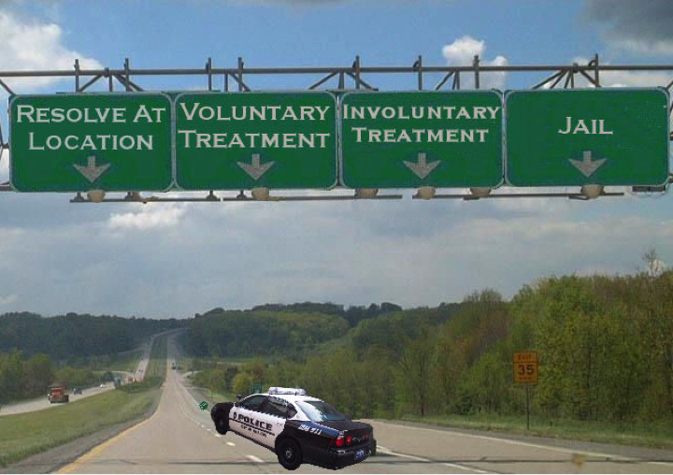
Four Outcomes for Officers Responding to Mental Health Crisis Calls

Slide 27
OBJECTIVES & OUTCOMES
4 Years of 911 Mental Health Crisis Calls
Notes:
(CHART: (from Charlottesville, Albemarle, UVA 911 ECC Center) documents that most Mental Health Crisis calls are either “resolved on location” or “voluntary transported to treatment” by police officers. There is also a steady, consistent decline in the number of mental health calls that end with an arrest. The emphasis of CIT program and training is to provide as many resources and options for the responding CIT officers.

Slide 28


OBJECTIVES & OUTCOMES
Objective: CIT Taskforce is to design and implement written protocols that govern the agencies’ interactions in working with people experiencing acute episodes of mental illness in situations in which law enforcement has intervened.

Slide 29

OBJECTIVES & OUTCOMES
Created Memorandum of Agreement (MOA)
Contracted with UVA Police Department establishing a Regional CIT Custody Exchange Program to enhance the handling of ECO patients at the University of Virginia Emergency Department (UVA ED) for evaluation. Five localities signed the TJA-CIT MOA for FY2013.

Slide 30
OBJECTIVES & OUTCOMES
Developed Standard Operating Procedures (SOP)
With Law Enforcement Departments for improved communications between Officers, Emergency Dispatchers, local Hospitals and Region Ten CSB with responding and transporting to ECO/TDO Crisis Calls.

Slide 31

OBJECTIVES & OUTCOMES
Initiated Monthly CIT Review Team Meetings
Where representatives from local law enforcement agencies (Police, Jail, 911, Probation) meet with community agencies (Hospitals, Mental Health Agencies, Wounded Warrior Program) to proactively review critical mental health cases and develop support and accountability plans to reduce incarceration and recidivism.

Slide 32
CIT Monthly Team Partner Identification
Law Enforcement
Officers - Dispatchers(911)
Magistrates - Jail staff
Probation
Mental Heath Agencies
Emergency Services -VA Wounded Warrior
Mental Health Advocates
Peer Consumer Specialist
Hospitals
- Doctors, Nurses, Psych Dept.

Slide 33
Data Entry Templates
Police /Jail
Region Ten Emergency
Services
Hospitals
On Our Own
911- ECC
Data Processing
CIT Coordinator
Data Reporting
Law
Enforcement
Reports
CIT Reports
Back to
Agencies

Slide 34
ECO Stats (2008 to 2011)
Statistic | Average
Time in Custody | 2:56 Hours
Originating Officer Time | 0:52 Minutes
ER Custody | 2:15 Hours
MH Evaluator Delay | 0:53 Minutes
Percent Not TDO | 50%
Percent by CIT Officer | 40%
Percent ER Diversion Room Used | 21%
34
Notes:
34

Slide 35



DIRECT QUOTES ABOUT CIT
CIT is still the most sought after training provided locally ” —Chief Mike Gibson, University of Virginia Police Department
The CIT training was one of the very best training sessions that has been given to me in my 28 years as a police officer” —Chief Tim Longo, Charlottesville Police Department

Slide 36


DIRECT QUOTES ABOUT CIT
“In the law enforcement community the Jail is the biggest benefactor of the CIT Program” —Col. Ronald Matthews Charlottesville- Albemarle Regional Jail
“There is no doubt in my mind that CIT training results in less instances of deadly use of force. I highly recommend that police administrators make this training mandatory for all of their officers” —Col. Steve Sellers, Albemarle County Police Department

Slide 37



DIRECT QUOTES ABOUT CIT
“Mutual respect, collaboration, and planning between law enforcement and Region Ten has never been better. CIT works!” –Buzz Barnet, LCSW, Emergency Services Director Region Ten CSB.
“NAMI applauds CIT and all their efforts to help those in crisis!” — Sally Rinehart, President, NAMI-Blue Ridge Family Alliance.

Slide 38
WHAT CIT IS NOT……
Active Shooter
-Virginia Tech
-Columbine High School
Situations where your personal safety / community safety is endangered
IMPORTANT: Follow your department’s protocols on officer safety

Slide 39
Receiving Facility
Accept All Patients (Regardless of Clinical Status)
15 Minute Officer Turnaround
(Police as Customer)
Appropriate Facility (re: Level of Acuity)
Evaluations 2 to 6 hours (Up to 24 hours)
Medical Examination
Complete Mental Status Examination
Wide-Ranging Disposition Options

Slide 40

Emergency Room Usage for ECOs

Slide 41


